Slide 1
MDraw
Graphics Manipulation Language
Huimin Sun(hs2740)
Dongxiang Yan(dy2224)
Jingyu Shi (js4151)
COMS 4115
Columbia University
August 16, 2013

Slide 2
Introduction
1. A C-like language designed specially for drawing graphics
2. Built-in types: Point, Line, Ellipse, Curve and others
3. Mdraw is easy to learn and to use
Functionality:
1. Basic calculation, basic control flow
2. Drawing graphics using point, line, ellipse, and curve

Slide 3
Tutorial Examples
How to manipulate these built-in types and functions:
Point p1;
p1 = Mpoint( x, y ); /* 2 parameter as the coordinate of the point*/
Line l1;
l1 = Mline(x1, y1, x2, y2); /* the coordinates of the 2 end point*/
Curve c1;
c1 = Mcurve(x, y, w, h, angst, angExt);
/*parameters as location, size, angular extents*/
Ellipse e1;
e1 = Mellipse( x, y, w, h );
e1.draw(); p1.draw(); c1.draw();

Slide 4
Tutorial Examples
void basic(){
if(1<2){
print “This is the start!”;
}
}
void paint(){
Ellipse e1;
int i;
for(i=0; i<20;i=i+1){
e1 = MEllipse(100-5*i, 100+10*i, 100+10*i, 30+5*i);
e1.draw();
}
Ellipse e2;
for (i=0;i<20;i=i+1){
e2 = MEllipse(5+5*i, 290+i*10, 290-10*i,125-5*i);
e2.draw();
}
}
This is a .mdraw file.
In basic() , it covers the basic
Functionalities.
paint() is a drawing function.
This file draws a pottery.

Slide 5
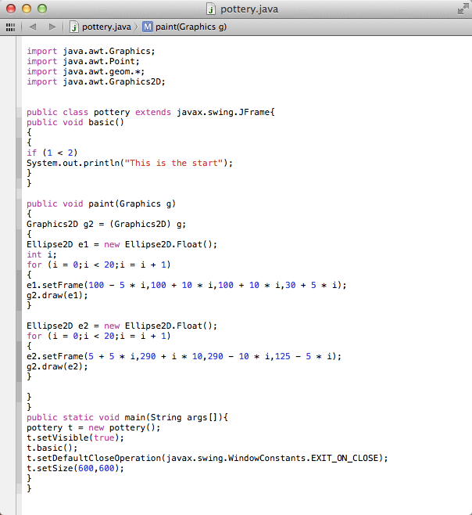
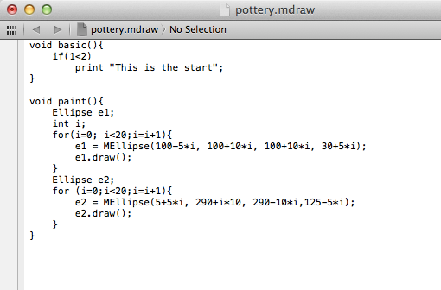
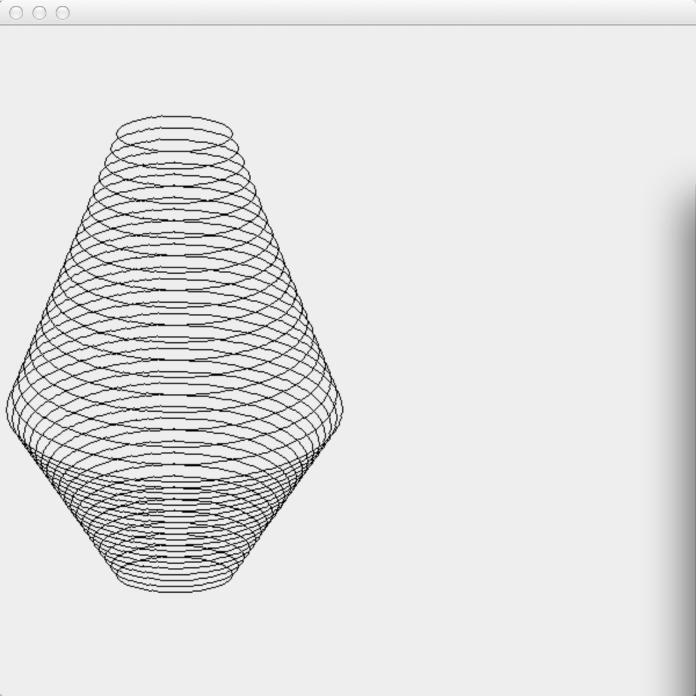

Examples

Slide 6
Implementation
Project Management
Architecture

Slide 7
Project Management
Scrum methodology
  6 weeks
  Milestones
  3 questions

Slide 8
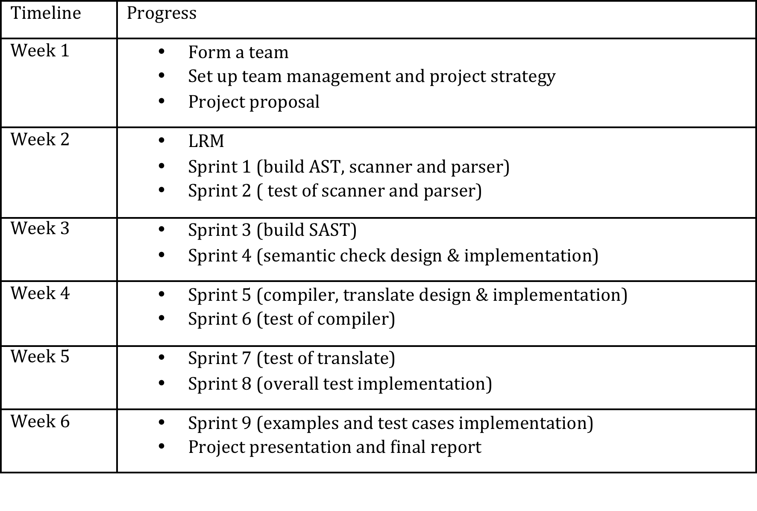
Project Timeline

Slide 9
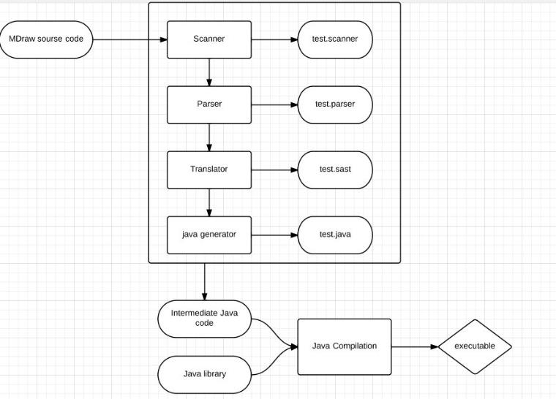
Architecture

Slide 10
Architecture
Scanner
  The scanner is used to tokenize the input source code by using lexical analysis.
  Comments, whitespace and other unnecessary tokens will be waived.
  If any, Illegal characters will fail the program.
  Ocamllex

Slide 11
Architecture
Parser
  From the stream of tokens output from the scanner, the parser generates the AST (abstract syntax tree).
  Ocamlyacc
Translate
  The translate is designed to do semantic checking
  The semantic check evaluates the type of a statement.
  Exceptions will be thrown.

Slide 12
Architecture
Java Generator
  Compile.ml
  Translate a program in AST form into a java program. Throw an exception if something is wrong, e.g., a reference to an unknown variable or function

Slide 13
Test
Scanner
Ast

Slide 14
Test
void basic(){
print (2+3);
}

Slide 15
Scanner
VOID
ID: basic
LEFT_PAREN
RIGHT_PAREN
LEFT_BRACE
PRINT
LEFT_PAREN
INTLITERAL: 2
PLUS
INTLITERAL: 3
RIGHT_PAREN
SEMICOLON
RIGHT_BRACE

Slide 16
AST
PROGRAM:[LIST:[CONSTRUCT_FUNCDEF:[FUNCDECL:[FUNTYPE[TYPE_VOID],FUNNAME[basic],LIST:[],LIST:[STMT_BLOCK:[LIST:[STMT_PRINT:[EXPR_BINOP:[EXPR_LITERAL:[LITERAL_INT:[2]],ADD,EXPR_LITERAL:[LITERAL_INT:[3]]]]]]]]]]]

Slide 17
Test
Print
If
For
While
Arithmetic
Gcd
Fib
Point
Line
Curve
Ellipse

Slide 18
While Test
void basic(){
int i;
i=10;
while(i>0){print i; i=i-1;}
}
Result:
10
9
8
7
6
5
4
3
2
1

Slide 19
Gcd Test
int gcd(int a, int b) {
while (a != b) {
if (a > b) a = a - b;
else b = b - a;
}
return a;
}
void basic()
{
print(gcd(2,14));
print(gcd(3,15));
print(gcd(99,121));
}
Result:
2
3
11

