Slide 1
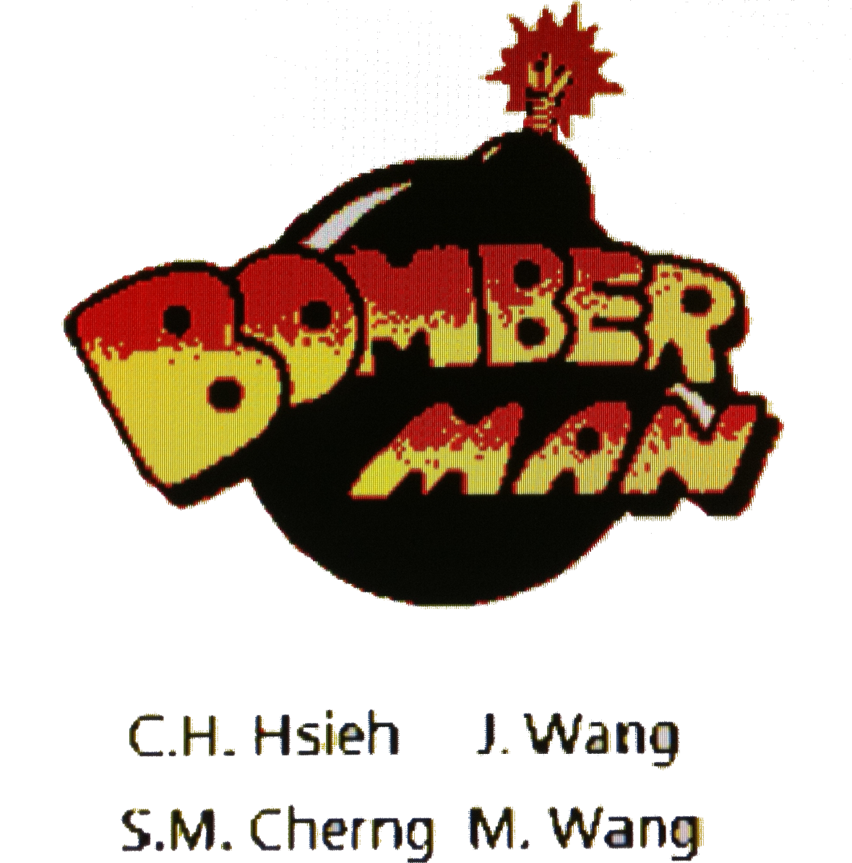

Slide 2
Overview
Graphics
Initial frame of game and 3D-like sprite development.
Audio
Try to generate some sound effect like bomb and utilize lab3 to play some simple song
Network
Allow four players to play synchronously. Solve the network problem

Slide 3
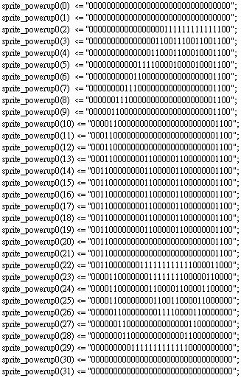
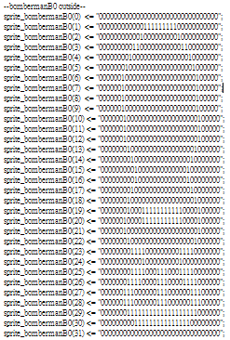
Graphic-development
We generate out graphics in an array representing 32x32 pixels.

Slide 4
Graphic-Difficulties
We use MatLab to analyze the pictures we get from Web site, and change it into the desired size we want, and divide the color into the several number we define(i.e. 5).The MatLab will form the sprite. However, the result we get is not so perfect; thus, we need to modify it by hand.
We use 200x200 to form the logo, it will cause us to compile about 2 hours. The time of compile will increase the difficulty of debugging.

Slide 5
Graphic-What we learned
We learn how to “draw” the pictures in pixel.
We learn how to write data into memory, and FPGA performs the different direction in the screen.
We learn how to use “control array” to set up the tile into map.

Slide 6
Audio Part
Explosion Sound
  Down sampling
  Read wave file to 16-bit samples
  Make a table in VHDL module
Music
  Make a table for a sine wave
  Input frequency
  Each note lasts 1 second

Slide 7
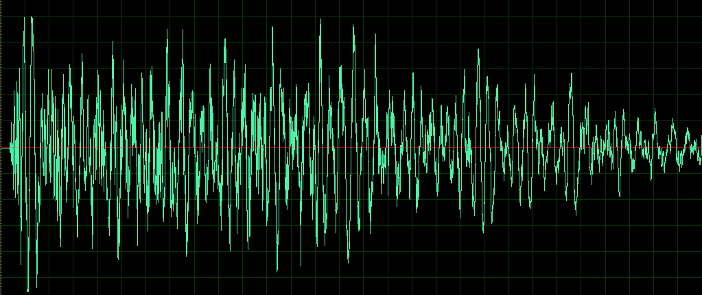
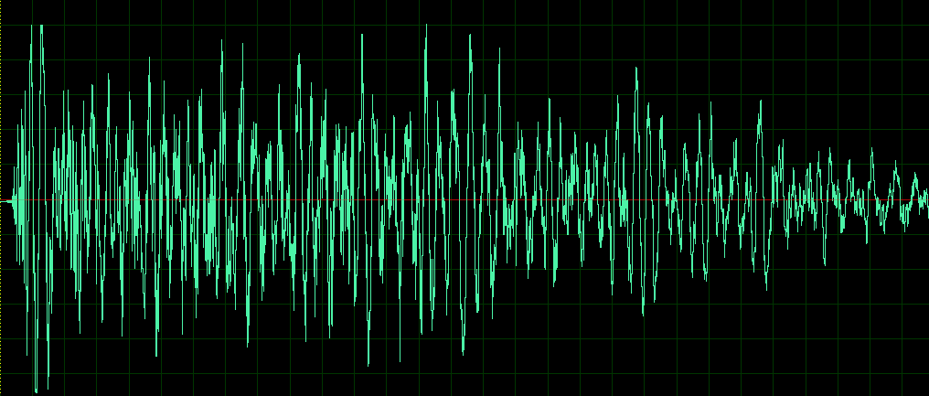
Audio Part

Slide 8
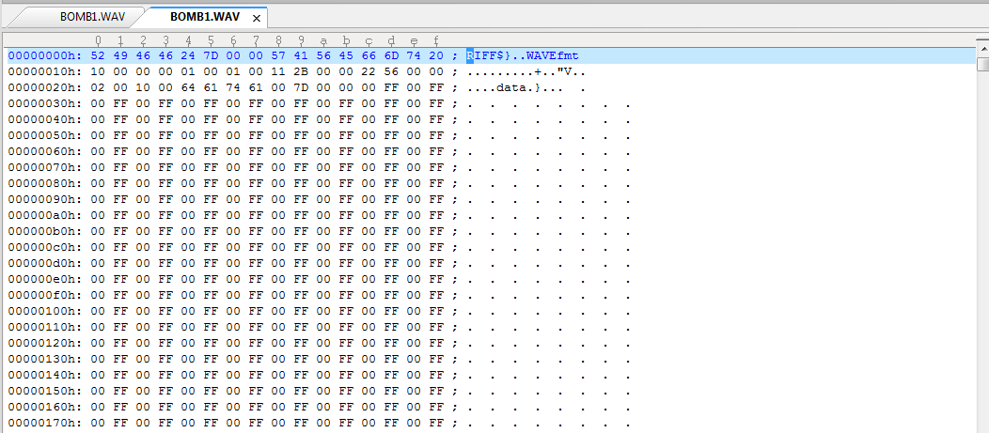
Audio Part

Slide 9
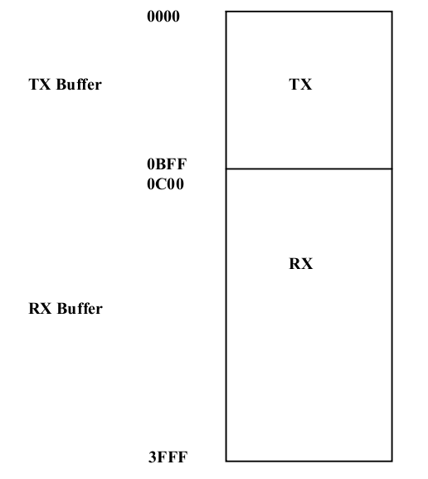
Packet TX/RX Mechanism
DM9000A initialization
  DM9000_init(unsigned char *mac_address)
Transmit Packets
  Packet Transmitting Buffer
  Transmission
  Clear Network Status Register
  TransmitPacket(unsigned char *data_ptr, unsigned int tx_len)
Receive Packets & ISR registration
  alt_irq_register(DM9000A_IRQ, NULL, (void*)ethernet_interrupt_handler)
  ReceivePacket(unsigned char *data_ptr, unsigned int *rx_len)
  Packet Receiving Buffer

Slide 10
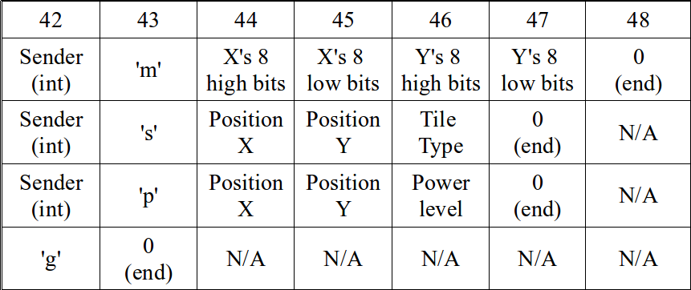
Packet Format Details
Before transmission → update checksum, packet_ID, UDP_packet_length
'g': game step increment; 'm': movement coordinates; 's': new tile allocation; 'p': new bomb placement; int: which player

Slide 11
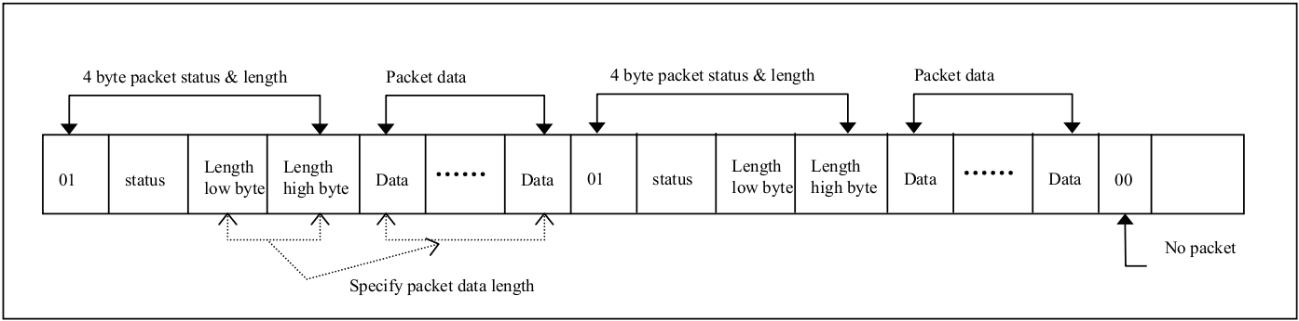
Synchronization Issues
2 players in-sync
  Interrupt handler handles 1 packet each time and disable interrupts
  Packet Transmission disable interrupts
  Too fast → delay and accumulate: 10ms delay in between transmissions
  Trade-off: game smoothness
4 players in-sync
  3 players send simultaneously → Still problematic: Scheduler
  Annoying: DHCP packet intervention

