Slide 1
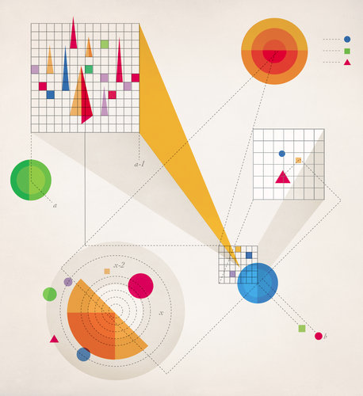
The Age of Big Data

Slide 2
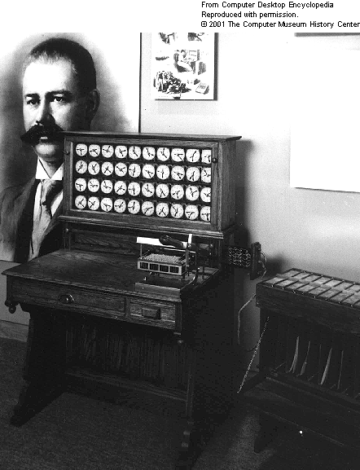
Data Scientist circa 1890

Slide 3
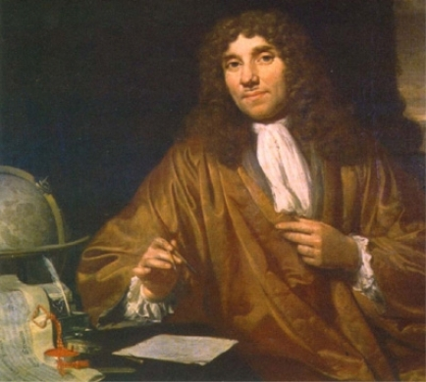
A Measurement Revolution

Slide 4
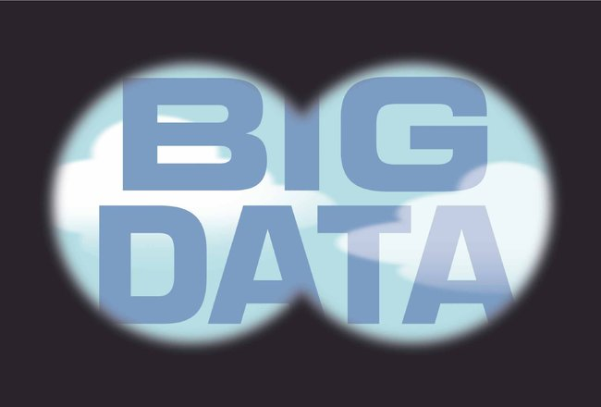
Way Beyond Orwellian

Slide 5
The Measurement Paradox
“You can’t manage what you can’t measure.” – Deming/Drucker
“Not everything that can be counted counts, and not everything that counts can be counted.” – Einstein/Cameron

Slide 6
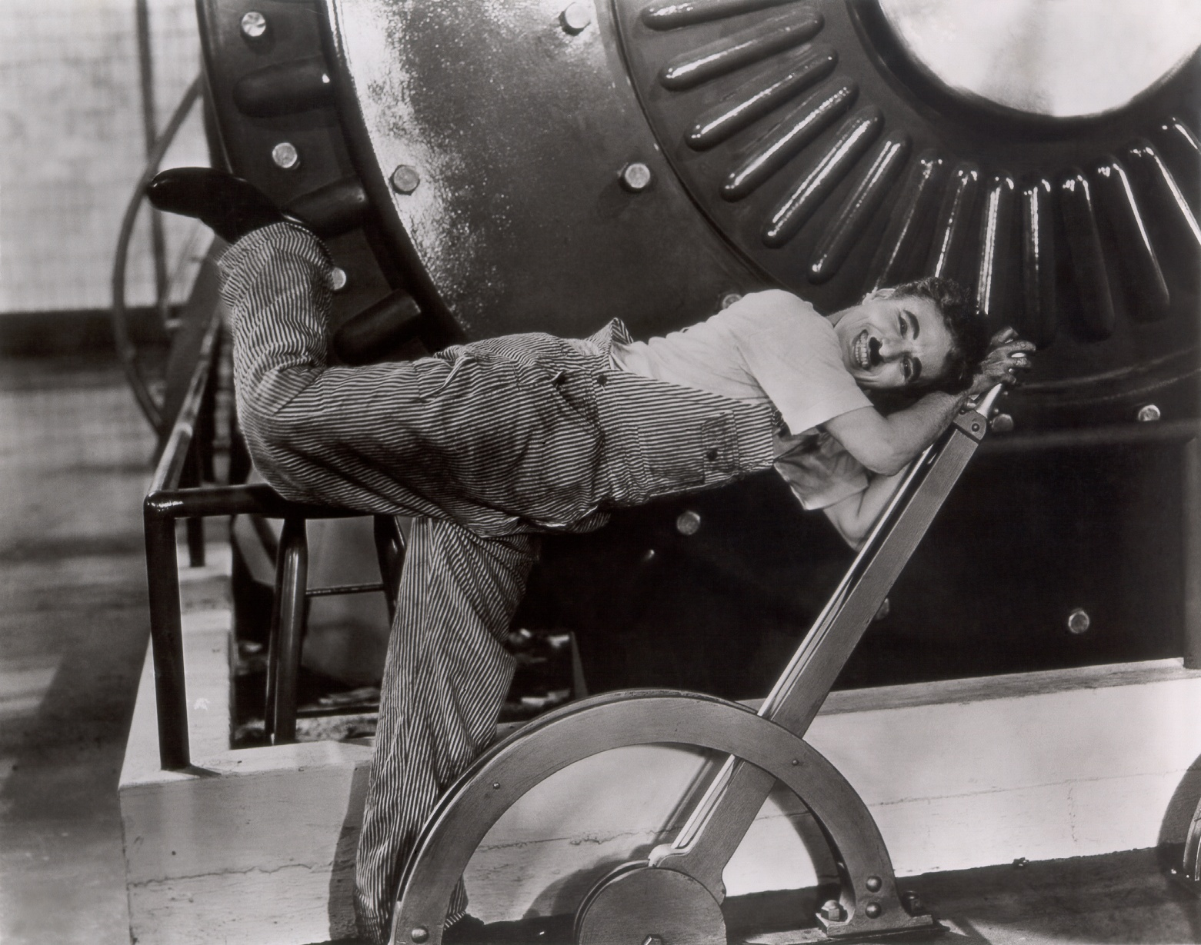
Scientific Management

Slide 7
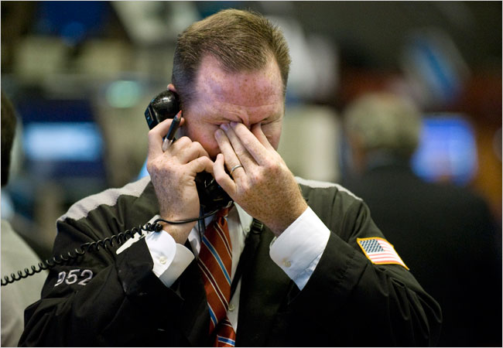
Models Behaving Badly

Slide 8
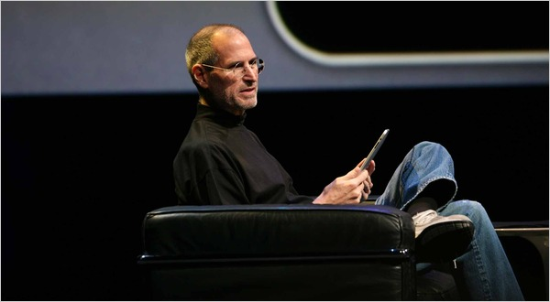
In Praise of Intuition

