Slide 1
Optimizing Continuity in Multiscale Imagery
Charles Han | Hugues Hoppe
Columbia University | Microsoft Research
18 December 2010

Slide 2
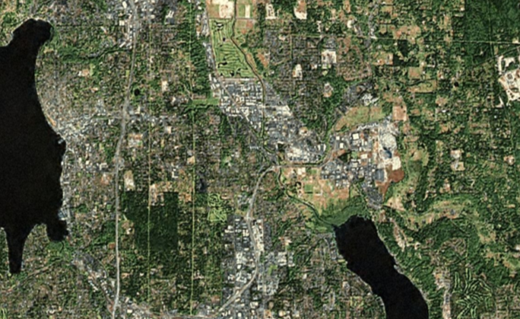
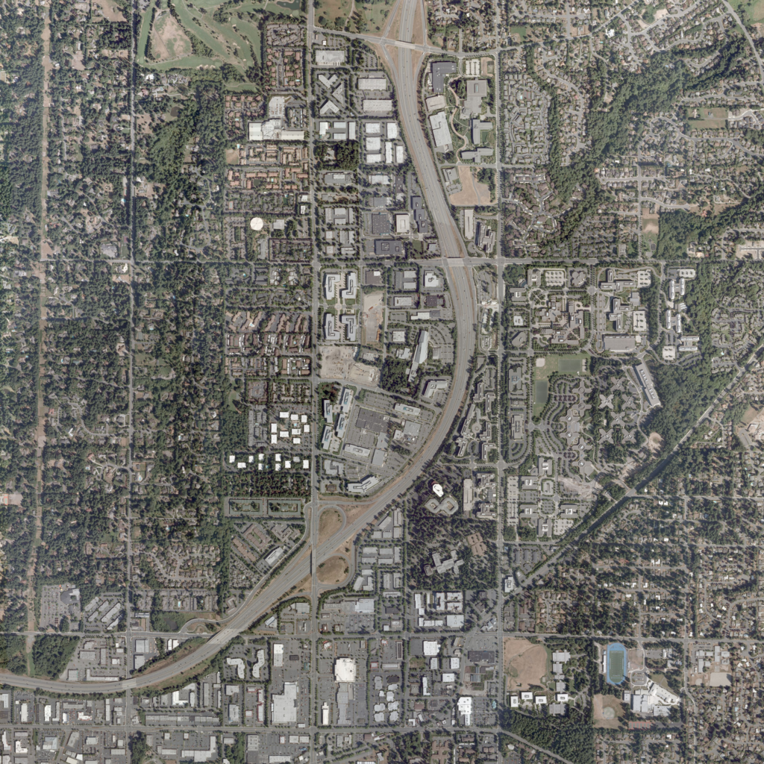
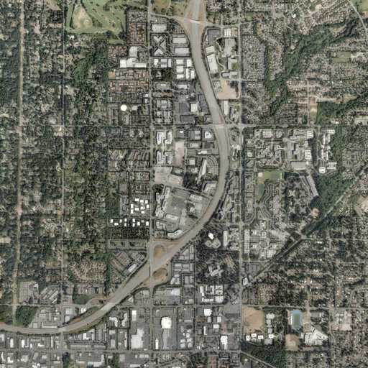
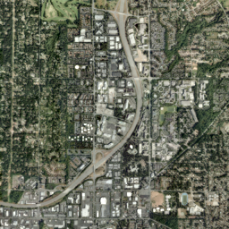
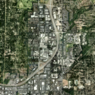
Multiscale imagery
Coarse-scale
Intermediate
Fine-scale

Slide 3
How to fill in the pyramid?
Coarse-scale
Fine-scale

Slide 4
How to fill in the pyramid?
discontinuity

Slide 5
Discontinuities across scales

Slide 6
How to fill in the pyramid?

Slide 7
How to fill in the pyramid?
discontinuity

Slide 8
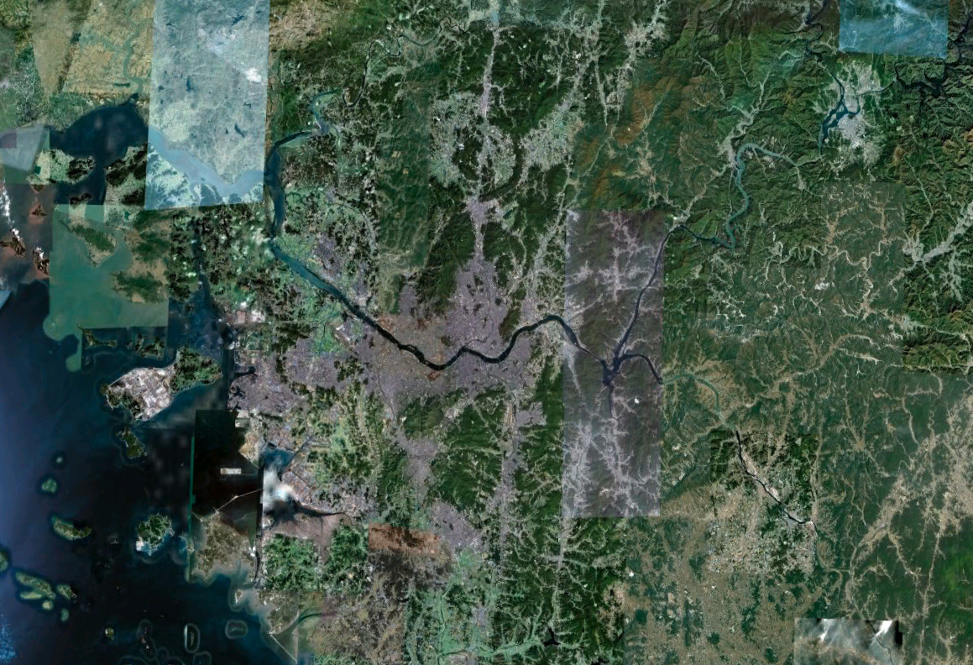
Patchwork appearance

Slide 9
How to fill in the pyramid?
smooth transitions
preserve original
imagery

Slide 10
Our result

Slide 11
Problem overview
smooth transitions
preserve original
imagery

Slide 12
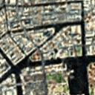
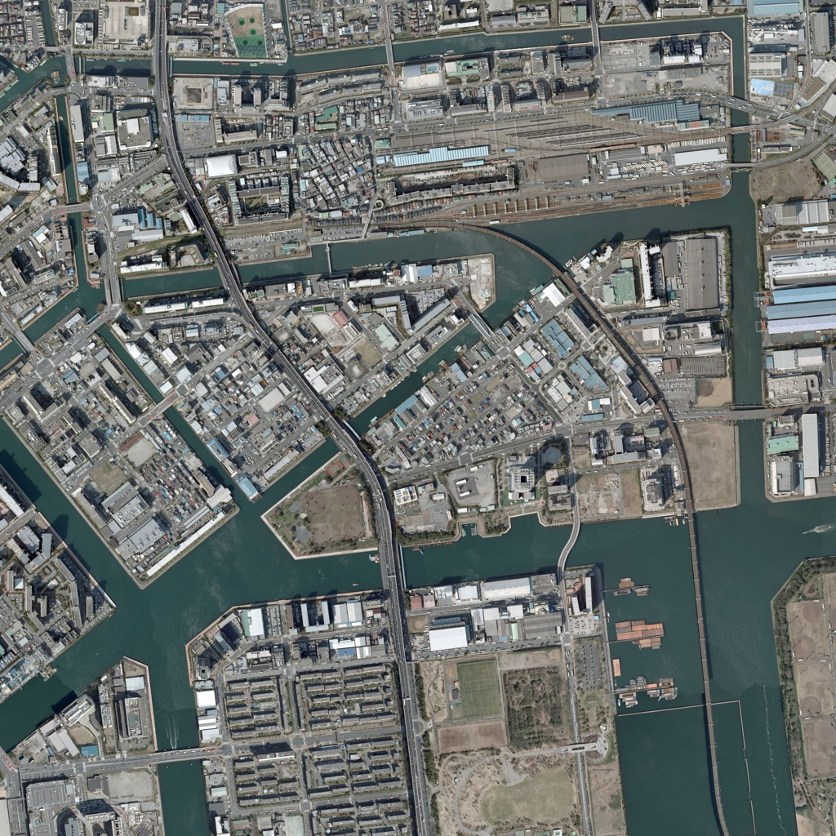
Problem overview
Input
“constraints”
preserve original
imagery

Slide 13
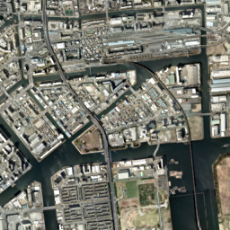
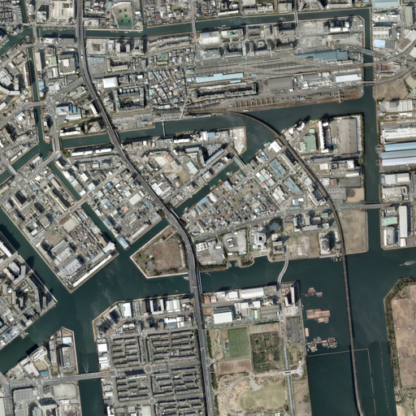
Problem overview
Output
“objective”
smooth transitions
…

Slide 14
Sounds a lot like optimization…
“objective”
“constraints”
smooth transitions
preserve original
imagery

Slide 15
Sounds a lot like optimization…
“objective”
“constraints”
Structural similarity measure (SSIM)
[Wang et al. 04], [Pang et al. 08]
Models visual similarities
Expensive to solve directly

Slide 16
Approach overview
Output
Downsample
Input
Structure transfer
Clipped Laplacian blending
Downsample
…

Slide 17
Approach overview
Output
Downsample
Input
Structure transfer
Clipped Laplacian blending
Downsample
…

Slide 18
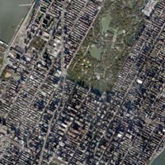
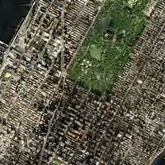
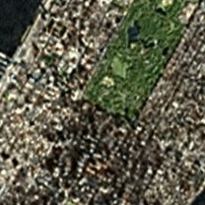
Structure transfer
Structure image
Solution
Color image

Slide 19
Structure transfer
count
z-score
-2
-1
0
color
1
2
μ_{S}
σ_{S}
Structure image

Slide 20
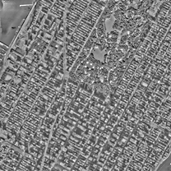
Structure transfer
z-scores
z-score
-2
-1
0
1
2
Structure image

Slide 21
Structure transfer
z-scores
Structure image
Solution
Color image

Slide 22
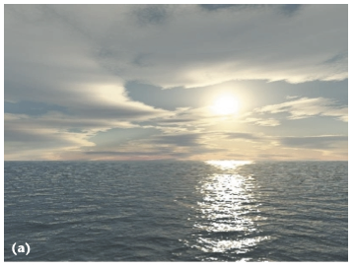
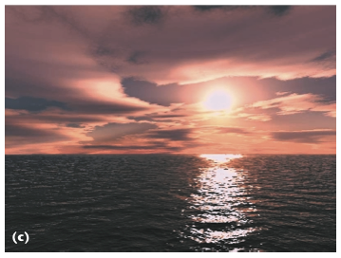
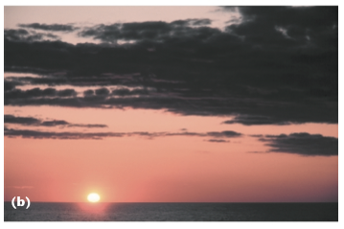
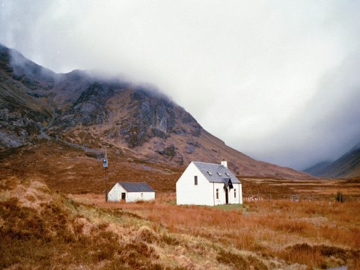
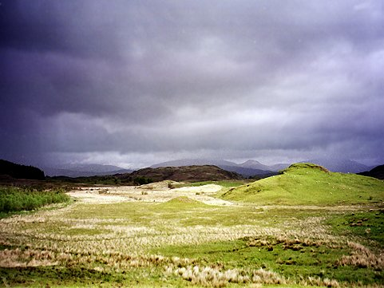
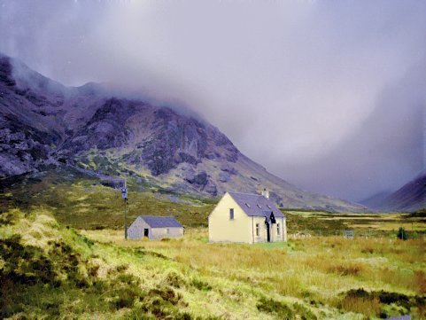
Histogram transfer
[Reinhard et al. 01]
[Pitié et al. 07]

Slide 23
Our approach
Assumes spatial registration
Efficient (Gaussian) model
Locally defined operation

Slide 24
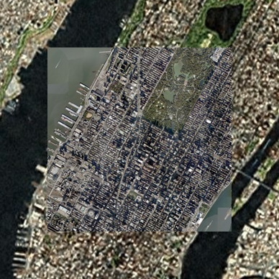
Local approach preserves appearance
Original data
(Global) Histogram transfer
(Local) Structure transfer

Slide 25
Approach overview
Output
Downsample
Input
Structure transfer
Clipped Laplacian blending
Downsample
…

Slide 26
Approach overview
Output
Downsample
Input
Structure transfer
Clipped Laplacian blending
Downsample
…

Slide 27
Goal: blending between levels
?
?
Input
(coarse)
Input
(fine)
Output

Slide 28
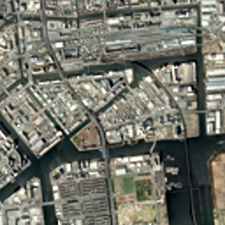
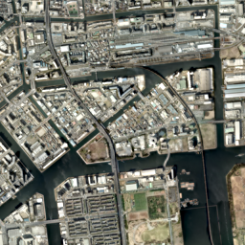
Linear interpolation causes blurring
linear interpolation
clipped Laplacian blending
(our result)

Slide 29
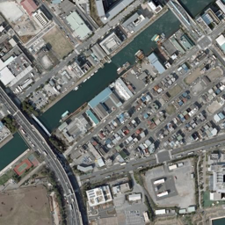
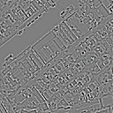
Laplacian pyramids
[Burt and Adelson 83]

Slide 30
Laplacian pyramids
?
?
?
?

Slide 31
Linear interpolation

Slide 32
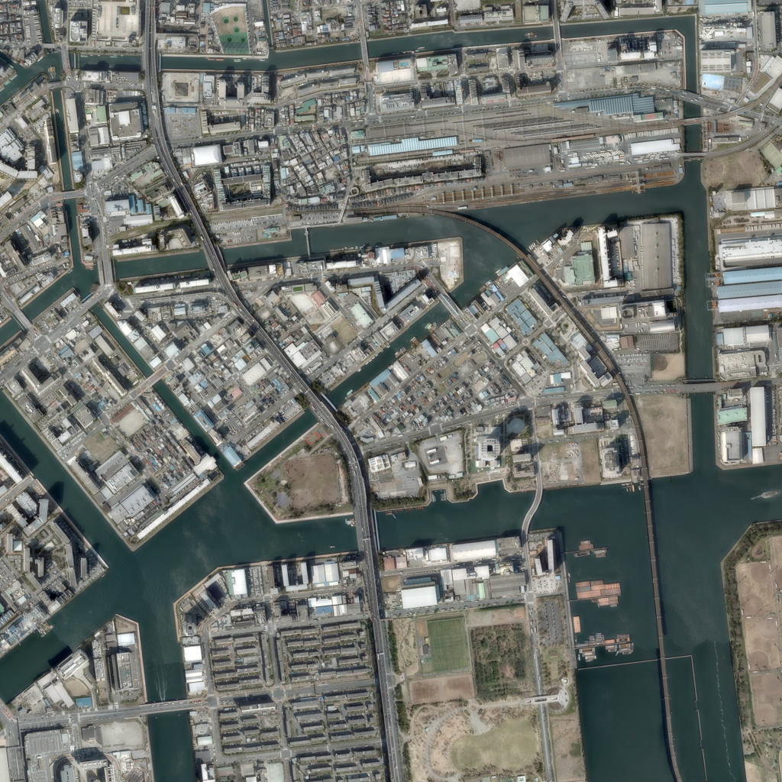
Linear interpolation
Blending fades out details

Slide 33
Clipped Laplacian blending
Copy details from fine image

Slide 34
Optimized algorithm
$$d_{c}=x_{c}−𝒢_{c}$$
$$x_{c}$$
–
$$𝒢^{′}$$
$$𝒢_{c}$$
+
$$x_{c}$$
$$x_{c+1}$$
+
+
$$x_{f−1}$$
$$x_{f}=𝒢_{f}$$
+
No Laplacian pyramids
Efficient memory access
(see paper)

Slide 35
Approach overview
Output
Downsample
Input
Structure transfer
Clipped Laplacian blending
Downsample
…

Slide 36
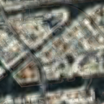
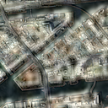
Comparison of intermediate level
Blurring
Linear interpolation
Structure transfer + linear interp.
Ghosting
Good
CLB only
Structure transfer + CLB

Slide 42
3D perspective view
Original
Our result

Slide 45
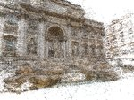
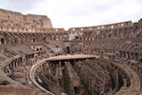
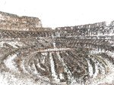
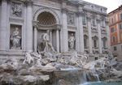
Future directions
Other multiscale imagery
[Kopf et al. 07]
[Agarwal et al. 09]

Slide 46
Future directions
Other multiscale imagery
Structure transfer for image pairs

Slide 47
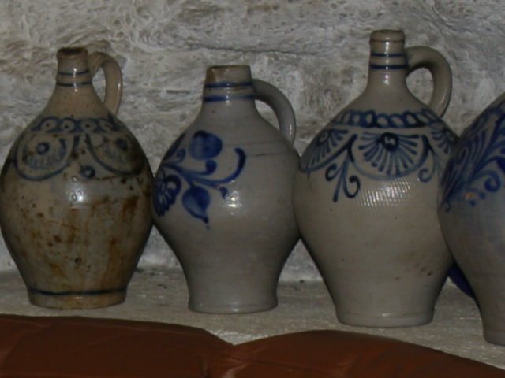
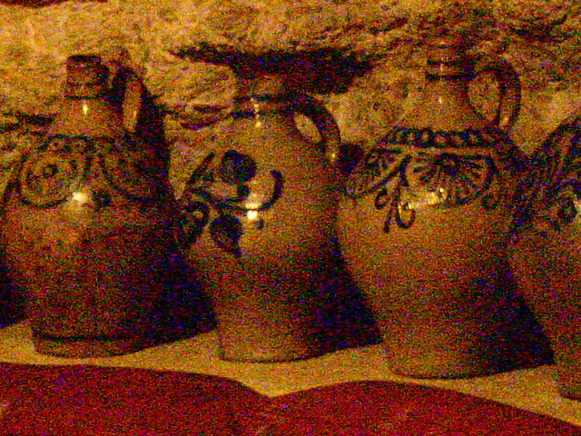
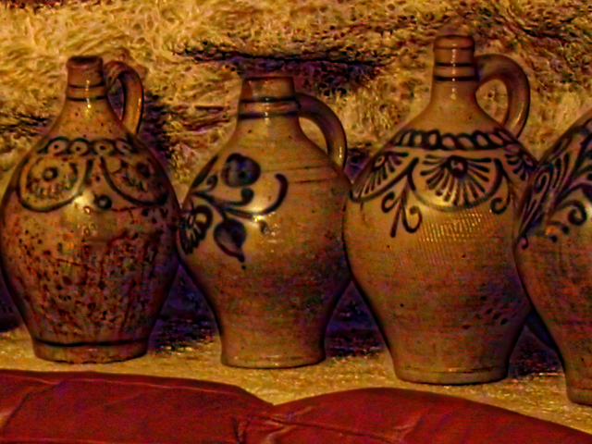
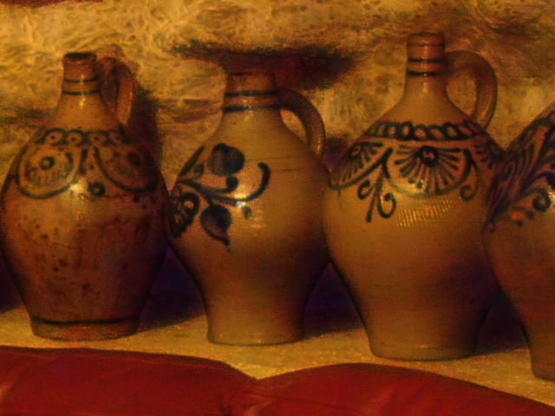
Structure transfer for image pairs
Flash
No flash
Structure transfer
[Petschnigg et al. 04]

Slide 48
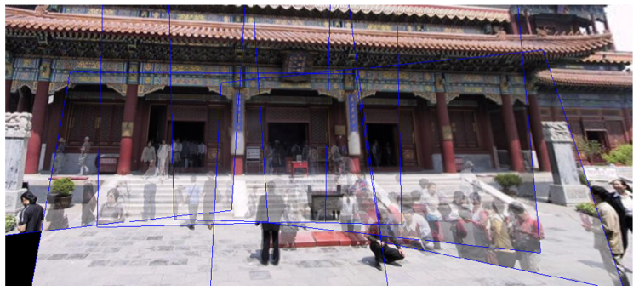
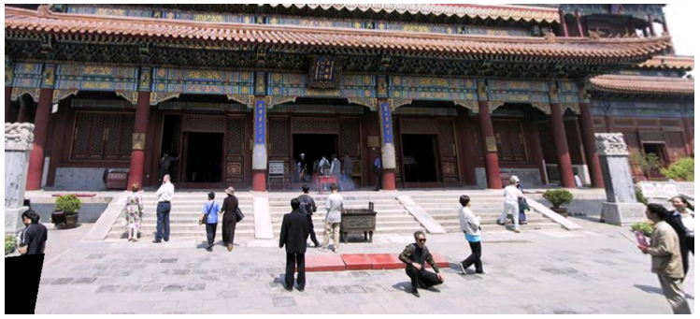
Future directions
Other multiscale imagery
Structure transfer for image pairs
Fine-scale warping/stitching

Slide 49
Thank you!
http://www.cs.columbia.edu/cg/continuity
Image data courtesy of:
Bing Maps
Google Maps
Google Earth
The authors would like to thank:
Matt Uyttendaele
Michael Kazhdan
Eric Stolnitz
Duncan Lawler
Nikolai Faaland
Eitan Grinspun
Ravi Ramamoorthi

