Slide 1
The Time-of-Flight Revolution
Mohit Gupta
Computer Science
Columbia University
Support: NSF

Slide 2
Time-of-Flight
$$d$$
object
$$t$$
A
B
clock
$$d=v×t$$
distance
velocity
flight time

Slide 3
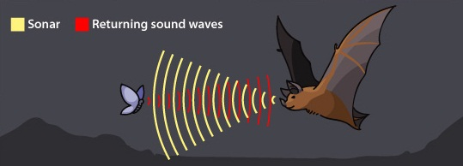
Time-of-Flight in Nature
Echolocation Using Sound-Wave Time-of-Flight
Image from http://askabiologist.asu.edu/echolocation

Slide 4
Galileo’s Experiment With Light (1638)
1000 meters
Galileo’s conclusion: “I have not been able to ascertain with certainty whether the appearance of the opposite light was instantaneous or not; but if not instantaneous it is extraordinarily rapid – I should call it momentary”
lantern
lantern
Galileo
Assistant
time = 6.7 microseconds << human perception limit

Slide 5
Fizeau’s Experiment (1849)
mirror
d = 8633 meters
observer
light source
Illustration courtesy Nathan Matsuda

Slide 6
Fizeau’s Experiment (1849)
mirror
d = 8633 meters
observer
light source
time $≅$ 58 microseconds
High Speed Timing Instrument Unavailable
Illustration courtesy Nathan Matsuda
Notes:
720 teeth spinning at 12.6 revolutions per second (rev/s)

Slide 7
Fizeau’s Experiment (1849)
mirror
observer
wheel
light source
Observer View: Pulsed Light
Illustration courtesy Nathan Matsuda
Notes:
720 teeth spinning at 12.6 revolutions per second (rev/s)

Slide 8
Fizeau’s Experiment: Fast Rotation
mirror
d = 8633 meters
observer
wheel
light source
720 teeth
ω=756 rpm
Computed Light Speed $c=3.153×{10}^{8} m/s$
($5\%$ accuracy)
Observer View: Light Blocked
Illustration courtesy Nathan Matsuda
Notes:
720 teeth spinning at 12.6 revolutions per second (rev/s)

Slide 9
Time-of-Flight Based Depth Sensing
emitted
light pulse
source
stop-watch
scene
received
light pulse
sensor
Impulse Time-of-Flight Imaging
$$depth=\frac{c}{2τ}$$
time delay τ
intensity
emitted pulse
received pulse
time
[Koechner, 1968]

Slide 10
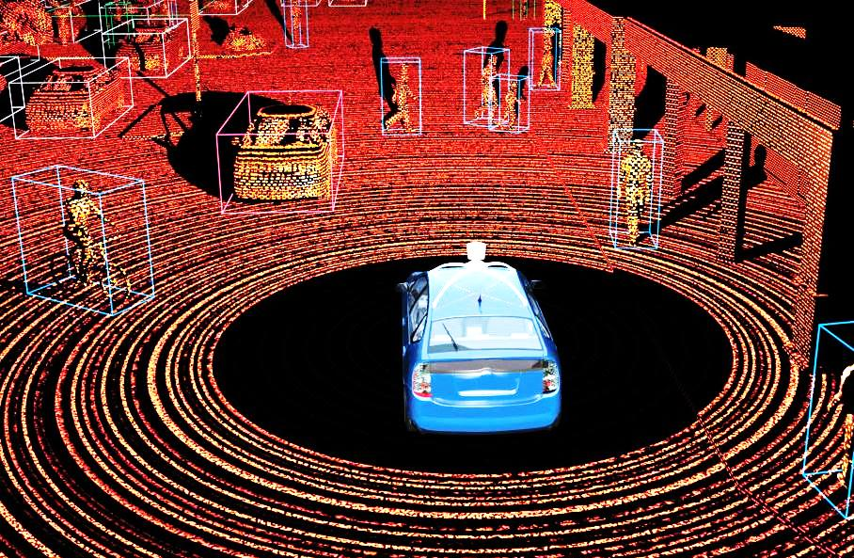
Impulse ToF Imaging: Example
Google self-driving car project

Slide 11
Time-of-Flight: Indirect Light
emitted
light pulse
source
direct path
scene
indirect paths
sensor
scene
received light
direct radiance (depth)
indirect radiance
intensity
time

Slide 12
Impulse ToF (Transient) Imaging: Examples
sensor
sensor
image
opaque wall
diffuse surface
shape
opaque wall
diffuse surface
scene
scene
Imaging around the corner
Kirmani et. al., 2009
3D around the corner
Velten et. al., 2012
diffuse surface
source
source
direct
sample
indirect
scene
BRDF
sensor
time
sensor
diffuse surface
BRDF estimation
Naik et. al., 2011
Light Transport Analysis
Wu et. al., 2012

Slide 13
Impulse ToF Imaging: Requirements
emitted
light pulse
source
stop-watch
scene
received
light pulse
sensor
Expensive Lasers
[Short (picosecond) and Powerful (mega joules) Light Pulse]
High Speed and High Dynamic Range Sensors
[Picosecond Time Resolution]

Slide 14
Continuous Wave ToF Imaging
source
continuous temporally modulated light
scene
sensor
sinusoid
intensity
emitted light
time
[Smith, 1980; Schwarte 1995; Lange, 2000]

Slide 15
Continuous Wave ToF Imaging
source
continuous temporally modulated light
scene
received
light
sensor
phase-shift$∝$travel distance (depth)
intensity
emitted light
received light
time
[Smith, 1980; Schwarte 1995; Lange, 2000]

Slide 16
Measuring Phase-Shift
$$phase φ_{rec}$$
intensity
received light
$$offset O_{rec}$$
$${amplitude A}_{rec}$$
time
Three Unknowns
$$L_{rec}(t)=O_{rec}+A_{rec}\cos\left(ωt−φ_{rec}\right)$$

Slide 17
Measuring Phase-Shift: Direct
Three Impulse Samples
intensity
received light
time
Short Exposure Time (nanoseconds)
Low Signal-to-Noise-Ratio

Slide 18
Measuring Phase-Shift: Correlation
sensor exposure function
$$E(t)$$
intensity
received light
$L_{rec}\left(t\right)$
time
Large Exposure Time (milliseconds)
Correlation: $I= \int{E\left(t\right)×L_{rec}\left(t\right) dt}$
measured
brightness
exposure
function
received
light

Slide 19
Measuring Phase-Shift: Correlation
$$E_{1} (t)$$
$$E_{2} (t)$$
$$E_{3} (t)$$
sensor exposure functions
intensity
received light
$L_{rec}\left(t\right)$
time
Large Exposure Time (milliseconds)
$$depth$$
Correlation 1: $I_{1}= \int{E_{1} \left(t\right)×L_{rec}\left(t\right) dt}$
$$phase φ_{rec}$$
High Signal-to-Noise-Ratio
Real Time Capture
Correlation 2: $I_{2}= \int{E_{2} \left(t\right)×L_{rec}\left(t\right) dt}$
$$offset O_{rec}$$
Correlation 3: $I_{3}= \int{E_{3} \left(t\right)×L_{rec}\left(t\right) dt}$
$${amplitude A}_{rec}$$

Slide 20
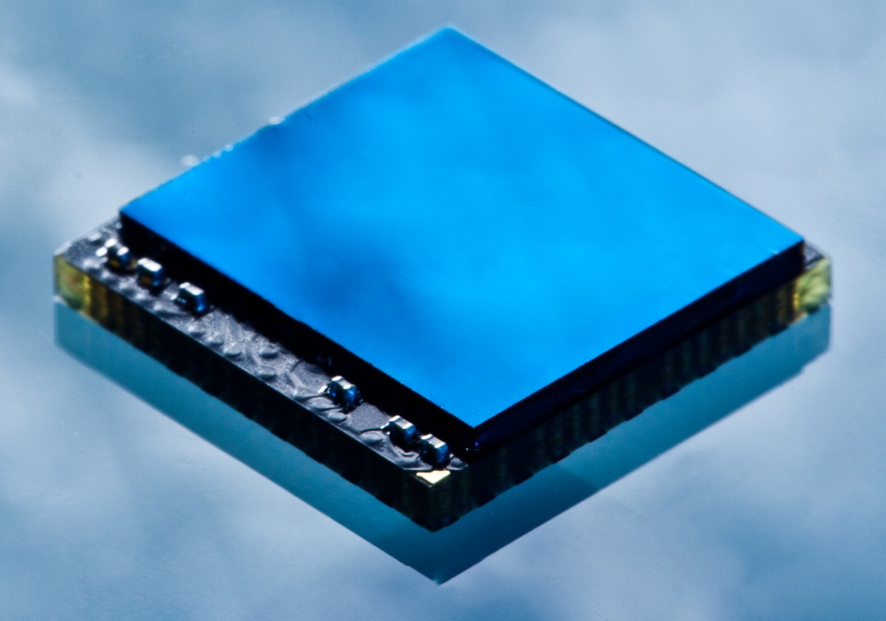
Correlation Sensors
Correlation Sensor Chip
(e.g., Photonic Mixer Device)
Measure Temporal Correlation of Incident Light With Exposure Function
Low Cost, Compact, Real Time
Image from http://en.wikipedia.org/wiki/PMDTechnologies

Slide 21
Comparison of Depth Accuracy
Time-of-Flight
Structured Light
Stereo / SfM
scene
scene
scene
computed shape
computed shape
computed shape
$$error ≅1mm$$
$$error ≅1 cm$$
$$error ≅10 cm$$
Lange
2000
Ren et. al.
2013
Gallup et. al. 2008
10 meters
$$θ$$
$$θ$$
high accuracy reconstruction
errors due to
small baseline
errors due to
lack of texture

Slide 22
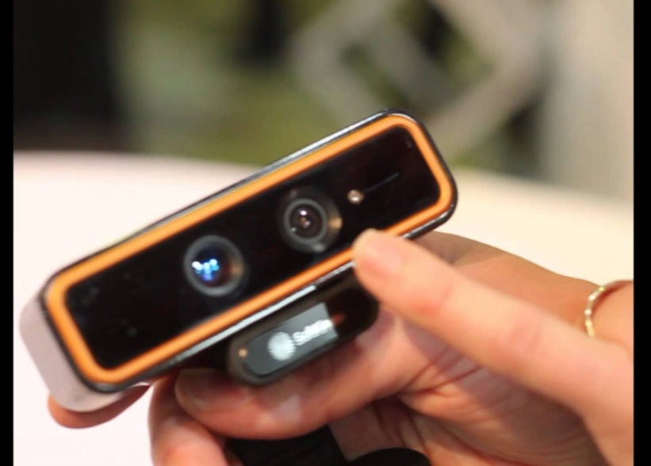
Correlation-Based ToF Devices
Microsoft Kinect for Xbox One
Intel SoftKinectic
5 million sold in the last 6 months
Embedded into consumer devices
Potential to Revolutionize Diverse Application Domains
http://news.xbox.com/2014/04/xbox-one-march-npd
http://www.engadget.com/2013/06/04/intel-announces-creative-depth-vision-camera-at-computex-2013/

Slide 23
Interreflections and ToF Imaging
scene
direct radiance
interreflections
sensor radiance
source
sensor
time

Slide 24
Interreflections and ToF Imaging
scene
direct radiance
total radiance
phase error
sensor radiance
source
sensor
time
Interreflections Produce Incorrect Phase

Slide 25
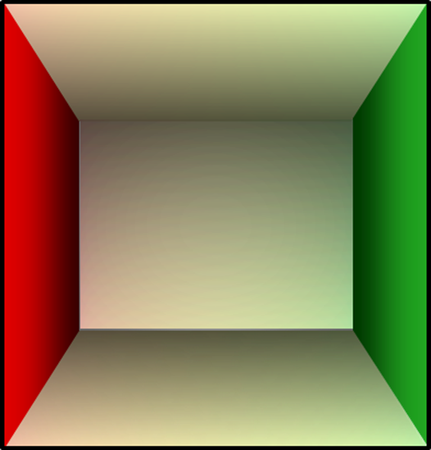
Errors in Shape Recovery
computed shape
error = 1.0 meters
3 meters
error =
0.6 meters
3 meters
ground
truth
camera view
5 meters
sensor

Slide 26
Multipath Interference: Existing Work
scene
indirect radiance
path 2
direct radiance
path 1
intensity
time
source
sensor
Sparse/Compressible Interreflections
[Godbaz et al. 2008, Jimenez et al. 2012, Dorrington et al. 2011]
[Godbaz et al. 2012, Kadambi et al. 2013, Kirmani et al. 2013, Freedman et al. 2014]
Infinite Indirect Paths
2-3 Indirect Paths

Slide 27
Multipath Interference: Existing Work
scene
direct radiance
interreflections
total radiance
sensor radiance
source
sensor
time
How To Separate Different Components?

Slide 28
How To Represent Interreflections?
direct radiance
interreflections
source
interreflections
intensity
$$φ_{direct}$$
direct
$$φ_{inter}$$
scene
$$A_{direct}$$
$$A_{inter}$$
time
sensor
Different Phases
Different Amplitudes

Slide 29
How To Represent Interreflections?
emitted light
direct radiance
interreflections
source
$$p_{direct}{=p}_{inter}$$
interreflections
$$p_{emit}= p_{direct}{=p}_{inter}$$
intensity
direct
scene
time
sensor
Different Phases
Different Amplitudes
Same Period (Frequency)

Slide 30
Signal Processing View
$$φ_{in}$$
$$p_{}$$
$$p_{}$$
$$φ_{out}$$
$$A_{in}$$
$$A_{out}$$
t
t
emitted sinusoid
scene
received sinusoid
source
sensor
Scene Modulates Only the Phase and the Amplitude
Sinusoid Period (Frequency) Remains Same

Slide 31
Phasor Representation of Sinusoids
Sinusoid
Phasor
phase ($φ$)
$$A$$
amplitude ($A$)
$$φ$$
intensity ($I$)
time ($t$)
modulation frequency
$$I=Acos(ωt−φ)$$
$$\vec{I}=Ae^{−jφ}$$

Slide 32
Signal Processing View: Phasor
$$\vec{P_{}^{emit}}$$
$$\vec{P_{}^{rec}}$$
emitted phasor
$$\vec{S}$$
received phasor
scene
source
sensor
$$P_{}^{rec}=S×P_{}^{emit}$$
light transport coefficient (complex)
One Coefficient for Every Emitted-Received Light Ray Pair

Slide 33
Signal Processing View: Phasor
emitted phasors
received phasors
$$\vec{P_{j}^{emit}}$$
$$\vec{P_{i}^{rec}}$$
$$\vec{S}$$
scene
source
sensor
$$P_{i}^{rec}=\sum_{j}{S_{ij}×P_{j}^{emit}}$$
light transport coefficients (complex)
Linear Input-Output Relationship

Slide 34
Phasor Light Transport Matrix
light transport matrix (complex)
array of received intensities (complex)
$${[P}_{}^{rec}]=\left[S\right]×{[P}_{}^{emit}]$$
array of emitted intensities (complex)
Phasor Light Transport Equation
Same Form As Conventional Light Transport
[O’Toole et al. 2014]

Slide 35
Phasor Light Transport: Propagation
Phasor Light Transport: Reflection
emitted signal
reflection
scene
free space propagation
source
Sinusoid
Phasor
intensity
Only Amplitude Changes
Only Phase Changes
time

Slide 36
Phasor Light Transport: Superposition
Phasor Light Transport: Scattering
scene
source
superposition
absorption
scattering medium
Sinusoid
Phasor
intensity
Both Phase and Amplitude Change
resultant
time

Slide 37
Phase Change vs. Modulation Frequency
phase change$φ$
modulation frequency$ω$
A
B
distance d
$$φ=\frac{ωd}{c}$$
speed of light
$φ$ is proportional to both d and $ω$

Slide 38
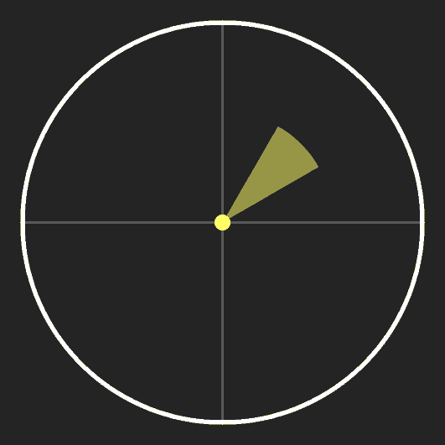
Interreflections vs. Modulation Frequency
emitted signal
(frequency $ω$)
sensor radiance
(interreflections)
resultant
source
different path lengths
$$∆φ$$
different phases same amplitude
resultant = 0
sensor
scene
Increasing Modulation Frequency
Decreasing Resultant Amplitude
angular spread of phases
Local Smoothness of Light Transport
[Nayar et al. 2006]
For High Temporal Frequency
Interreflection Component is Constant
$$∆φ∝ω$$

Slide 39
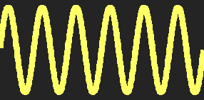
Interreflections vs. Modulation Frequency
total radiance
emitted signal
(frequency $ω$)
direct radiance
interreflection
source
different path lengths
sensor radiance
direct
sensor
scene
time
For High Temporal Frequency
Interreflections Do Not Affect Phase
For High Temporal Frequency
Interreflection Component is Constant

Slide 40
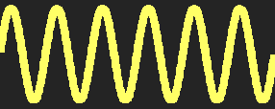
Phase Ambiguity
$${φ(A)}_{}$$
$${φ(B)}_{}$$
high frequency
source
A
B
sensor
Different Scene Depths Have Same Phase

Slide 41
Phase Ambiguity
$${φ(A)}_{}$$
$${φ(B)}_{}$$
low frequency
source
A
B
sensor
Unambiguous Depth Range: $R_{unambiguous}{=\frac{1}{2ω}}_{}$

Slide 42
Disambiguating Phase
same phase
$${φ_{1}(A)}_{}$$
$${φ_{1}(B)}_{}$$
high frequency 1
source
A
B
sensor
different phases
$${φ_{2}(A)}_{}$$
$${φ_{2}(B)}_{}$$
high frequency 2
source
A
B
sensor
Compute Phases at Two High Frequencies
[Jongenelen et al. 2010, 2011]

Slide 43
Micro Time-of-Flight Imaging
high frequency 1
source
high frequency 2
source
period 1
period 2
sensor
sensor
Modulation Signals With Micro (Small) Periods

Slide 44
Conventional vs. Micro ToF Imaging
Conventional ToF Shifting: One Low Frequency
Three Measurements
Micro ToF Shifting: Two High Frequencies
Four Measurements

Slide 45
Simulations: Cornell Box
3.0 m
interreflections
3.0 m
3.0 m
direct radiance
source
sensor

Slide 46
Cornell Box: Input Images
957 MHz.
930 MHz.

Slide 47
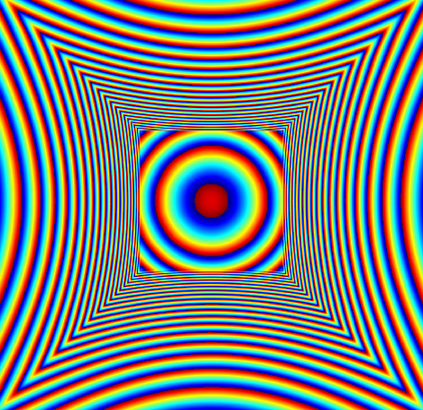
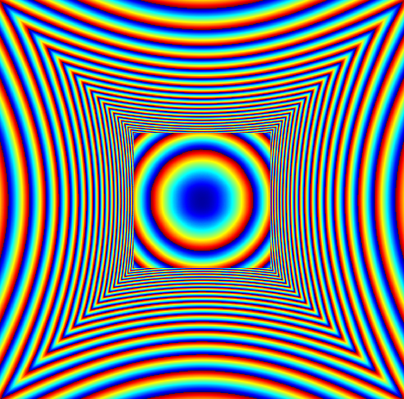
Cornell Box: Phase Maps
ambiguities
ambiguities
957 MHz.
930 MHz.
0
2π

Slide 48
Cornell Box: Shape Comparison
conventional ToF imaging (10 MHz.)
error = 1.0 meters
3 meters
Micro ToF imaging
3 meters
error = 0.6 meters
ground truth

Slide 49
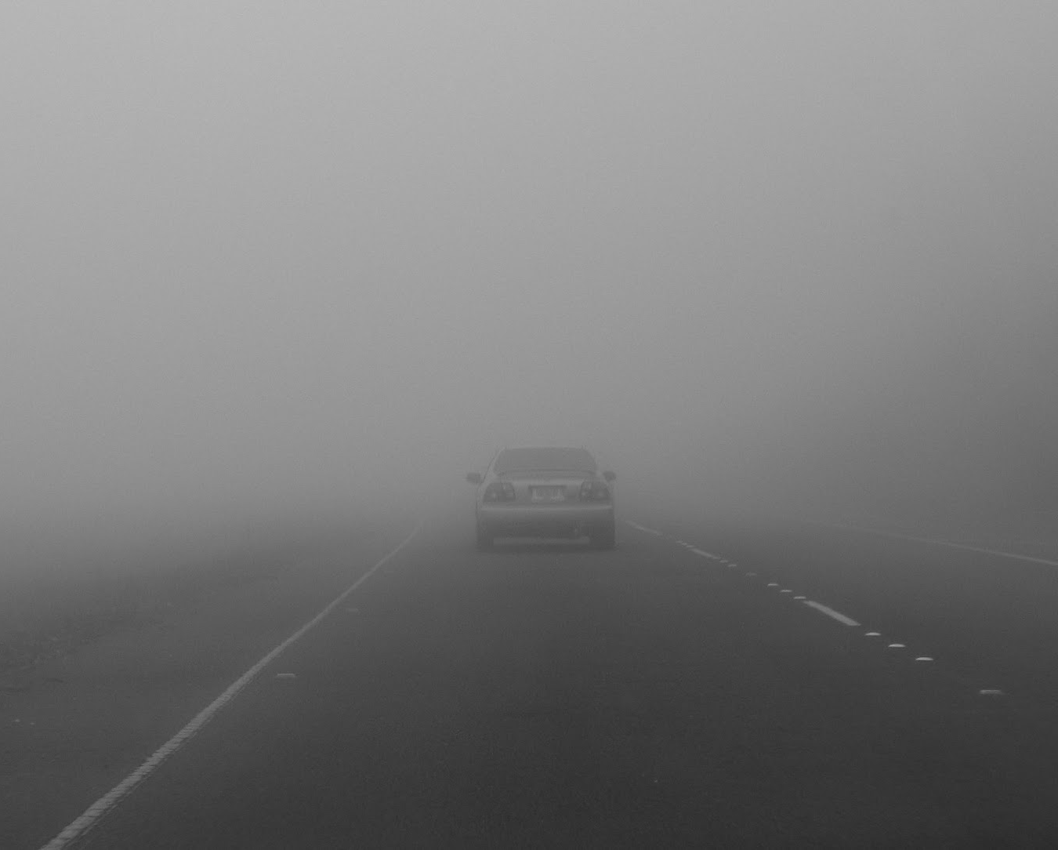
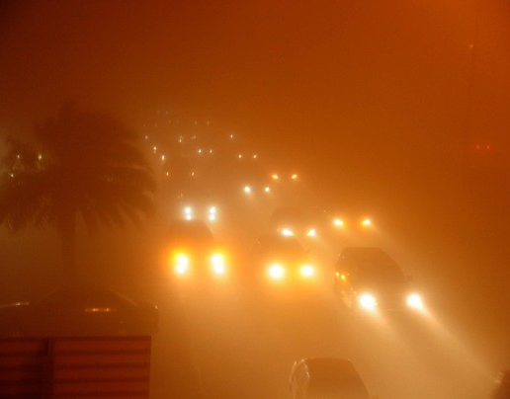
Scattering in Real World
Driving through fog/mist
Driving through a dust storm
Images from: drivinglessonsedinburgh.blogspot.com, ngm.nationalgeographic.com

Slide 50
Scattering and ToF Imaging
scene
direct radiance
scattering medium
backscatter
sensor radiance
source
sensor
time

Slide 51
Scattering and ToF Imaging
scene
direct radiance
scattering medium
total radiance
phase error
sensor radiance
source
sensor
time
time
Scattering Produces Incorrect Phase

Slide 52
Sphere: Shape Comparison
2 meters
ground
truth
Micro ToF
error = 1.2 meters
error = 0.4 meters
conventional ToF
Depths Underestimated
Micro ToF Achieves High Accuracy Shape

Slide 53
Direct-Indirect Separation
total
radiance
direct
radiance
indirect (global)
(Interreflection)
$φ$ (phase)
radiance
$A$ (amplitude)
$D$ (direct)
$O$ (offset)
$G$ (global)
time
$$D=2A G=O−A$$
Direct-Global Separation Using Three Measurements

Slide 54
Direct-Global Separation
Color Bleeding due to Interreflections
Direct Component
Global Component (x2)
Direct Component
Global Component (x2)

Slide 55
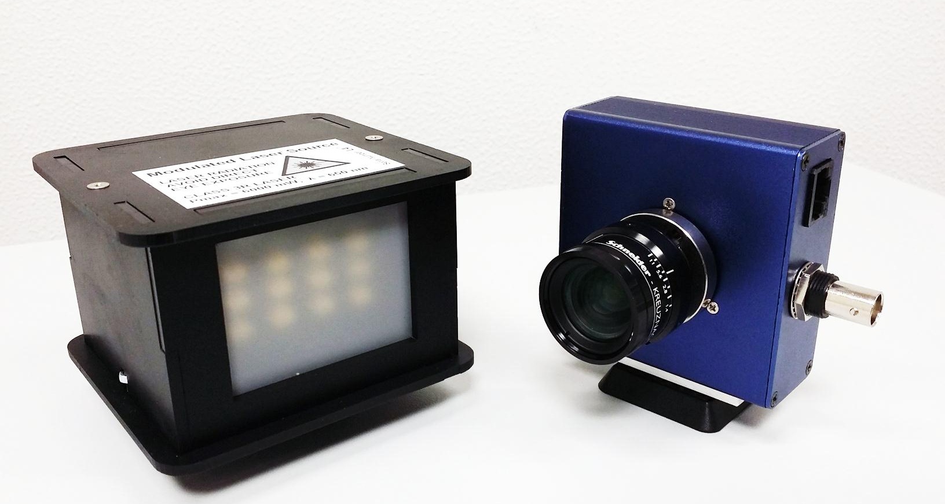
Experimental Setup
light source
(bank of laser diodes)
sensor
(PMD CamBoard Nano)
Maximum System Modulation Frequency = 125 MHz.

Slide 56
Experiments: V-Groove
movable wall
$$θ$$
fixed wall
2.0 meters
interreflections
5.0 meters
2.0 meters
sensor

Slide 57
Scene Images Captured By PMD Sensor
apex angle = 45º
apex angle = 60º
apex angle = 90º
image resolution = 120 x 165

Slide 58
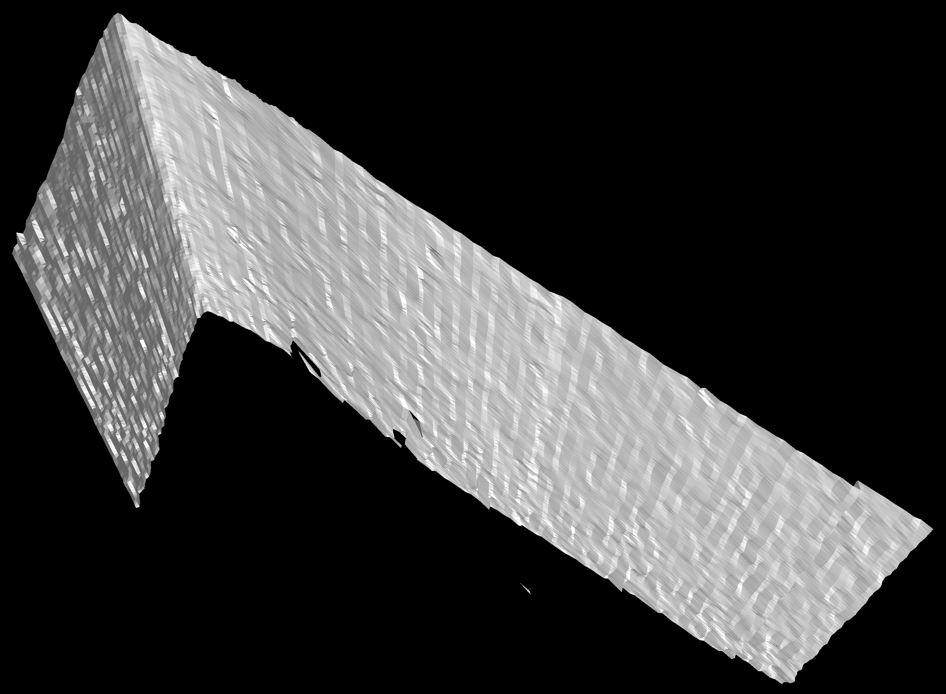
Reconstructed Shape using Micro ToF
concave edge

Slide 59
Shape Comparisons
conventional ToF
mean error = 86.6 mm
45º
Micro ToF [proposed]
mean error = 2.8 mm
ground truth

Slide 60
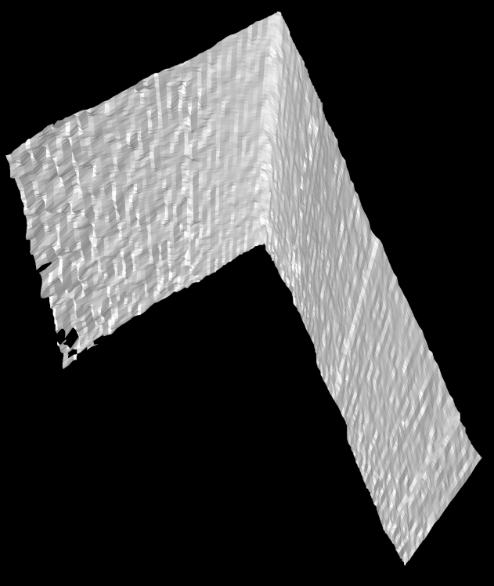
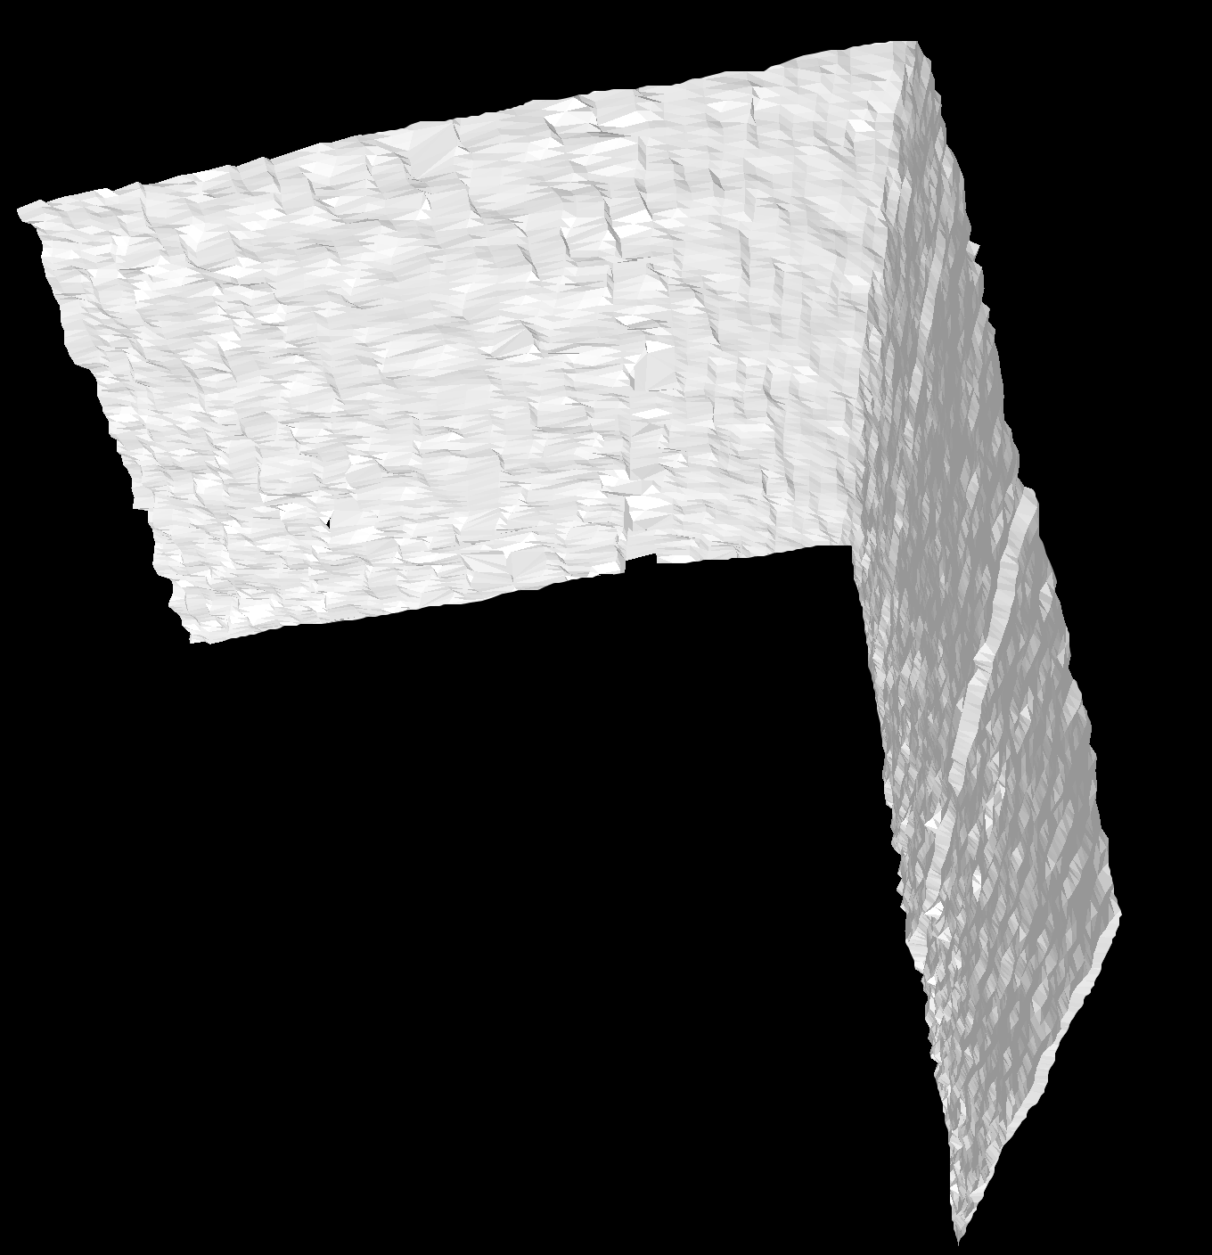
Reconstructed Shapes: Different Angles
concave edge
concave edge
$$θ=60°$$
$$θ=90°$$

Slide 61
Shape Comparisons
conventional ToF
mean error = 69.8 mm
conventional ToF
mean error = 56.9 mm
60º
90º
Micro ToF
mean error = 6.2 mm
ground truth
ground truth
Micro ToF
mean error = 6.7 mm

Slide 62
Recovered Shape vs. Frequency
45º

Slide 63
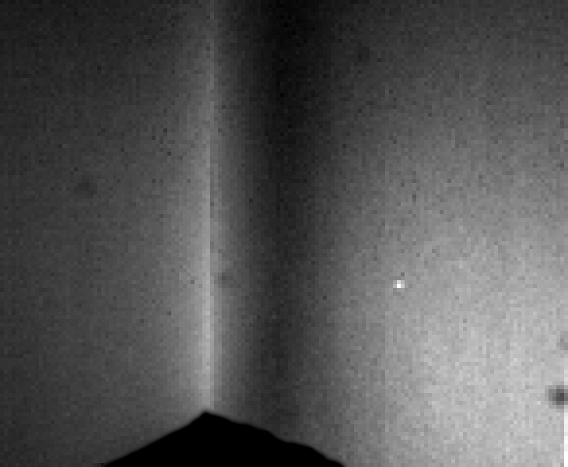
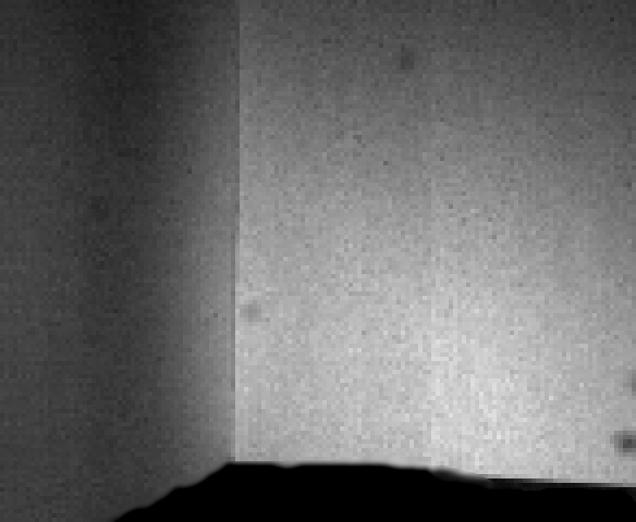
Direct-Global Separation Vs. Apex Angle
Direct
Global
apex angle = 45º
apex angle = 90º
decreasing global component

Slide 64
Summary
Indirect Illumination Hurts Time-of-Flight Imaging
Use High Frequencies that are Slightly Different

Slide 65
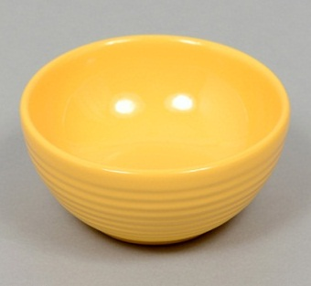
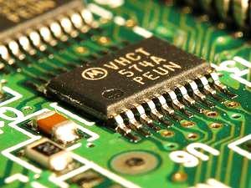
How High Should The Frequency Be?
TeraHz.
Material Property
(Increasing Smoothness)
GigaHz.
Increasing Frequency
MegaHz.
10³ m
10¹ m
10⁻¹ m
10⁻³ m
Geometric Scale (Decreasing Scene Size)

Slide 66
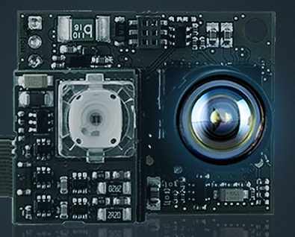
Technology (Devices) Required
Material Property
(Increasing Smoothness)
PMD Camboard Nano
Available
Off-the-Shelf
10³ m
10¹ m
10⁻¹ m
10⁻³ m
Geometric Scale (Decreasing Scene Size)

Slide 67
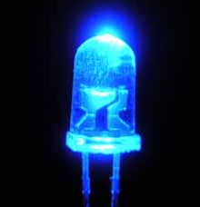
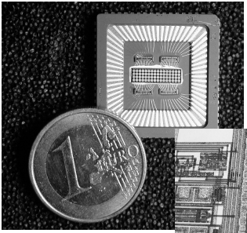
Technology (Devices) Required
GHz. LED
Chen et. al.
1999
GHz. MSM Sensor
Buxbaum et. al.
2002
Material Property
(Increasing Smoothness)
Sensors/Sources in Research Labs
Available
Off-the-Shelf
10³ m
10¹ m
10⁻¹ m
10⁻³ m
Geometric Scale (Decreasing Scene Size)

Slide 68
Technology (Devices) Required
Future
Sensors/Sources?
Material Property
(Increasing Smoothness)
Sensors/Sources in Research Labs
Available
Off-the-Shelf
10³ m
10¹ m
10⁻¹ m
10⁻³ m
Geometric Scale (Decreasing Scene Size)

Slide 69
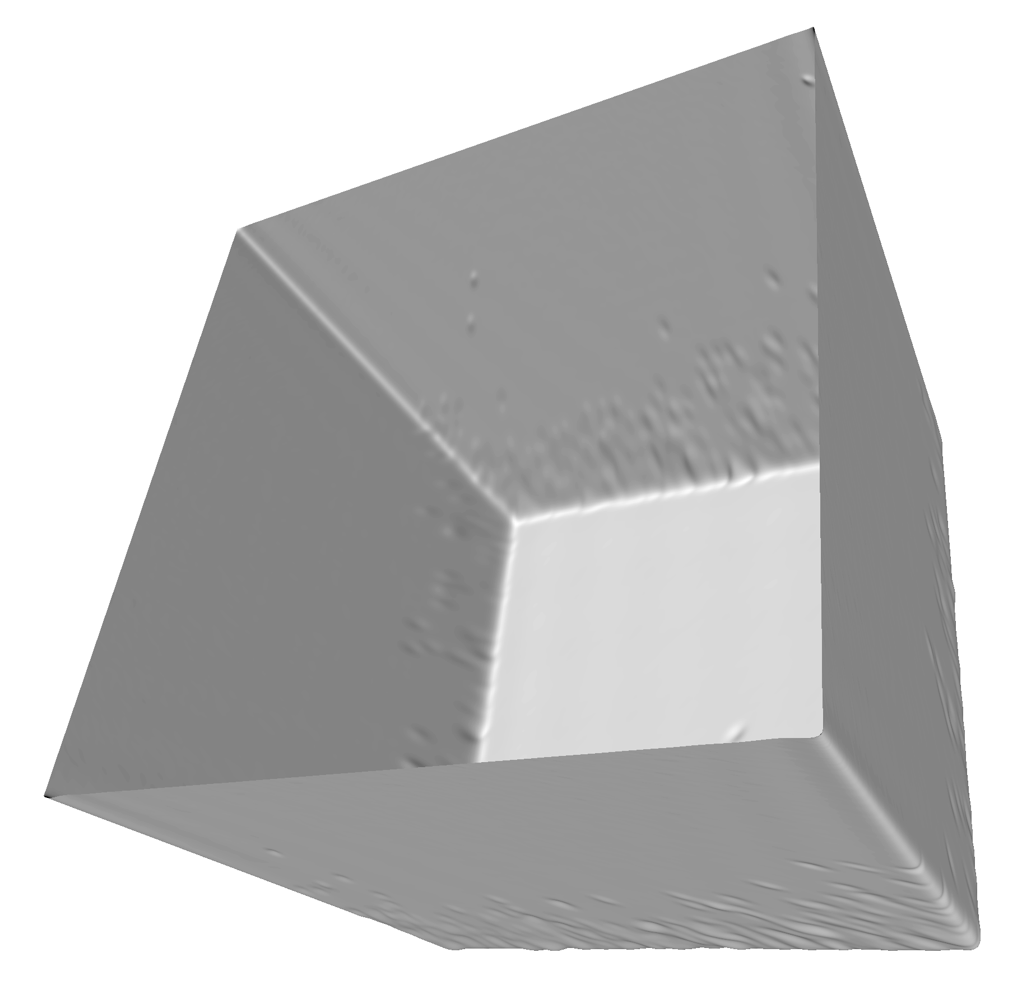
Conclusion
source
interreflections
direct
scene
scene
source
sensor
sensor
Phasor Light Transport
Generalization of C-ToF Imaging
scene
shape
direct
global
Shape Recovery
Fast Light Transport Analysis

Slide 70
Acknowledgments
Shree K. Nayar
Matthias B. Hullin and Jaime Martin

Slide 71
Questions
http://www.cs.columbia.edu/CAVE/projects/phasor_imaging/

Slide 72
Extra Slides

Slide 73
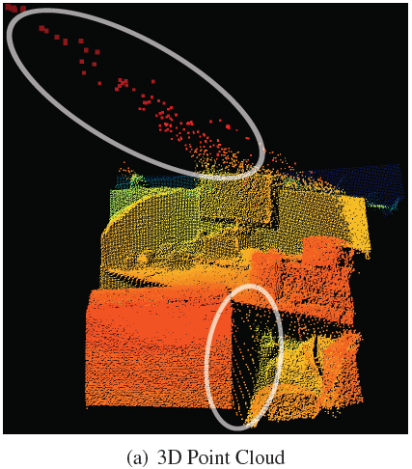
Research Problems
Flying Pixels
Strong Ambient Illumination
flying pixel
sunlight
sensor
P
Q
sensor
scene
scene
shadow
sunlight
flying pixels
depth errors
[Reynolds et al. 2011]
[Kazmi et al. 2013]

Slide 74
General Modulation Functions
$$ω_{1}$$
$$ω_{2}$$
$$ω_{n}$$
=
+
+…+
square wave
sinusoids
$$\vec{P_{ω}^{in}}$$
$$\vec{P_{ω}^{out}}$$
$$\vec{S_{ω}}$$
source
scene
sensor
$$P_{ω}^{out}=S_{ω}×P_{ω}^{in}$$
Each Frequency Considered Independently

Slide 75
Recovered Shape vs. Albedo

Slide 76
Error Maps Vs. Increasing Frequency
albedo = 1.0
error = 1.0m
error = 0.0m

Slide 77
Disambiguating Phase
sensor
scene depth ($d$)
phase 1 ($φ_{1}$)
phase 2 ($φ_{2}$)
phase to depth mapping
Two High Frequencies Sufficient
$$d=f(φ_{1},φ_{2})$$
Notes:
Let’s look at the problem in 1D.
Suppose we have two high frequencies. It turns out that if the frequencies are very close to each other, their combination can emulate a low frequency. <Nice graphic>
This is called beat frequency, and is frequently encountered in acoustics and music.
In particular, if the frequencies are f1 and f1+delta, the resulting frequency is delta/2. For example, if f1 is 49Hz., and f2 is 51Hz., the beat frequency is a very low 1Hz.

Slide 78
Simulations: V-Groove
3.0 m
angle = 70°
4.0 m
4.5 m
sensor

Slide 79
V-Groove: Shape Comparison
conventional ToF imaging (10 MHz.)
Micro ToF imaging
(3 frequencies)
ground truth

Slide 80
Reconstruction Error Vs. Frequency
45 degree v-groove
60 degree v-groove
250
140
120
200
100
150
80
reconstructed error (mm)
reconstructed error (mm)
100
60
40
50
20
0
0
20
40
60
80
100
0
0
20
40
60
80
100
modulation frequency
modulation frequency

Slide 81
Reconstruction Error Vs. Frequency
90 degree v-groove
120
100
80
reconstructed error (mm)
60
40
20
0
0
20
40
60
80
100
modulation frequency

Slide 82
Apex Angle Vs. Modulation Frequency
45 degree v-groove
60 degree v-groove
90
90
85
80
80
70
75
reconstructed angle (degrees)
reconstructed angle (degrees)
60
70
65
50
45
60
40
0
20
40
60
80
100
55
0
20
40
60
80
100
modulation frequency
modulation frequency

Slide 83
Apex Angle Vs. Modulation Frequency
90 degree v-groove
125
115
reconstructed angle (degrees)
105
95
90
85
0
20
40
60
80
100
modulation frequency

