Slide 1
Gigapixel Computational Imaging
Oliver Cossairt, Daniel Miau, Shree Nayar
Columbia University
Supported by
Darpa Award #W911NF-10-1-0214
NSF GRFP Award
Notes:
can we capture the images Ila showed in a single snapshot?

Slide 2
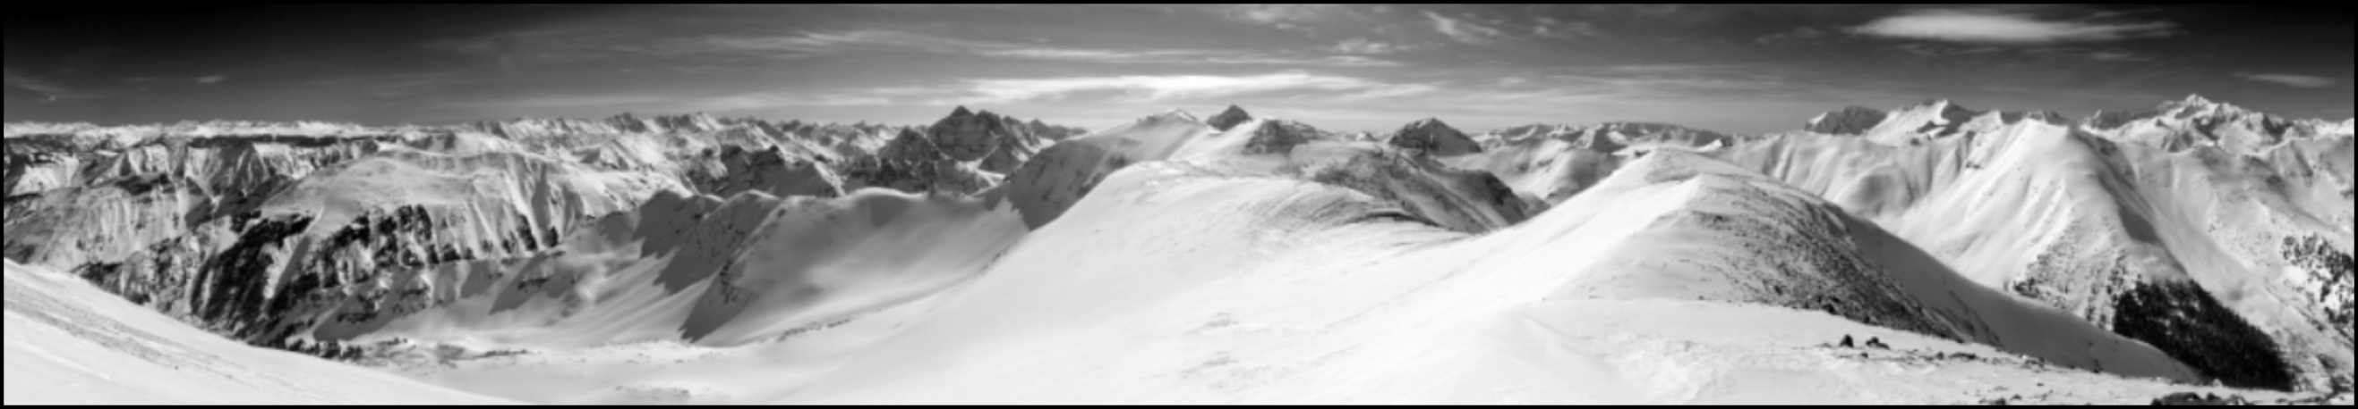

Images with a Billion Pixels
Gigapixel image from gigapan.org (stitched)

Slide 3
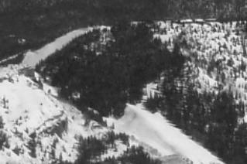
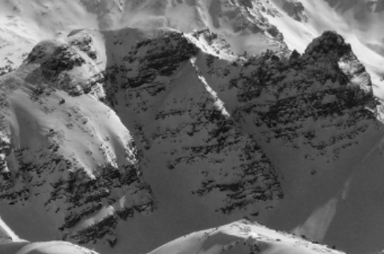
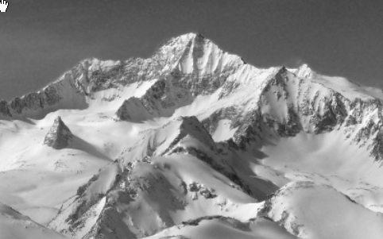
Images with a Billion Pixels
Gigapixel image from gigapan.org (stitched)
Why is there no Gigapixel Camera Today ?

Slide 4
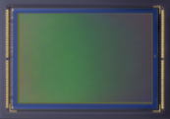
Is it Image Sensor Resolution?
Assume 1 micron pixels (Fife et. al 08)
10 megapixel sensor
2.5 mm
4 mm

Slide 5
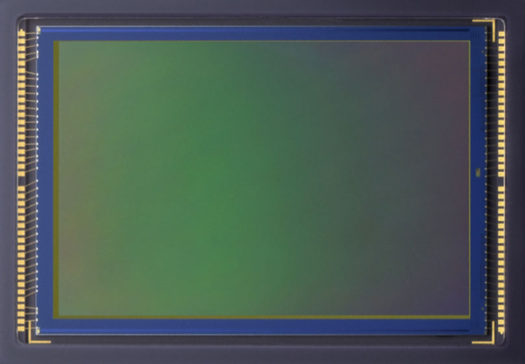
Is it Image Sensor Resolution?
Assume 1 micron pixels (Fife et. al 08)
1 gigapixel sensor
25 mm
40 mm
The Limits are Due to Optics

Slide 6
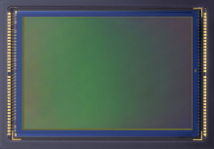
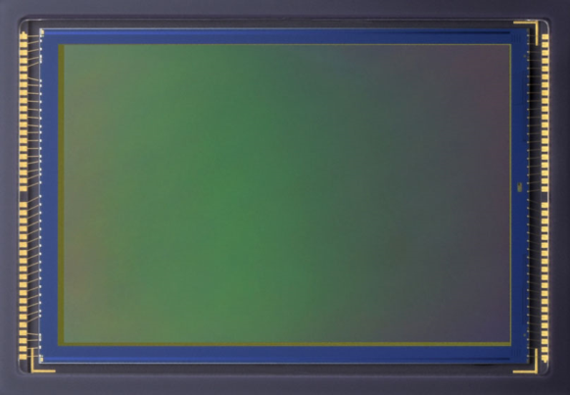
Defining Optical Resolution
δ
Spatial Resolution
δ
δ: minimum resolvable spot size
δ

Slide 7
Defining Optical Resolution
Space-Bandwidth Product (Resolution)
SBP: # resolvable spots in image

Slide 8
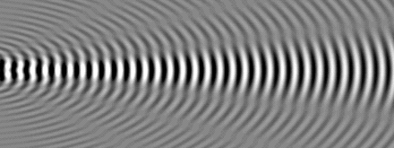


Is Resolution Limited by Diffraction?
Diffraction Spot Size
δ_{d}

Slide 9
Is Resolution Limited by Diffraction?
M
h
*
M
w
*
M
f
*
R_{diff}
Diffraction Limited Scaling Law
10⁹ pixels
Resolution
40 mm sensor
Scale (M)

Slide 10

The Curse of Geometric Aberrations
δ_{g}

Slide 11
The Curse of Geometric Aberrations
M
h
*
M
w
*
M
f
*
R_{diff}
Geometric Aberration Scaling Law
Aberration Limit
Resolution
R_{geom}
(Lohmann ‘89)
Scale (M)

Slide 12
Compromise: Trading Off Light
δ_{g}

Slide 13
Compromise: Trading Off Light
M
h
*
M
w
*
M
f
*
R_{diff}
R_{tradeoff}
Empirical (F/#)³ = f Scaling Law
Resolution
R_{geom}
(Lohmann ‘89)
Scale (M)

Slide 14
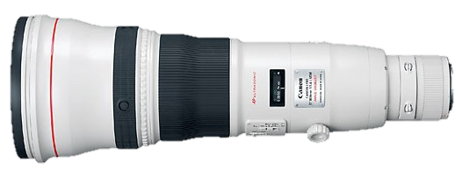
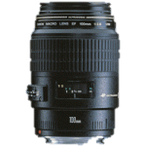

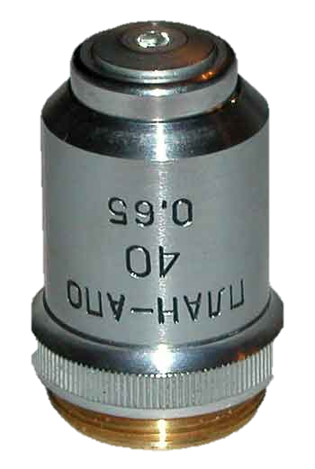
Compromise: Trading Off Light
R_{tradeoff}
10⁹ pixels
(Lohmann ‘89)
Telephoto
F/10 1000mm FL
SLR Lens
F/5 125mm FL
Resolution
400 mm
sensor
Wide Angle
F/3 27mm FL
Microscope
F/1 1mm FL
Scale (M)

Slide 15
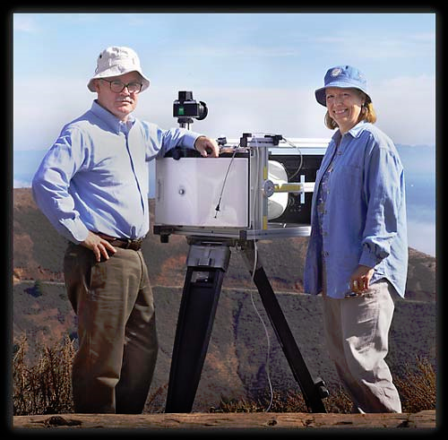
Compromise: Trading Off Light
The F/22 90º FOV Assymagon Lens
35mm
450mm
Graham Flint courtesy of Wired.com

Slide 16
Proposed Solution: Computational Imaging
Computations
Reduce complexity with computations
(Cathey and Dowski ’96)
(Robinson et. al ‘09)
(Guichard et al. ‘09)
(Cossairt and Nayar ’10)

Slide 17
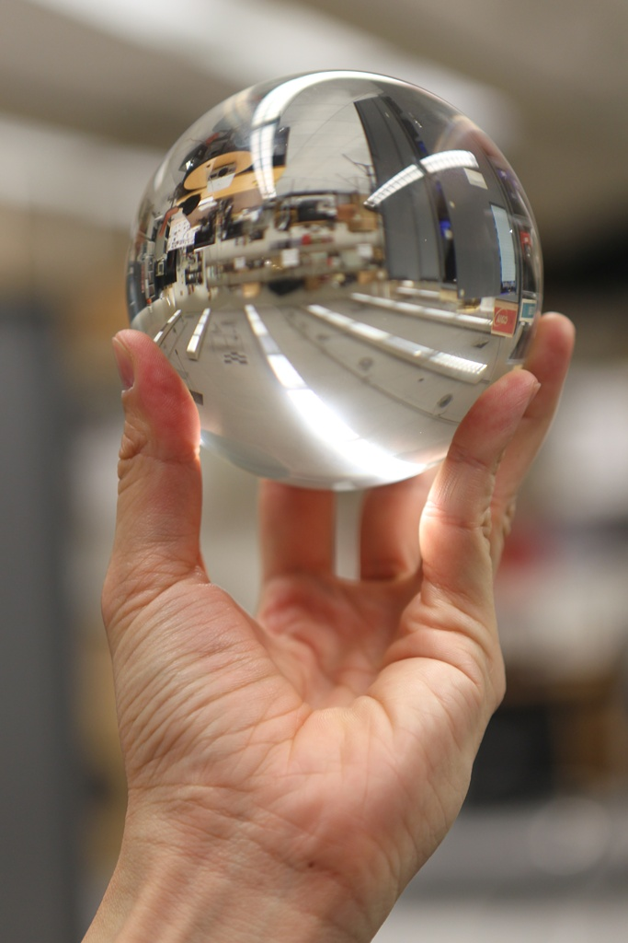
Proposed Solution: Computational Imaging

Slide 18
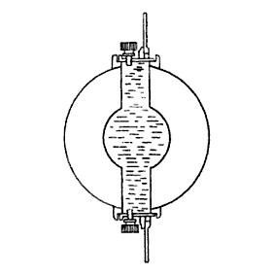
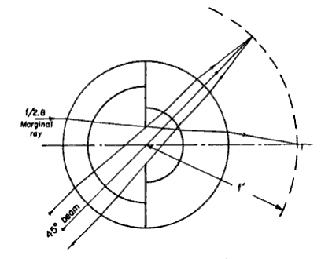
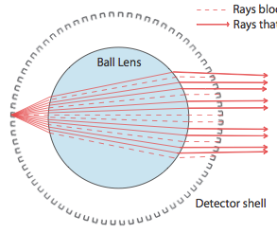
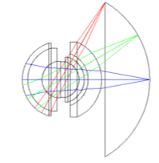
Spherical Optics
Sutton Lens
Baker Ball Lens
Recent Monocentric Designs
(Sutton 1859)
(Baker ‘42)
(Krishnan and Nayar ‘09)
(Marks and Brady ‘10)

Slide 19
Deblurring Error vs. Lens Scale
Computations
1) Pixel size remains constant

Slide 20
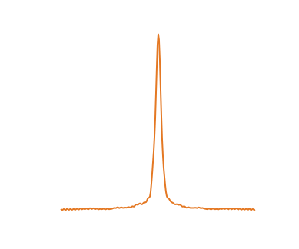
Deblurring Error vs. Lens Scale
Computations
1) Pixel size remains constant
Point Spread Function
-50
0
50
Pixels
2) PSF size increases linearly

Slide 21

Deblurring Error vs. Lens Scale
Computations
1) Pixel size remains constant
Simulations using natural images
0.14
0.12
0.10
Point Spread Function
0.08
RMS Deblurring Error
0.06
0.04
0.02
-50
0
50
1
12
25
37
50
62
75
87
100
Pixels
Scale (M)
2) PSF size increases linearly
3) Error increases sub-linearly

Slide 22
Resolution and Deblurring Error
Deblurring error is proportional to pixel size (shot noise limited)
SNR
Sensor
Noise
Pixel
Size
What pixel size will produce a SNR invariant to lens scale?

Slide 23
A Scaling Law for Computational Imaging
Computations
R_{diff}
R_{comp}
R_{tradeoff}
Computational Imaging Scaling Law
10⁹ pixels
Resolution
75mm sensor
R_{geom}
Scale (M)

Slide 24
A Ball Lens Gigapixel Camera
15 x 15 Array of 5Mpix ½” Lumenera Sensors

Slide 25
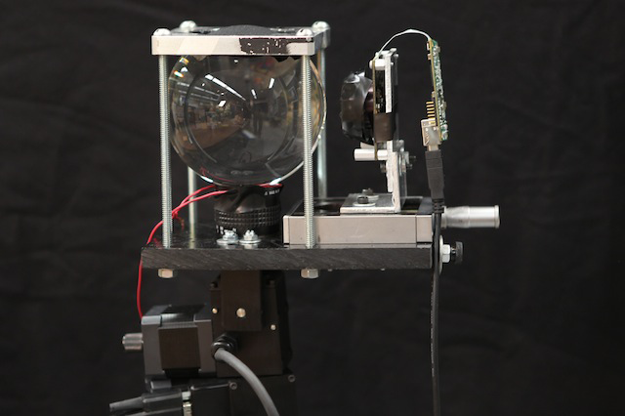
Proof of Concept
Sensor
Ball Lens
Pan/Tilt
Motor

Slide 26
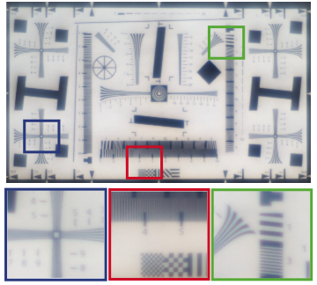
Proof of Concept: Image Quality
Captured

Slide 27
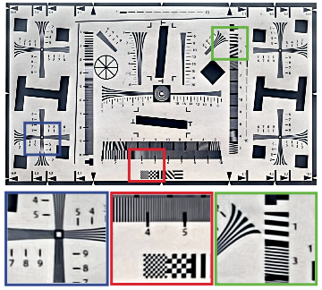
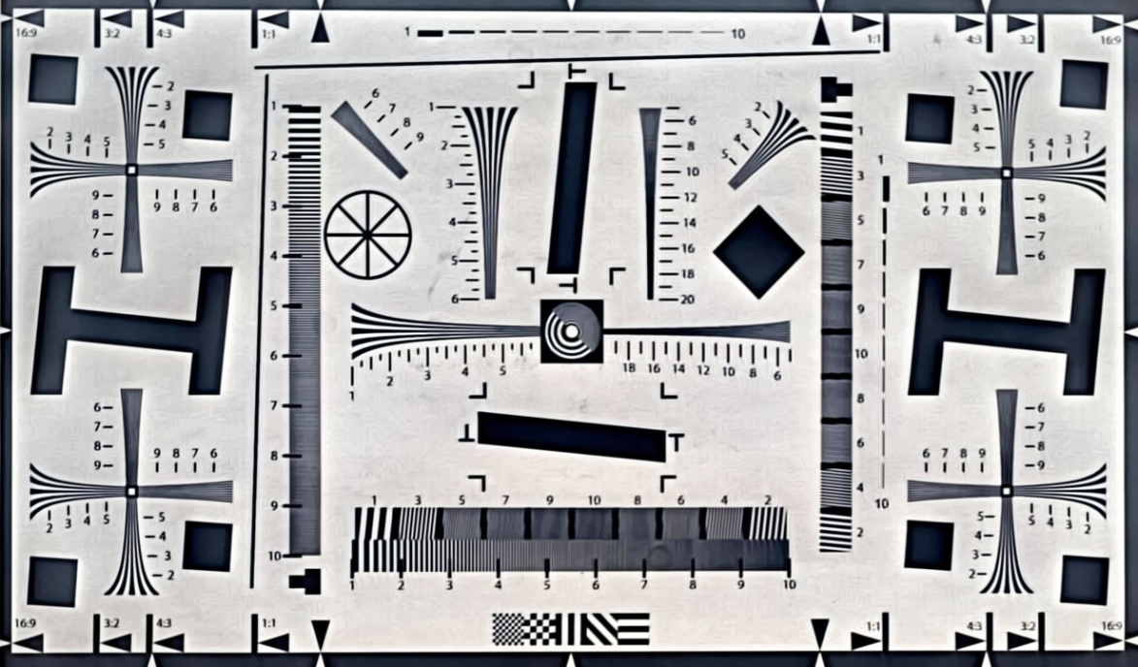
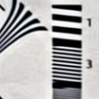
Proof of Concept: Image Quality
Deblurred

Slide 28
Example Gigapixel Images

Slide 29
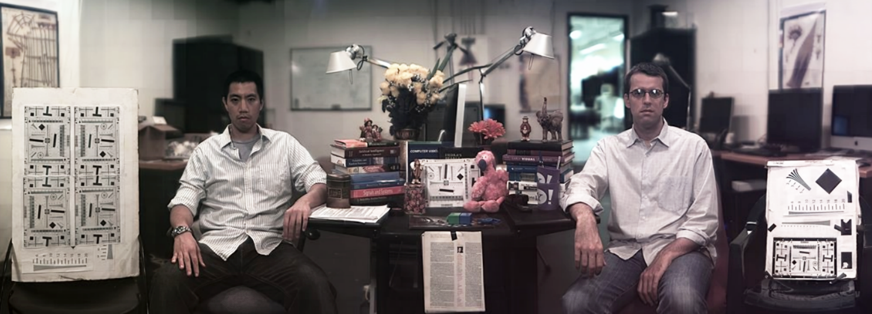
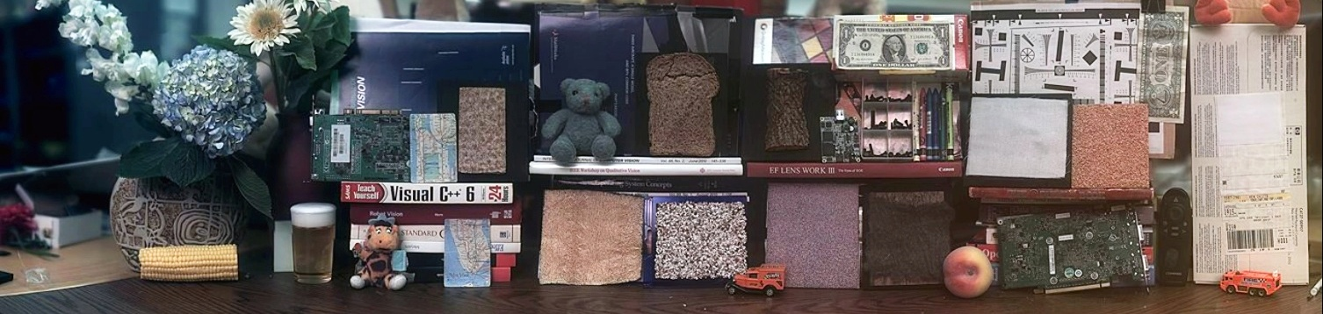
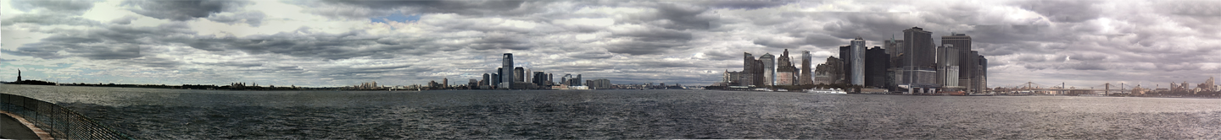
Example Gigapixel Images
65,269 pixels
Portrait
(1.6 Gigapixels)
24,801 pixels
82,000 pixels
Still Life
(1.7 Gigapixels)
22,000
110,000 pixels
Skyline
(1.4 Gigapixels)
22,000

Slide 30
A Single Element Design
Parallel effort by DARPA MOSAIC Program led by D. Brady
(Brady and Hagen ‘09)(Marks and Brady ‘10)
Notes:
----- Meeting Notes (3/30/11 11:33) -----
A parallel effort is the system developed under the mosaic program led by David brady, which also uses multiscale

Slide 31
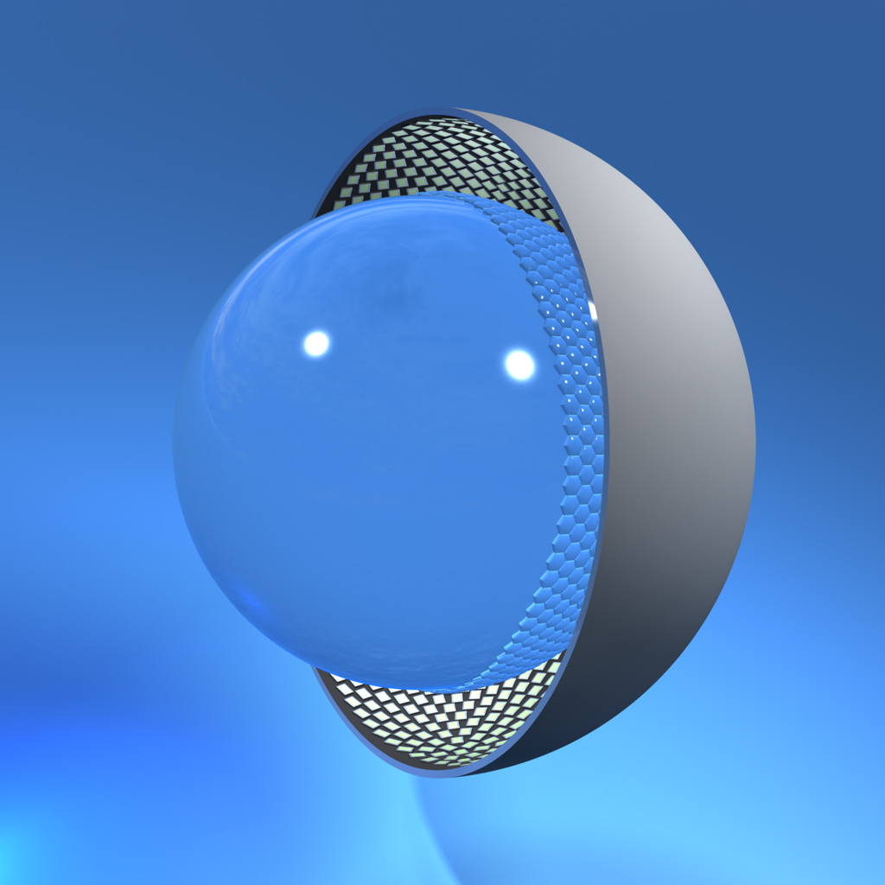
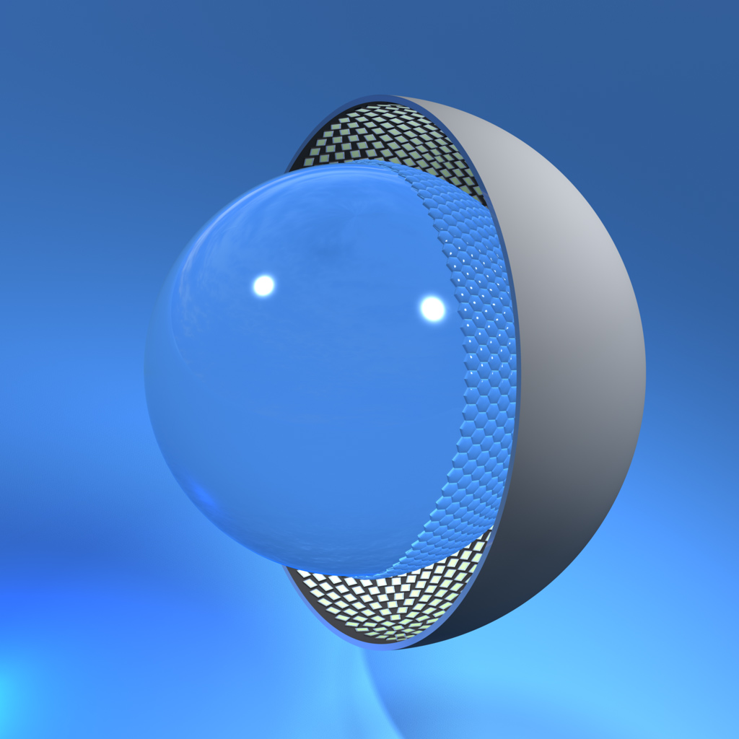
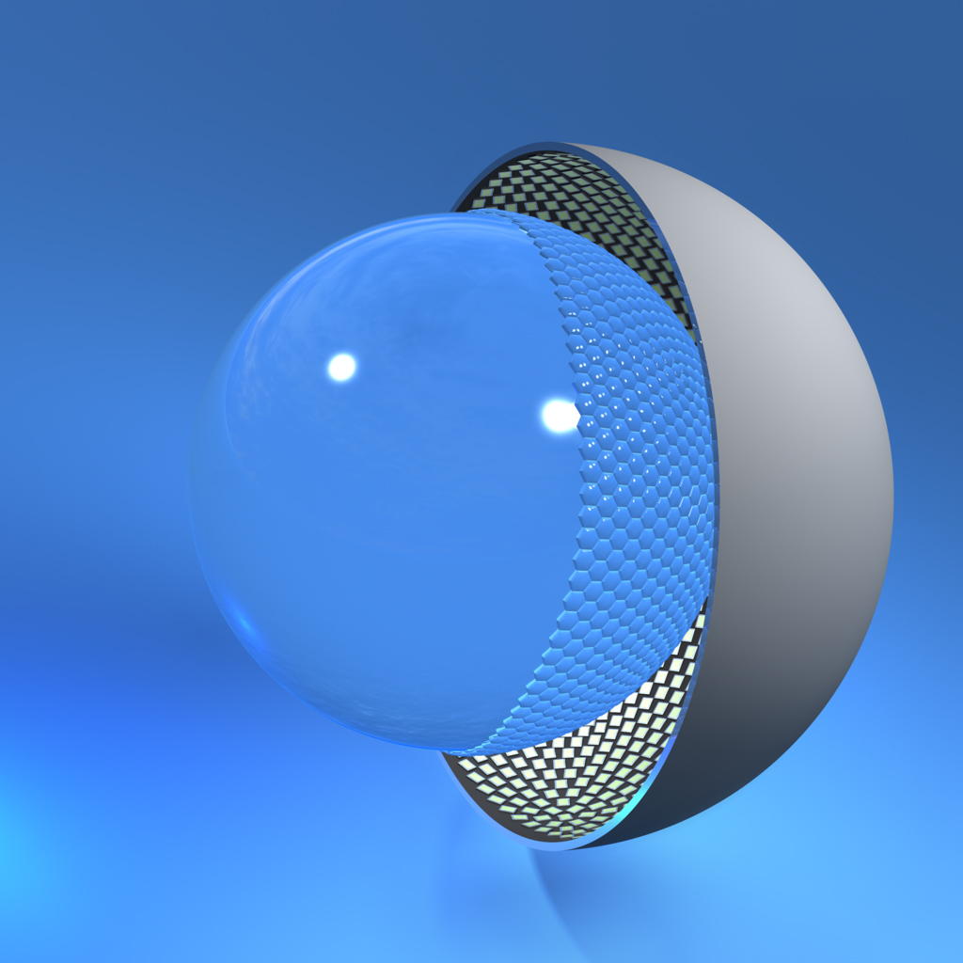
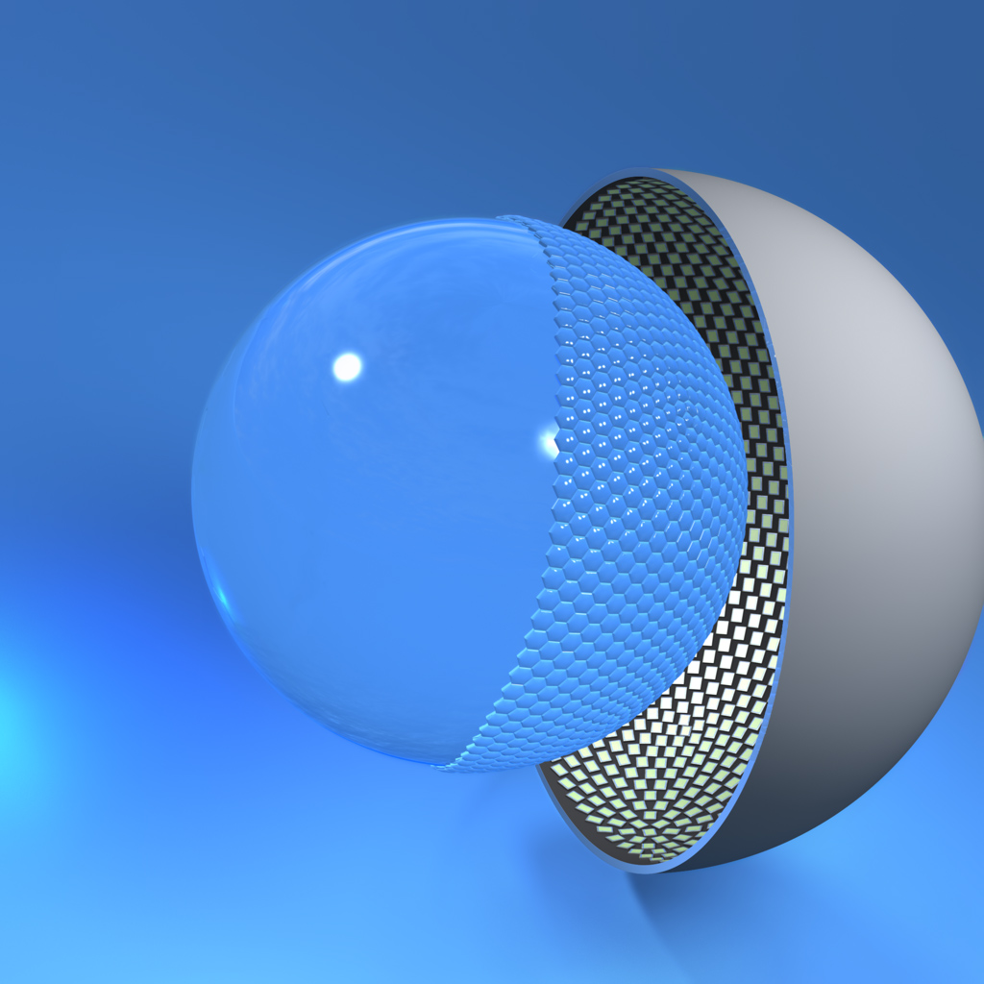
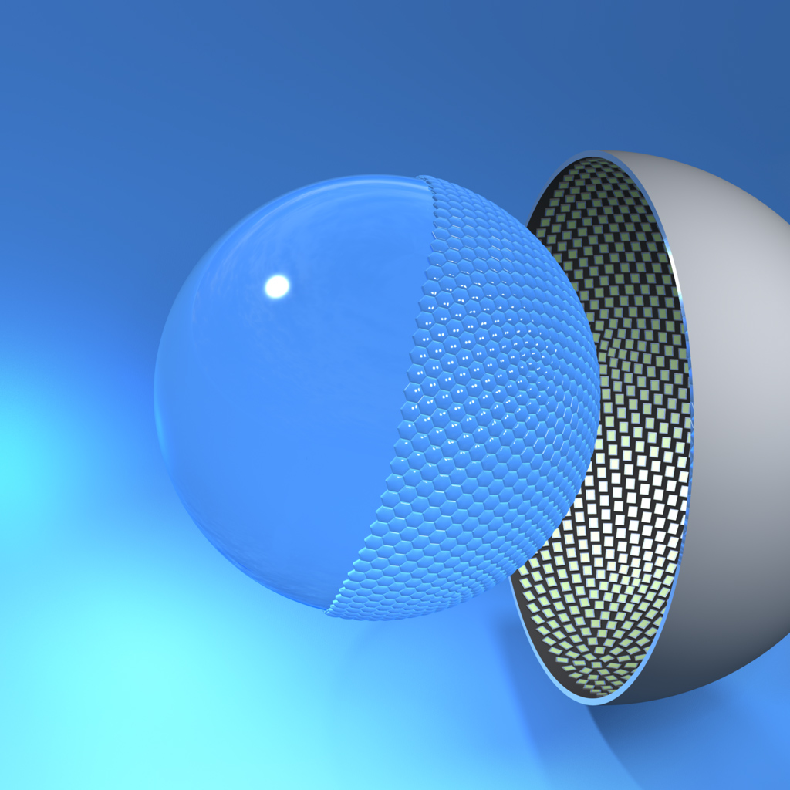
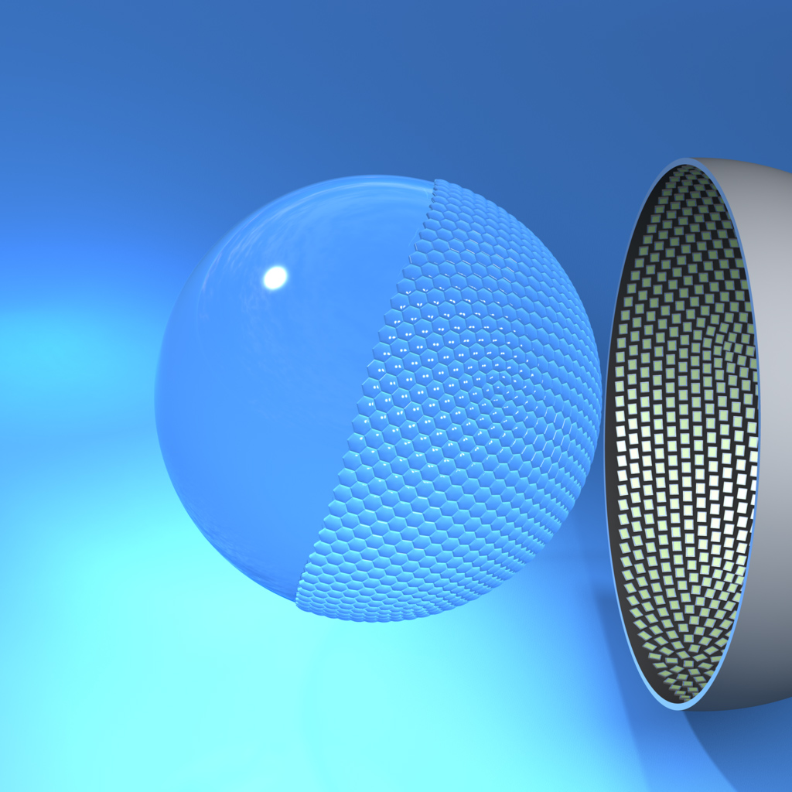
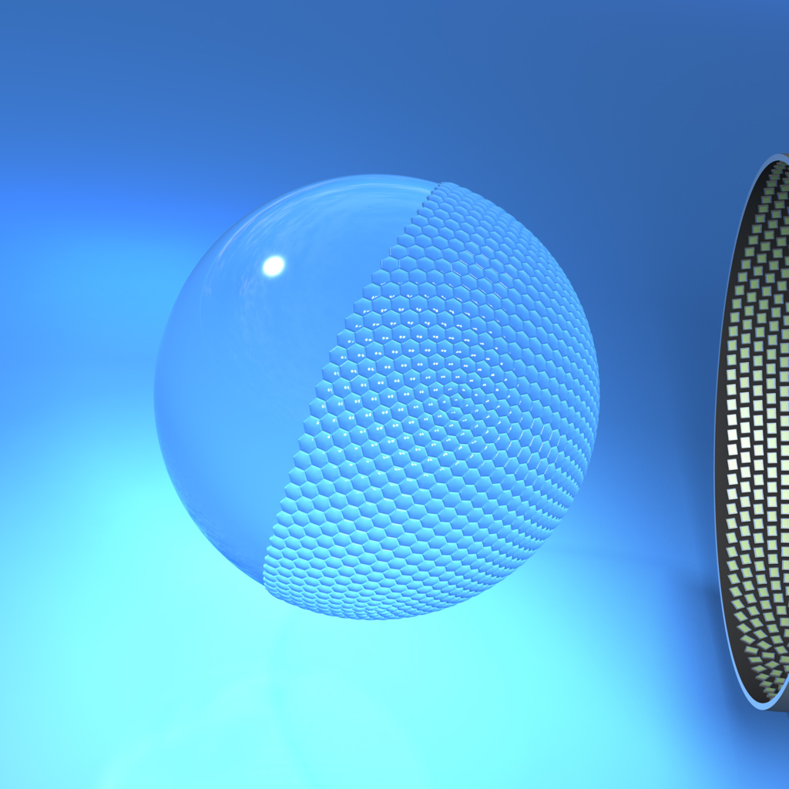
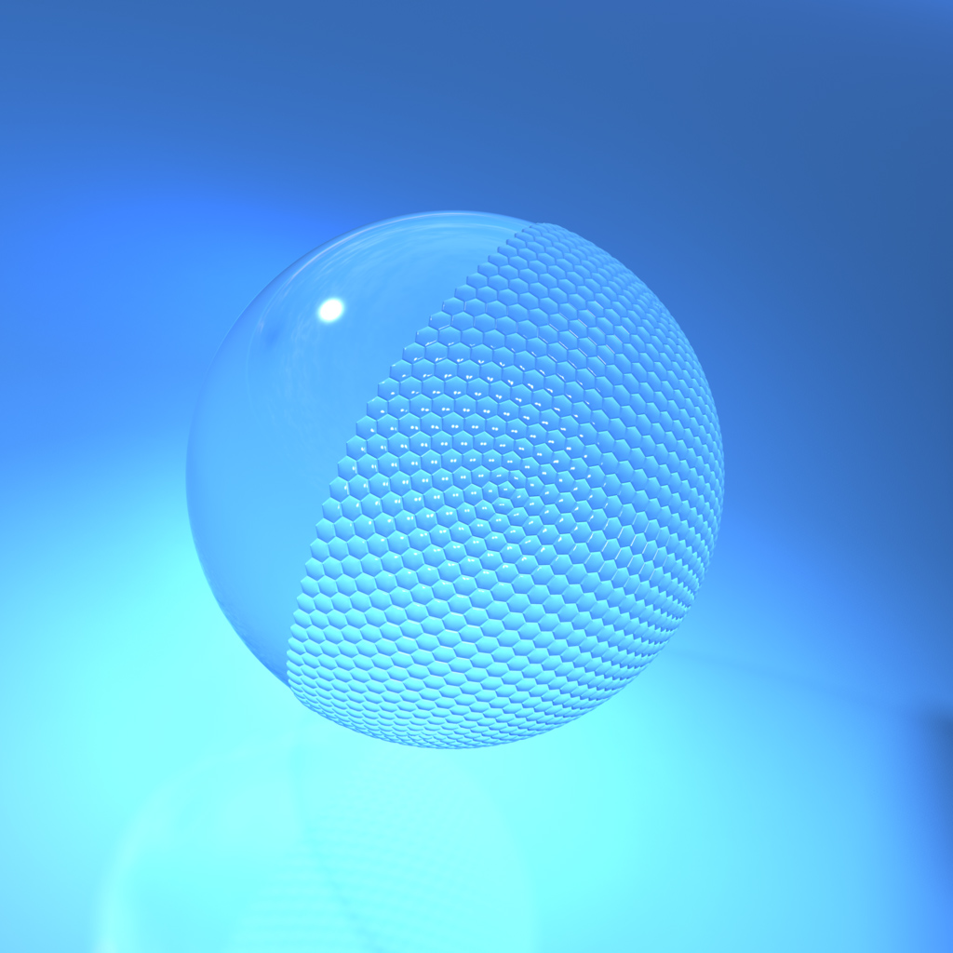
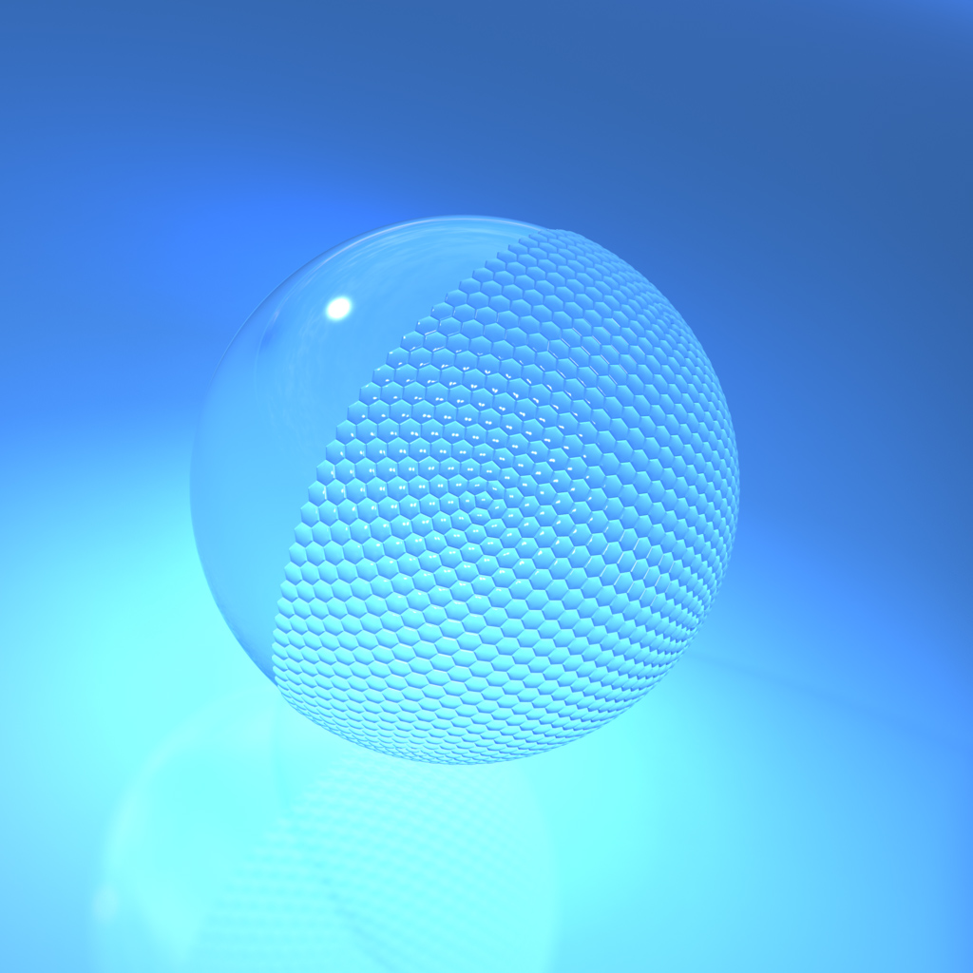

A Single Element Design
Sensor
Array
Ball
Lens
Ball
Lens
Lens
Array
Lens
Array

Slide 32
Next Steps: SNR vs. Complexity
(Marks and Brady ‘10)
1-Shell
2-Shell
3-Shell
4-Shell
5-Shell
6-Shell
Raytrace
Complexity
Deblurring Error
Diffraction
limit
Diffraction
limit
Diffraction
limit
Diffraction
limit
Diffraction
limit
Diffraction
limit
MTF
Spatial frequency
Spatial frequency
Spatial frequency
Spatial frequency
Spatial frequency
Spatial frequency

Slide 33
Next Steps: SNR vs. Complexity
(Marks and Brady ‘10)
SNR= .85
SNR = .74
Relative SNR
SNR = .44
SNR = .22
SNR = .19
SNR = .01
Number of Shells (Complexity)

Slide 34
Conclusion
New Scaling Law
Gigapixel Camera
Gigapixel Images
R_{d}
R_{c}
R_{f}
SBP
R_{g}
Scale (M)
Single Element Design
SNR vs. Complexity

Slide 35
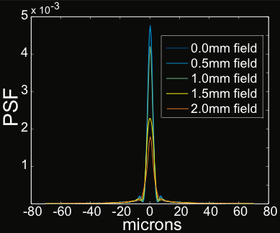
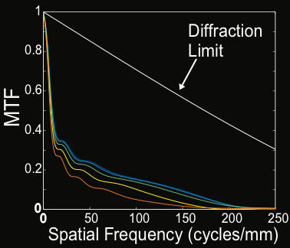
A Ball Lens Gigapixel Camera

Slide 36
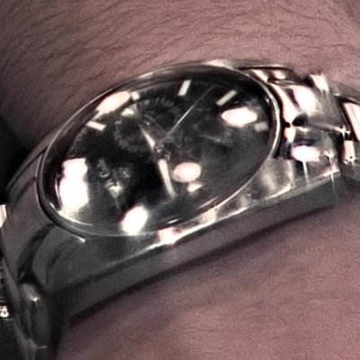
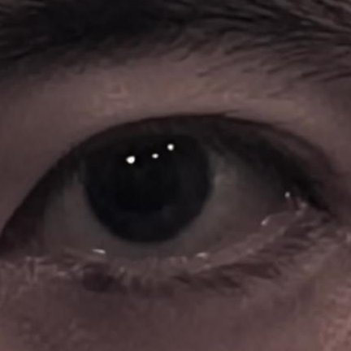
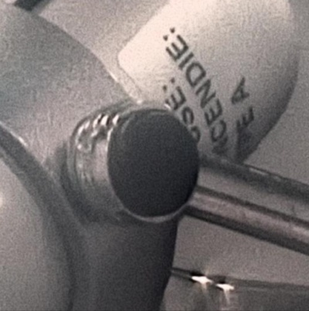
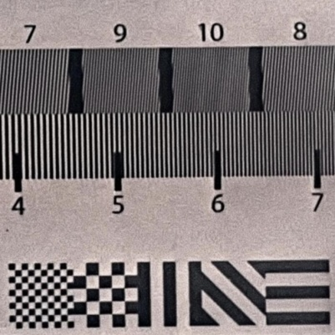
Portrait (1.6 Gigapixels)
65,269 pixels
24,801 pixels
Watch
Eye
Lamp
Resolution chart
URL: http://gigapan.org/gigapans/09d557515ee4cc1c8c2e33bf4f27485a/

Slide 37
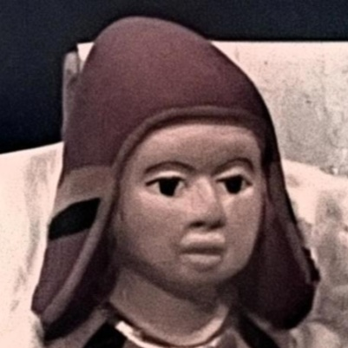
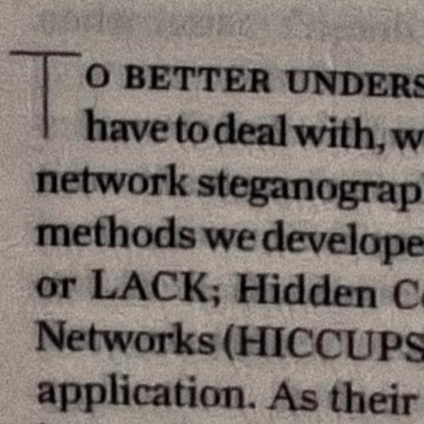
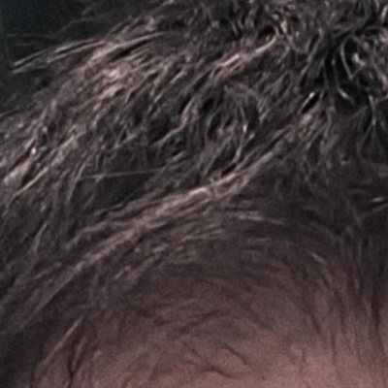
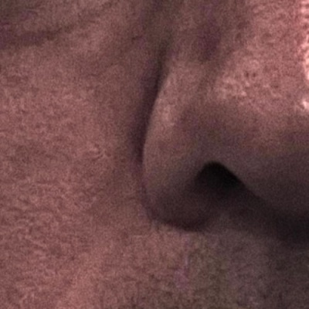
Portrait (1.6 Gigapixels)
65,269 pixels
24,801 pixels
Figurine
Text
Hair
Skin
URL: http://gigapan.org/gigapans/09d557515ee4cc1c8c2e33bf4f27485a/

Slide 38
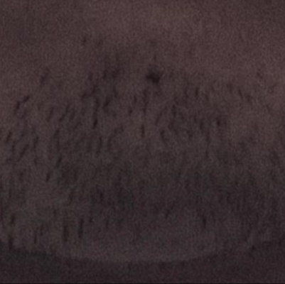
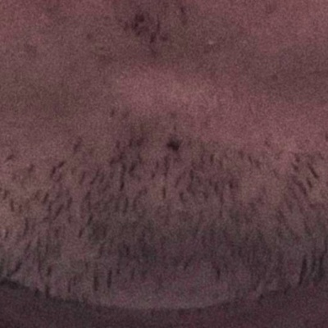
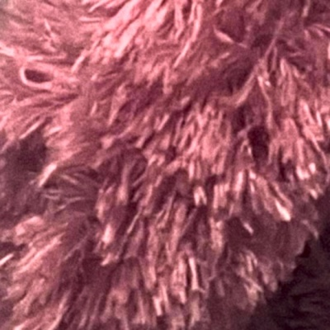
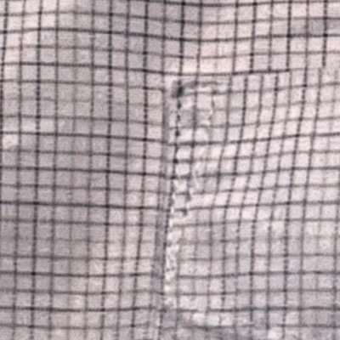

Portrait (1.6 Gigapixels)
65,269 pixels
24,801 pixels
Facial Hair
Stuffed animal
Pattern on shirt
Denim weave
URL: http://gigapan.org/gigapans/09d557515ee4cc1c8c2e33bf4f27485a/

Slide 39




Still Life (1.7 Gigapixels)
82,000 pixels
22,000 pixels
Resistor
Dollar bill
Fingerprint
2D barcode
URL: http://gigapan.org/gigapans/0dca576c3a040561b4371cf1d92c93fe/

Slide 40




Still Life (1.7 Gigapixels)
82,000 pixels
22,000 pixels
Real flower
Plastic flower
Loofah
Fabric weave
URL: http://gigapan.org/gigapans/0dca576c3a040561b4371cf1d92c93fe/

Slide 41




Still Life (1.7 Gigapixels)
82,000 pixels
22,000 pixels
Bread
Map
Steel brush
Bolt threads
URL: http://gigapan.org/gigapans/0dca576c3a040561b4371cf1d92c93fe/

Slide 42




New York and New Jersey Skyline (1.4 Gigapixels)
110,000 pixels
22,000
Statue of Liberty
(~2.32km)
Apartments
(~860m)
Person on boat deck
(~860m)
Empire State Building
(~6.45km)
URL: http://gigapan.org/gigapans/7173ad0acace87100a3ca728d40a3772/

Slide 43




New York and New Jersey Skyline (1.4 Gigapixels)
110,000 pixels
22,000
Sailboat
(~1.61km)
People on Boat
(~860m)
Flag on Brooklyn Bridge
(~2.19km)
Cars
(~1.5km)
URL: http://gigapan.org/gigapans/7173ad0acace87100a3ca728d40a3772/

