Slide 1
Removing Image Artifacts Due to Dirty Camera Lenses and Thin Occluders
Jinwei Gu ¹, Ravi Ramamoorthi ²,
Peter Belhumeur ¹, Shree Nayar ¹
¹ Columbia University
² University of California at Berkeley
December 18, 2009

Slide 2
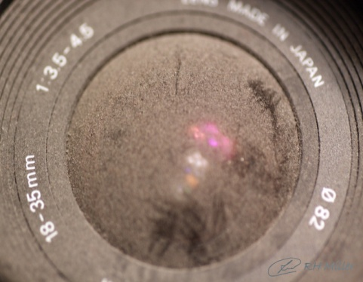
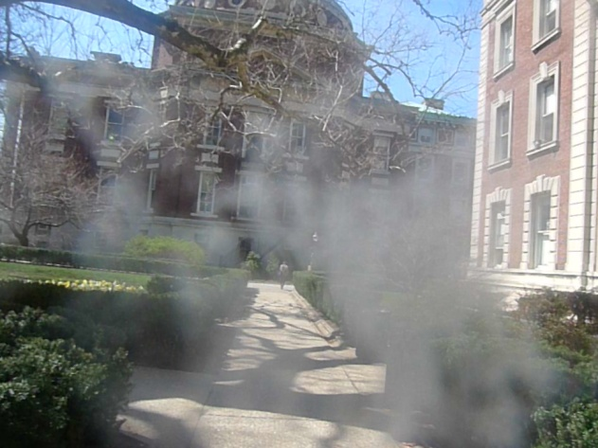
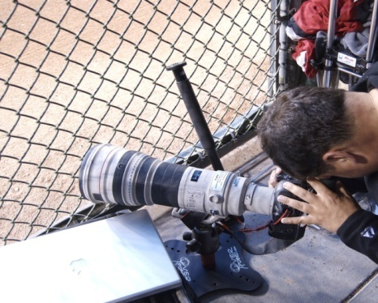
Two Common Artifacts in Photography
Dirty camera lens / filter (e.g., dust, dirt, fingerprints)
Hazy, murky appearance, affecting a large portion of the image
A layer of thin occluders (e.g., fences, tree branches)
Blurry, partial occlusion patterns

Slide 3
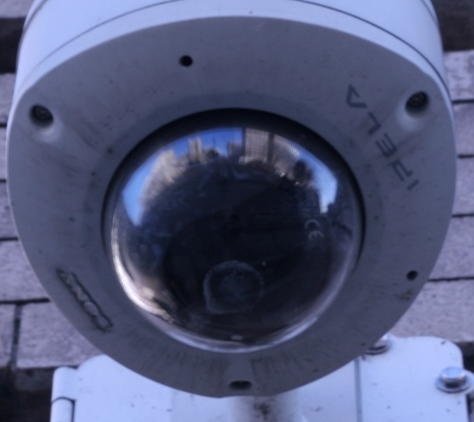
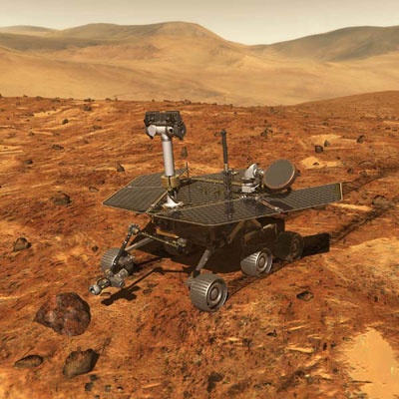
Can We Just Clean the Lens?
Not always applicable. For example:
Existing images and videos
Automated imaging systems
Dust/Dirt
We need computational methods to
remove these image artifacts.
Outdoor Security Cameras
Mars Exploration Rovers
(NASA)

Slide 4
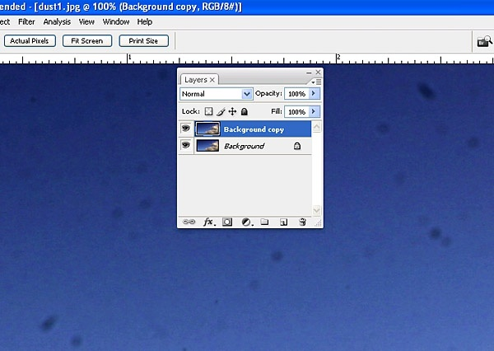
“Hole-Filling” with Texture Synthesis
Main Limitations:
Require considerable user interaction
Only work for small artifacts on a regular background
??
Photo Editing Tool
Dust on a Lens
Notes:
4

Slide 5
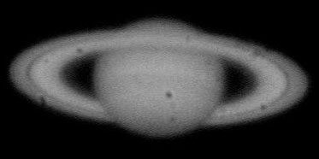
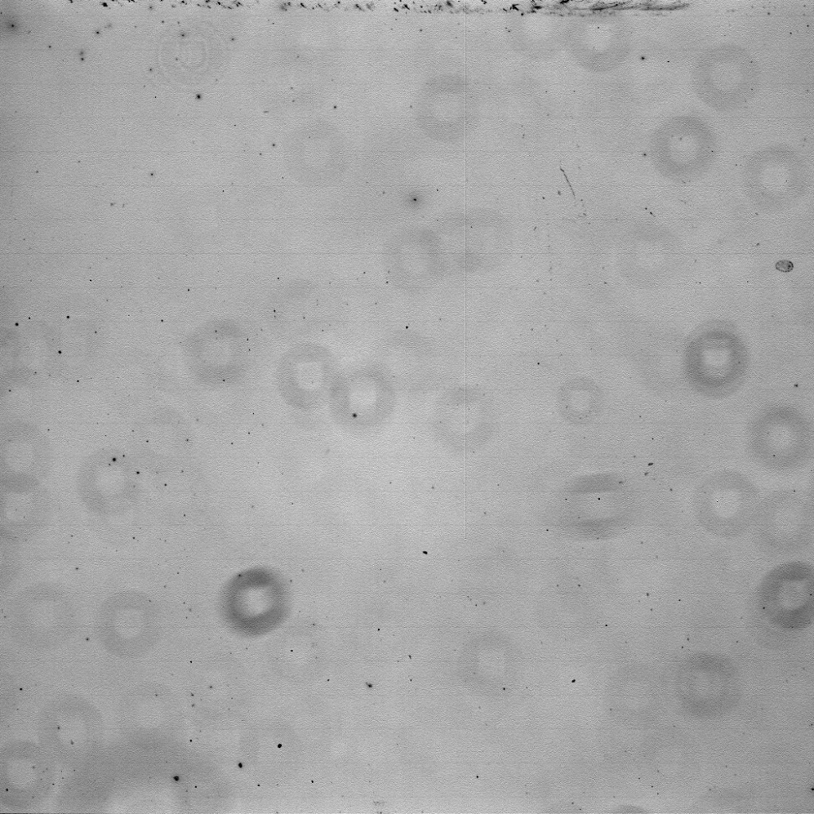
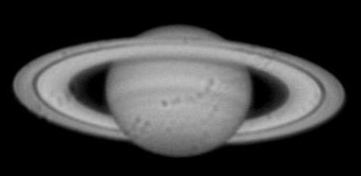
Flat Field Images in Astrophotography
Dust “Doughnuts”

Slide 6
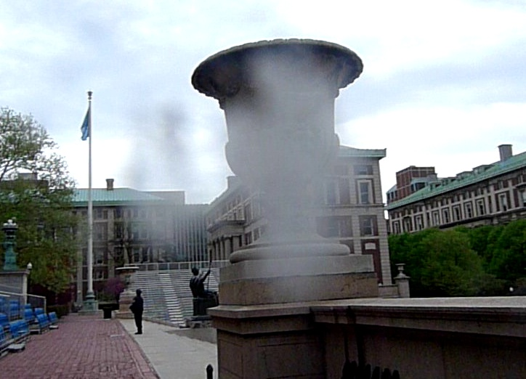
Formation of the Image Artifacts
Both artifacts include two components:
Attenuation (absorption / occlusion)
Scattering (stray lights, e.g., sun light)
Darker
(Attenuation)
Brighter
(Scattering)
Image taken with a dirty lens

Slide 7
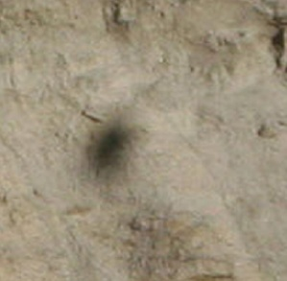
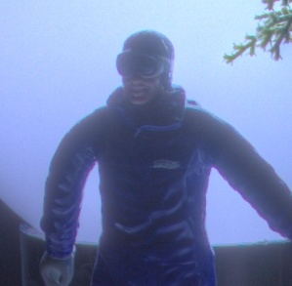
Related Work
Simulation of Lens Dust Artifacts
Only dust attenuation
Simulation of the artifact (NOT artifact removal)
[Willson et al. 2005]
Removal of Sensor Dust Artifacts
Small artifacts with dust attenuation
User interaction is needed
[Zhou and Lin 2007]
Lens Veiling Glare
Similar effect as scattering
Caused by lens inter-reflection and diffraction
[Talvala et al. 2007]

Slide 8
Our Contribution
A physically-based image formation model, including
Attenuation + Scattering
Computational methods for artifact removal
Fully automatic ➔ No user labeling needed
Pixel-wise recovery ➔ Can handle large artifact
NOT single-image based methods

Slide 9
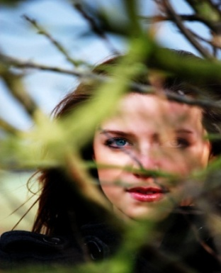
Image Formation: An Intermediate Layer
Scene
Intermediate
Layer
Camera
…
Lens dust/dirt
Fence
Tree branches

Slide 10
Image Formation (1): Attenuation
Scene
Intermediate
Layer
Pinhole
Sensor
Attenuation map

Slide 11
Image Formation (1): Attenuation
Scene
Intermediate
Layer
Lens
Sensor
Attenuation map
Defocus blur kernel

Slide 12
Image Formation (2): Scattering
Scene
Intermediate
Layer
Lens
Sensor
The intermediate layer itself acts as a light source.
Radiance scattered
from the environment
Defocus blur kernel

Slide 13
Image Formation Model
Captured
Image
Attenuation
Scattering
Clean
Image
Attenuation
Map
Defocus
Blur Kernel
Radiance
by Scattering
Stray light (e.g., the sun) might be outside the field of view.
Large corrupted area because of camera defocus.
High frequency in I₀(x) is (partially) preserved.
Image taken with a dirty lens

Slide 14
Dirty-Lens Artifact: Model Simplification
Assumption
L₁
where
L₂
L₃
Aggregate of Outside Illumination
(scene dependent)
The simplified model
Attenuation Map
Scattering Map
(camera dependent)
(camera dependent)

Slide 15
Removal of Dirty-Lens Artifact
Method 1: (the camera is accessible)
Directly measure a(x) and b(x) with a simple calibration.
Method 2: (the camera is not accessible)
Estimate a(x) and b(x) from multiple images taken with the same dirty lens camera (e.g., a video)

Slide 16
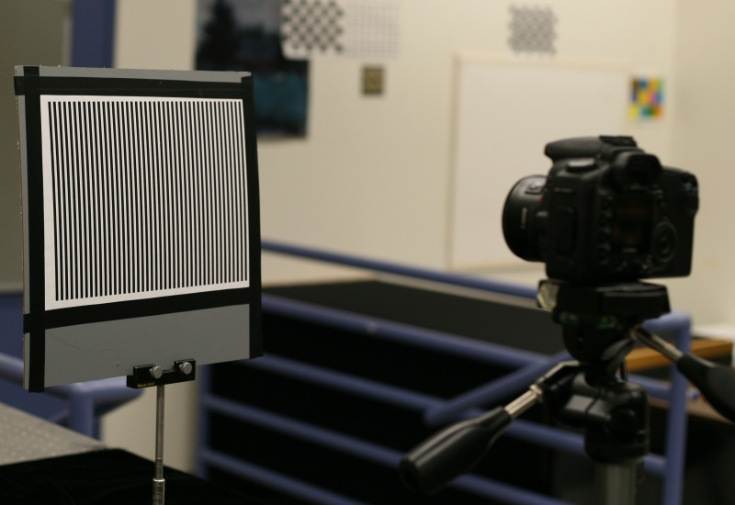
Method 1: Removal with Calibration
Measure a(x) and b(x) directly with a stripe pattern.
[Nayar et al., 2006]
Stripe Pattern
Dirty Lens
Camera
Shift

Slide 17
Method 1: Removal with Calibration
Measure a(x) and b(x) directly with a stripe pattern.
[Nayar et al., 2006]
Stripe
Pattern
Dust
Lens
Sensor

Slide 18
Method 1: Removal with Calibration
Measure a(x) and b(x) directly with a stripe pattern.
[Nayar et al., 2006]
Shift
Stripe
Pattern
Dust
Lens
Sensor

Slide 19
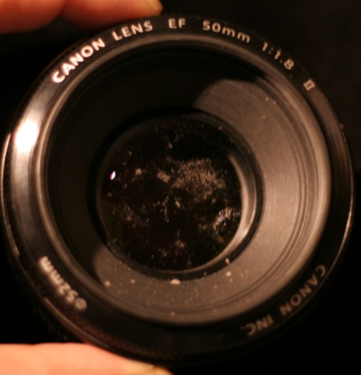
Method 1: Removal with Calibration
Measure a(x) and b(x) directly with a stripe pattern.
[Nayar et al., 2006]
Dirty Lens
(EF 50mm)
Input
(16 images)
Attenuation
a(x)
Scattering
b(x)

Slide 20
Method 1: Removal with Calibration
Captured
Image
Clean
Image
Attenuation
Map
Scattering
Map
Aggregate of
Outside Illumination
Information is missing to estimate c directly from I(x).
Prior: natural images should have sparse gradients.
[Rudin et al., 1992]

Slide 21
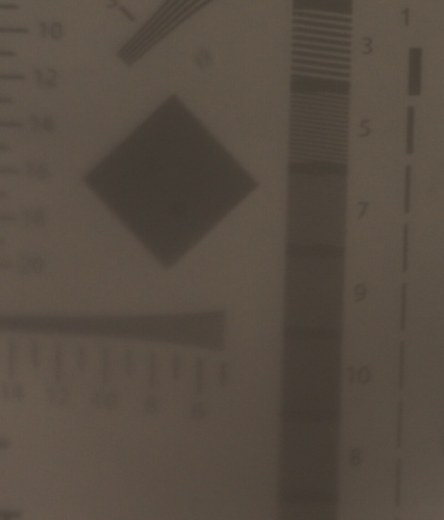
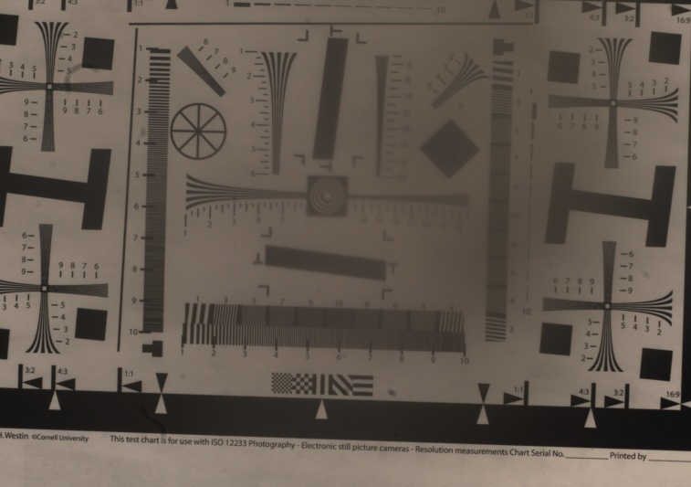
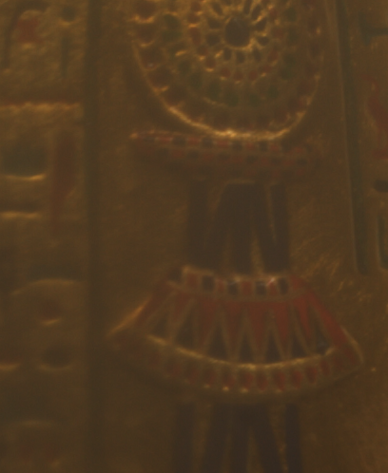
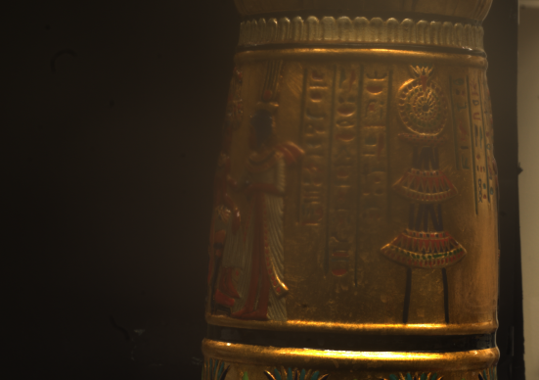
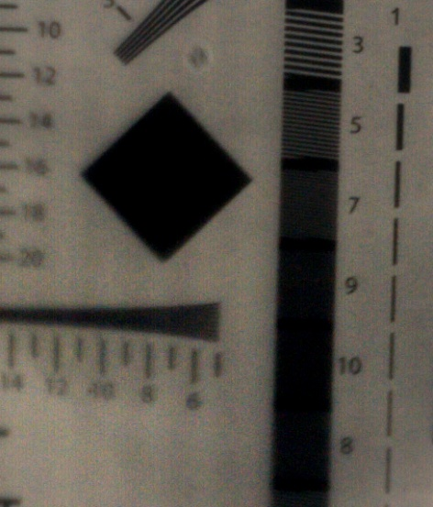
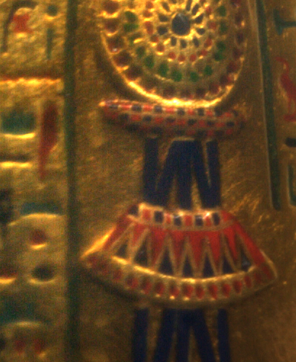
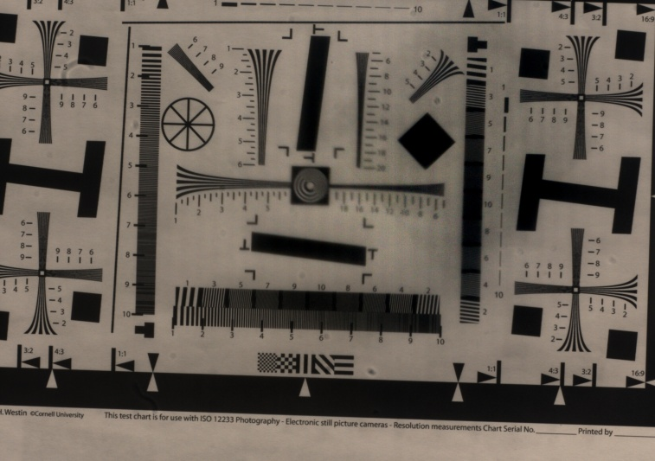
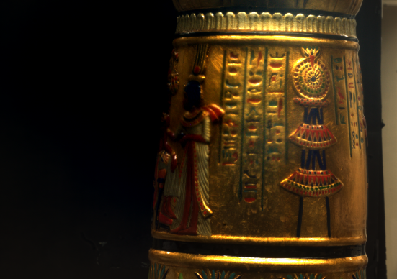
Method 1: Experimental Results
Captured
I(x)
Recovered
I₀(x)

Slide 22
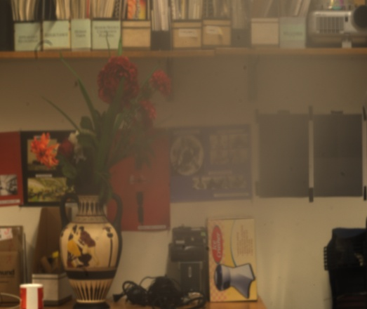
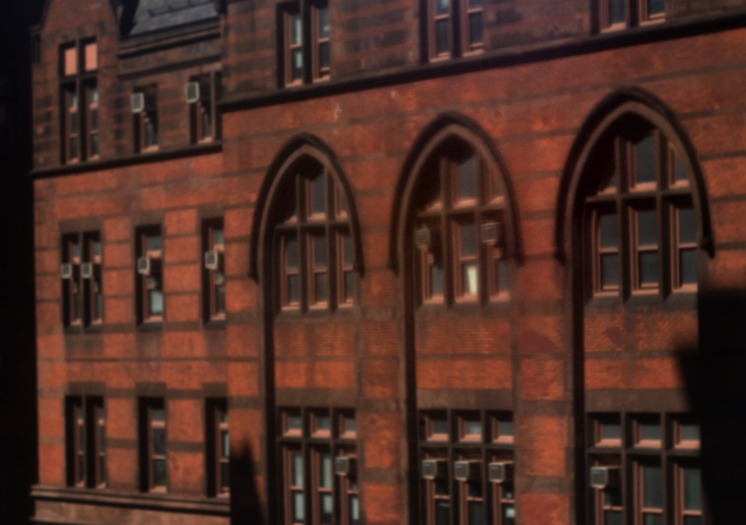
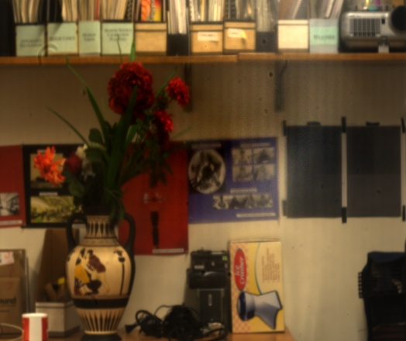
Method 1: Experimental Results
Captured
I(x)
Recovered
I₀(x)

Slide 23
Method 2: Removal from Video
Estimate a(x) and b(x) from multiple images taken with the same dirty lens camera.
Prior: the average of (lots of) natural images should be a smoothly-varying image.
[Burton and Moorhead, 1987]
[Torralba et al., 2008]
[Kuthirummal et al., 2008]
Average of a set
of natural images
Video taken with
a dirty lens camera

Slide 24
Method 2: Removal from Video
Estimate a(x) and b(x) from multiple images taken with the same dirty lens camera.
Prior: the average of (lots of) natural images should be a smoothly-varying image.
[Burton and Moorhead, 1987]
[Torralba et al., 2008]
[Kuthirummal et al., 2008]
Average of a set
of natural images
Average of the images taken with
a dirty lens camera

Slide 25
Method 2: Removal from Video
Fitting
Fitting

Slide 26
Method 2: Removal from Video
Attenuation Map: a(x)
Scattering Map: b(x)

Slide 27
Method 2: Experimental Results
Input video
Output video

Slide 28
Method 2: Experimental Results
Input video
Output video

Slide 29
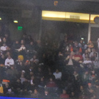
Thin-Occluder Artifact
Compared to dirty-lens artifact:
Different Physical Phenomena
Attenuation ➔ occlusion
Scattering ➔ reflection of the occluder
Less Controllability
Impractical to calibrate (e.g., fences, tree branches)
Occlusion patterns are not guaranteed to be fixed across multiple captured images.

Slide 30
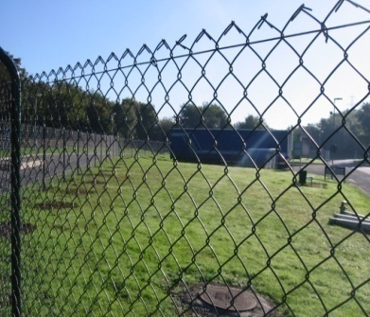
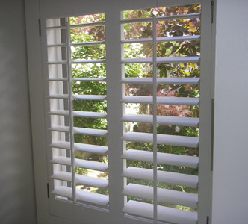
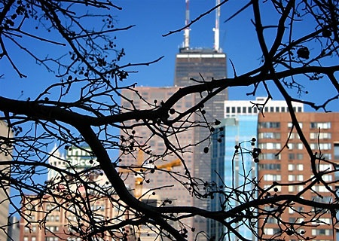
Thin-Occluder Artifact: Model Simplification
Captured
Image
Clean
Image
Occlusion
Pattern
Occluder’s
Brightness
Defocus
Blur kernel
Assume the occluder itself has a uniform brightness
Occluder Brightness
Fences
Window Shutter
Tree Branches

Slide 31
Thin-Occluder Artifact: Model Simplification
Captured
Image
Clean
Image
Occlusion
Pattern
Occluder’s
Brightness
Defocus
Blur kernel
Assume the occluder itself has a uniform brightness
Occluder Brightness
The simplified model

Slide 32
Removal from Multiple Apertures
Recover I₀(x) and a(x) from multiple images taken with different aperture sizes: (assume the scene is in focus)
the i-th captured image
the corresponding
defocus blur kernel

Slide 33
Removal from Multiple Apertures
Recover I₀(x) and a(x) from multiple images taken with different aperture sizes: (assume the scene is in focus)
If the depths are known, M>=2. In general, M>=3.
An iterative algorithm
…

Slide 34
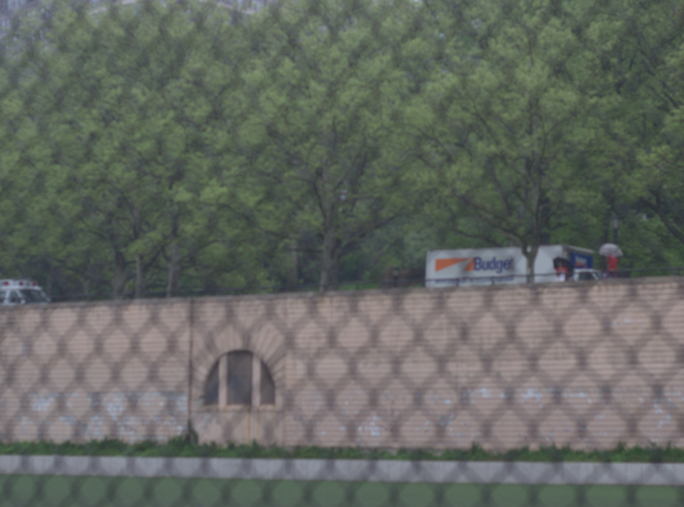
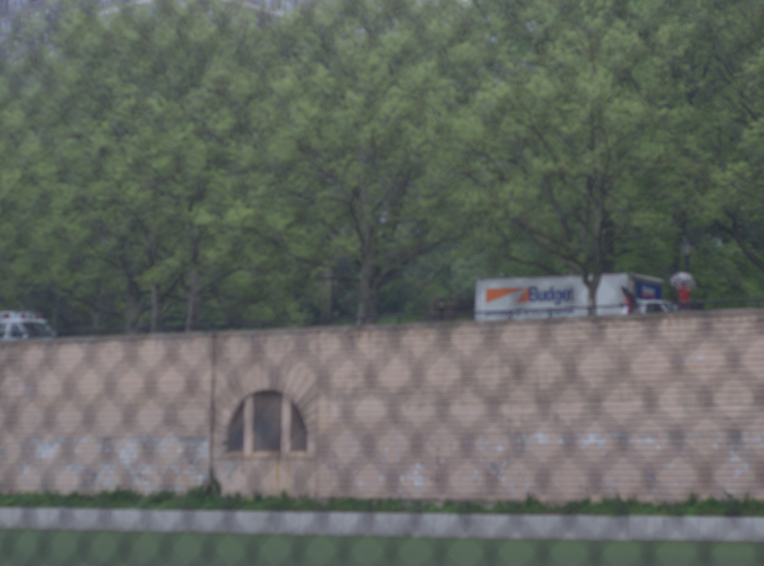
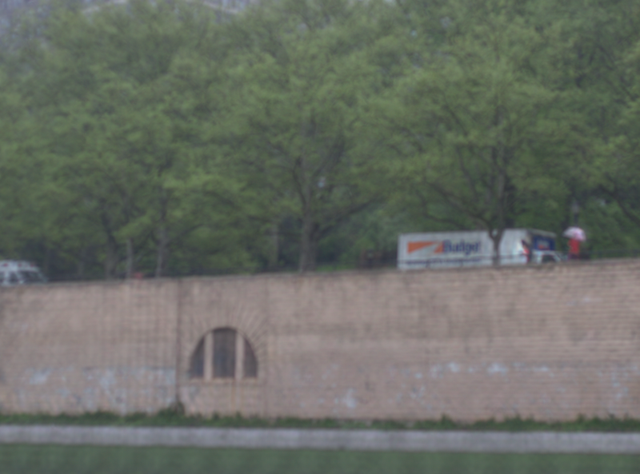
Experimental Results: Known Depth
Input Image 1 (f/4.5)
Input Image 2 (f/3.2)
Recovered Image I₀(x)
Recovered Pattern a(x)

Slide 35
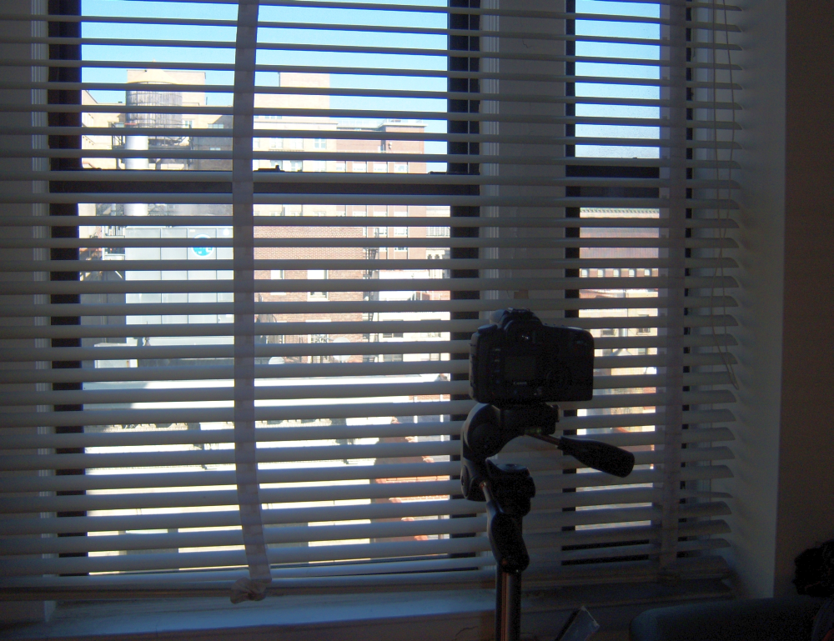
Experimental Results: Unknown Depth
Window Blinds
Camera
Scene Setup

Slide 36
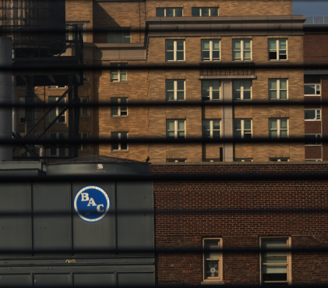
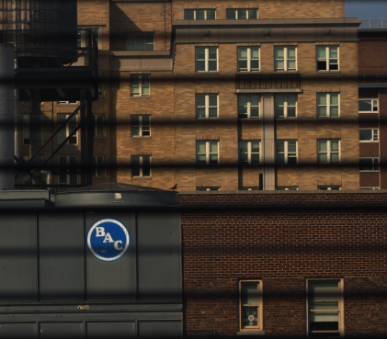
Experimental Results: Unknown Depth
Captured
Images
Recovered Image I₀ over iterations
I₁ (f/5.6)
I₂ (f/4)
I₃ (f/2.8)

Slide 37
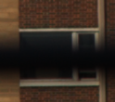
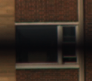
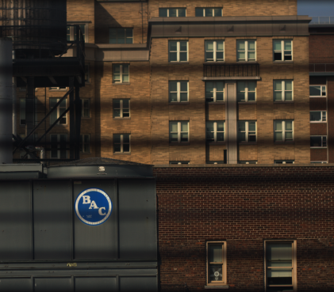
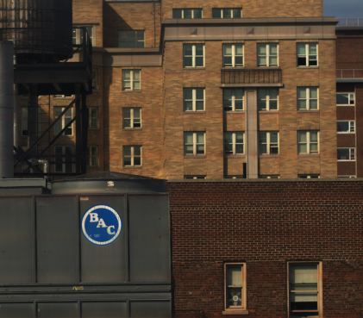
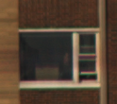
Experimental Results: Unknown Depth
I₁ (f/5.6)
I₂ (f/4)
I₃ (f/2.8)
Recovered Image I₀

Slide 38
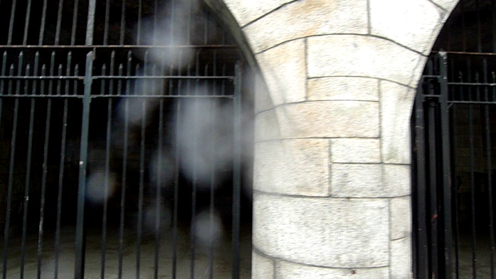
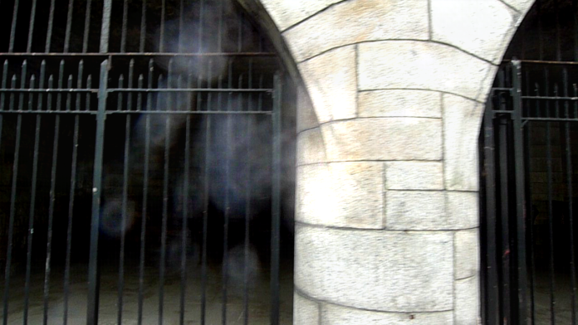
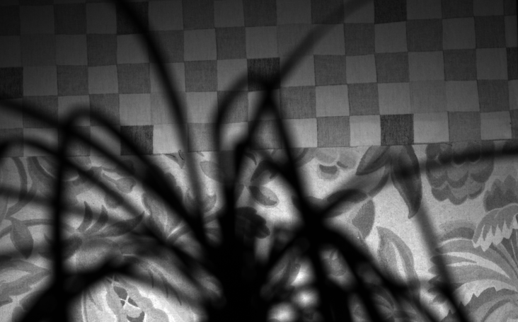
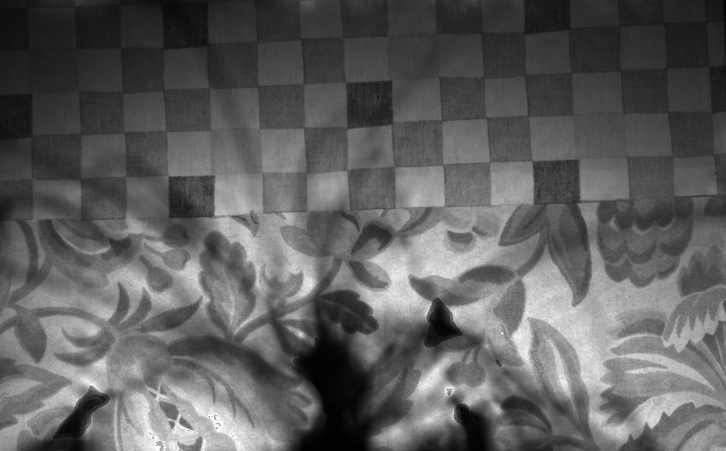
Limitations
Lens glare
Captured image
Recovered image
Thick occluders
Captured image
Recovered image

Slide 39
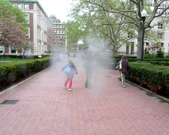
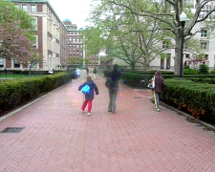
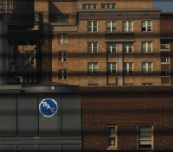
Summary
A physically-based model for two artifacts:
Attenuation + Scattering
Fully automatic methods for artifact removal
With Calibration
(>=2 images)
Single Image
Dirty lens
Artifact
No Calibration
Video
Thin Occluder
Artifact
Known Depths
>=2 images
Unknown Depths
>=3 images
Future work:
Single image methods using additional image priors.

Slide 40
Acknowledgement
Changyin Zhou,Oliver Cossairt, Neeraj Kumar, Alex Berg, Sujit Kuthirummal for helpful discussions.
Anonymous reviewers for valuable comments and suggestions.
NSF, ONR, Sloan Fellowship for the funding support.

Slide 41
Removing Image Artifacts Due to Dirty Camera Lenses and Thin Occluders
Jinwei Gu ¹, Ravi Ramamoorthi ²,
Peter Belhumeur ¹, Shree Nayar ¹
¹ Columbia University
² University of California at Berkeley
December 18, 2009

Slide 43
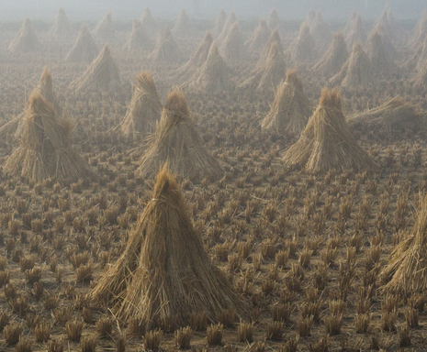
Dirty-lens Artifact vs. Hazy Image
Dirty Lens Artifact
A Hazy Image
Notes:
In term of phenomena, hazy image only includes scattering, and more uniform spatially.
Dirty-lens artifact has more spatial texture, and include both attenuation and scattering.

Slide 44
Our Methods vs. Dehazing Methods
Model for dirty-lens artifact:
Model widely used for hazy image:
where

Slide 45
Validation of Model Simplification
Separate attenuation and intensification, since the intensification term is assumed to be a global effect.
[Nayar et al., 2006]
Illumination
Dirt/dust
Sensor

Slide 46
Validation of Model Simplification
Separate attenuation and intensification, since the intensification term is assumed to be a global effect.
[Nayar et al., 2006]
Illumination
Dirt/dust
Sensor

Slide 47
Validation of Model Simplification
Separate attenuation and intensification, since the intensification term is assumed to be a global effect.
[Nayar et al., 2006]
2x
Illumination
Dirt/dust
Sensor

Slide 48
Validation of Model Simplification
Separate attenuation and intensification, since the intensification term is assumed to be a global effect.
[Nayar et al., 2006]
Input Images
(Zoom 20x)

Slide 49
Validation of Model Simplification
Separate attenuation and intensification, since the intensification term is assumed to be a global effect.
[Nayar et al., 2006]
=
Input Images
Percentage Error < 0.6%
Therefore, we have verified:

Slide 50
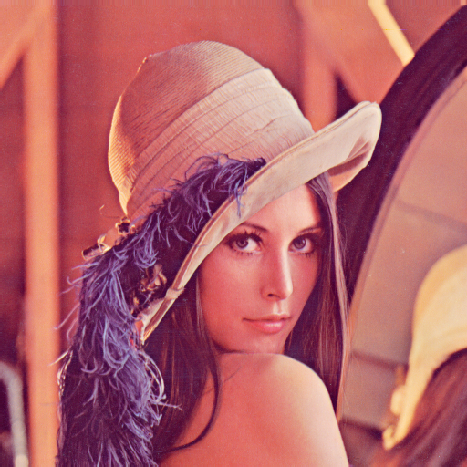
Simulation Results for Estimating c
Recovered Image
Input Image
Percentage Error < 0.44%

Slide 51
Method 2: Polynomial Fitting
Iterative fitting in a “RANSAC” fashion: use only inliers for the next iteration
Inliers over iterations
Notes:
Explain more about how to estimate the dirty region, using a RANSAC like algorithm

Slide 52
Method 2: Polynomial Fitting
Iterative fitting in a “RANSAC” fashion: use only inliers for the next iteration
Notes:
Explain more about how to estimate the dirty region, using a RANSAC like algorithm

Slide 53
Method 2: Why Average of Gradient?
Image Formation Model
Gradient
Because of camera defocus, a(x) and b(x) are smoothly varying
So, the gradient is (approximately) only related to attenuation
Notes:
Explain more about how to estimate the dirty region, using a RANSAC like algorithm

Slide 54
Thin-Occluder Artifact: Iterative Algorithm
Requires two images taken with different apertures,
Iterative algorithm solves for I₀ and a from I₁ and I₂:
where we define:
and

Slide 55
Artifact Removal with Known Depths
Experimental results:
I₁ (f-num 5.6)
k₁
I₂ (f-num 2.8)
k₂
Input Images

Slide 56
Artifact Removal with Known Depths
Experimental results:
Recovered Image
Recovered Pattern
Output over Iterations

Slide 57
Aperture Settings
Rules of Thumb:

