Slide 1
Coded Rolling Shutter Photography:
Flexible Space-Time Sampling
Jinwei Gu
Yasunobo Hitomi
Tomoo Mitsunaga
Shree Nayar
Columbia University
Sony Corporation
Sony Corporation
Columbia University
ICCP 2010
March 30, 2010

Slide 2

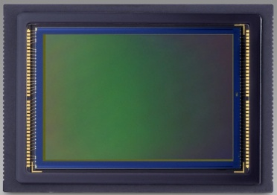

The Revival of CMOS Image Sensors
Rapidly overtaking CCD image sensors
…
CMOS Image Sensor

Slide 3
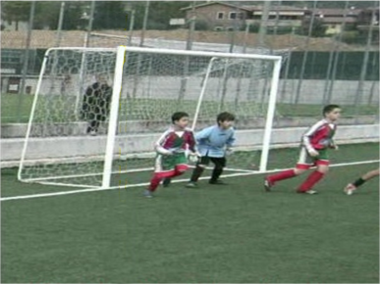
Rolling Shutter of CMOS Image Sensors
Rows are exposed & readout from top to bottom
Used in almost all consumer CMOS image sensors
No frame buffer → Low cost, high fill factor, good SNR
Readout
Skew
Image Rows
Exposure
Photo courtesy http://www.dvxuser.com
Rolling Shutter
Time
Notes:
Emphasize “sequentially”

Slide 4
Camera Shutter: Space-Time Sampling
Image Rows
Time
Rolling Shutter (CMOS)
[Liang et al., 08]
[Bradley et al., 09]
[Geyer et al., 05]
[Ait-Aider et al., 06]
Notes:
In script, emphasize it is a 2-D shutter function

Slide 5
Camera Shutter: Space-Time Sampling
1-D
1-D
Image Rows
Image Rows
Time
Time
Rolling Shutter (CMOS)
Global Shutter (CCD)
2-D
1-D
Image Rows
Image Rows
Time
Time
Coded Rolling Shutter
Flutter Shutter
[Raskar et al., 06]
Notes:
In script, emphasize it is a 2-D shutter function

Slide 6
A Closer Look at CMOS Image Sensor
CMOS Image Sensor

Slide 7
Conventional Rolling Shutter
Image Rows
Time
Sequentially addressing rows from top to bottom.

Slide 8
Conventional Rolling Shutter
Exposure
Image Rows
Time
Sequentially addressing rows from top to bottom.

Slide 9
Conventional Rolling Shutter
Exposure
Readout
Image Rows
Time
Sequentially addressing rows from top to bottom.

Slide 10
Conventional Rolling Shutter
Exposure
Readout
Image Rows
Time
Readout timing for different rows cannot overlap.
Sequentially addressing rows from top to bottom.

Slide 11
Coded Rolling Shutter: Low Cost
Image Rows
Time
Coded START
Coded STOP
Only require modifying the Address Generator
Programmable Address Generator can be designed.
Notes:
mention it clearly that Address Generator send both start and stop signal.
To well understanding that CRSP can be realized just by modify Address Generator.

Slide 12
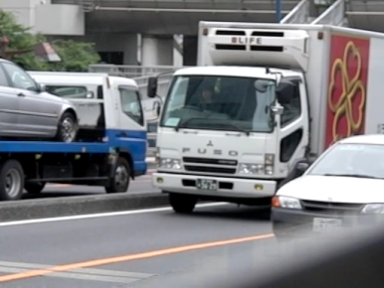
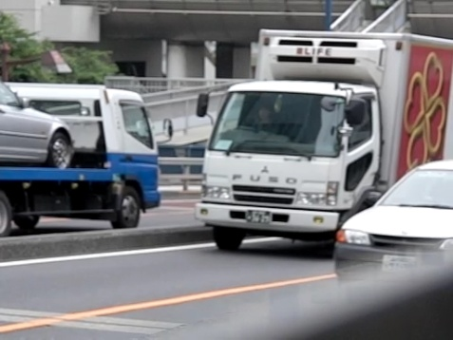
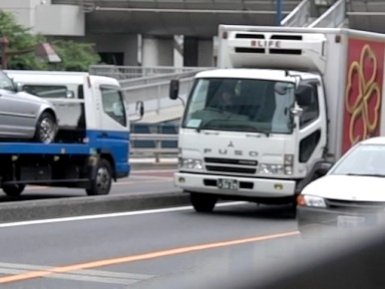
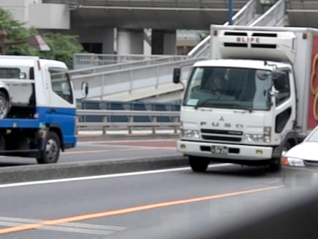
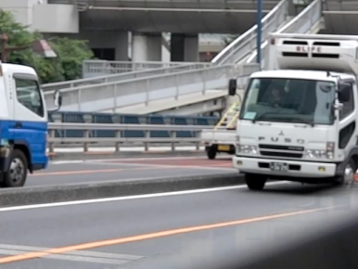
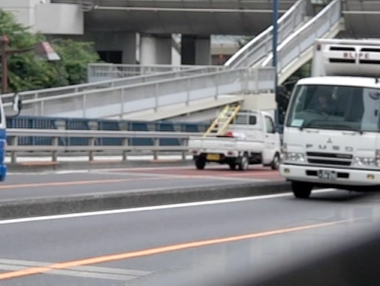
Emulation of Coded Rolling Shutter
Capture space-time volumes with high-speed cameras
Simulate images taken with Coded Rolling Shutter
Image Rows
Image Rows
Time
Time
Captured Video
Coded Exposure
Emulated
Coded Image
(Casio EX-F1, 300fps, 512x384)

Slide 13
Readout Timing: The Assignment Problem
readout time per row
(e.g. 15~40 µs)
Image Rows
Time
(one frame time)
A constraint for all coding schemes:
and
where

Slide 14
Coded Rolling Shutter Photography
Coded Readout Timing
High Speed Photography
Optical Flow & Its Applications

Slide 15
High-Speed Photography
Tradeoff vertical resolution for temporal resolution
Conventional Rolling Shutter
Skew:
Time Lag:
Image
Rows
(readout time per row)
Time

Slide 16
High-Speed Photography
Tradeoff vertical resolution for temporal resolution
Interlaced Readout: higher frame rate & less skew
Interlaced Readout
Skew:
Time Lag:
Image
Rows
(readout time per row)
Time

Slide 17
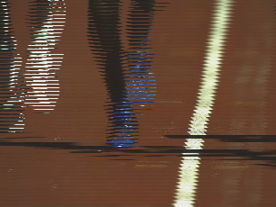
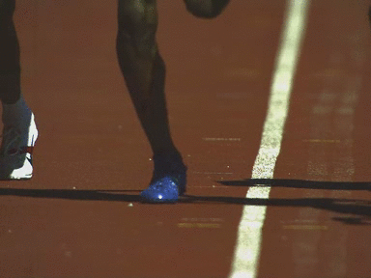
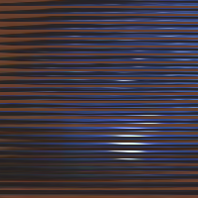
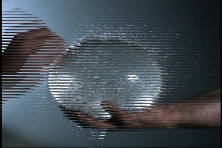
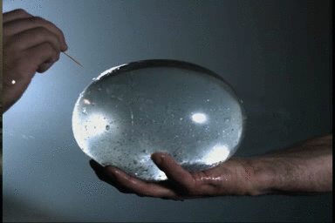
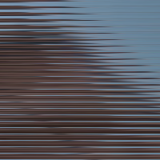
Interlaced Readout: Results
Input: coded image (3072x2048)
Output (384 x 256 x 8 frames)
Input: coded image (3072x2048)
Output (384 x 256 x 8 frames)
Source video courtesy: http://www.visionresearch.com. Phantom V7.1 Camera. 600fps.

Slide 18
High-Speed Photography
Tradeoff vertical resolution for temporal resolution
Conventional Rolling Shutter
Skew:
Time Lag:
Image
Rows
(readout time per row)
Time

Slide 19
High-Speed Photography
Tradeoff vertical resolution for temporal resolution
Staggered Readout: very short time lag (e.g.,15~40 µs)
Staggered Readout
Skew:
Time Lag:
Image
Rows
(readout time per row)
Time

Slide 20
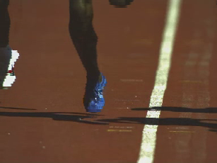

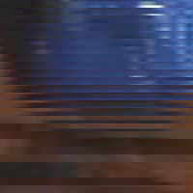
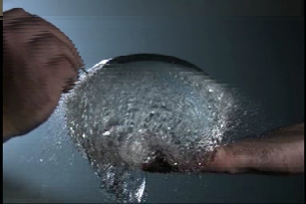
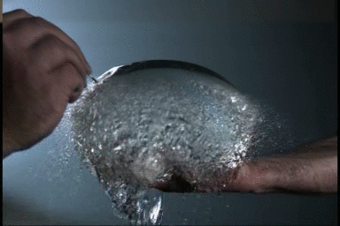

Staggered Readout: Results
Input: coded image (3072x2048)
Output (384 x 256 x 8 frames)
Input: coded image (3072x2048)
Output (384 x 256 x 8 frames)
Source video courtesy: http://www.visionresearch.com. Phantom V7.1 Camera. 600fps.

Slide 21
Optical Flow and Its Applications
Image
Rows
Time
Sub-image 1
Sub-image 2
1. Motion Interpolation

Slide 22
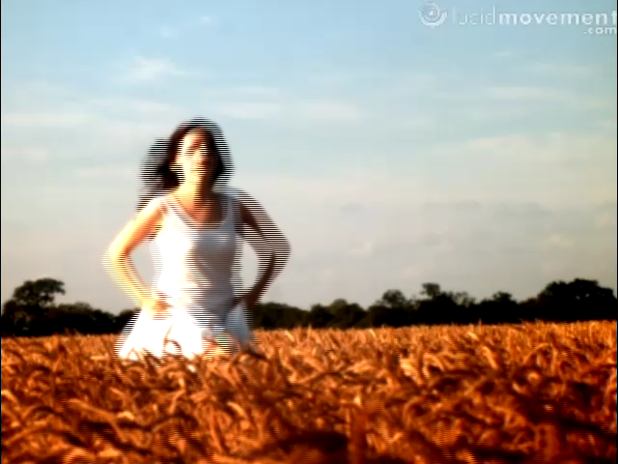
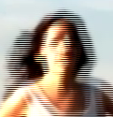
Optical Flow and Its Applications
Image
Rows
Time
Sub-image 1
Sub-image 2
1. Motion Interpolation
Input: Coded Image (640x480)
Source video courtesy: http://www.lucidmovement.com. SVSi, GigaView Camera. 532fps.

Slide 23
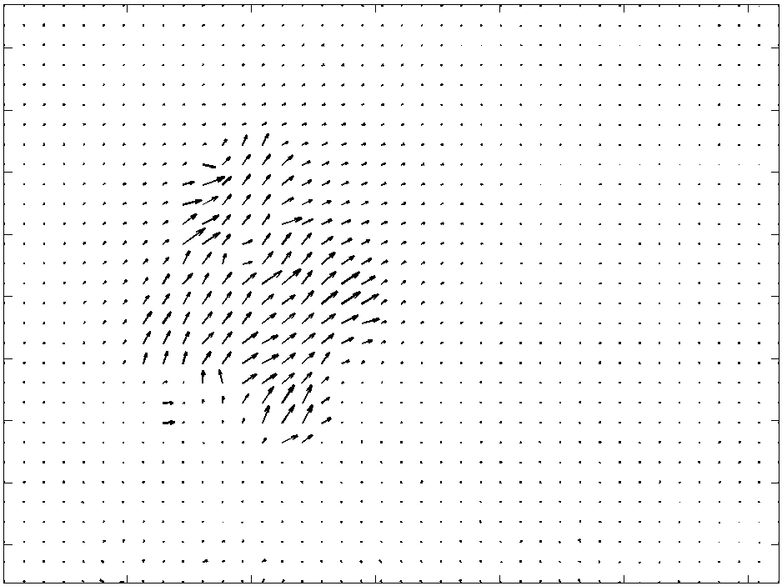
Optical Flow and Its Applications
Image
Rows
Time
Sub-image 1
Sub-image 2
1. Motion Interpolation
Estimated Optical Flow

Slide 24
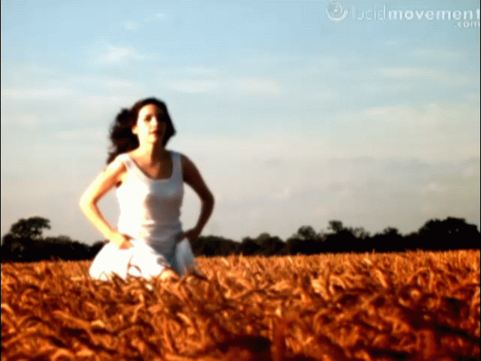
Optical Flow and Its Applications
Image
Rows
Time
Sub-image 1
Sub-image 2
1. Motion Interpolation
Output: Interpolated Video (640x480x100)

Slide 25
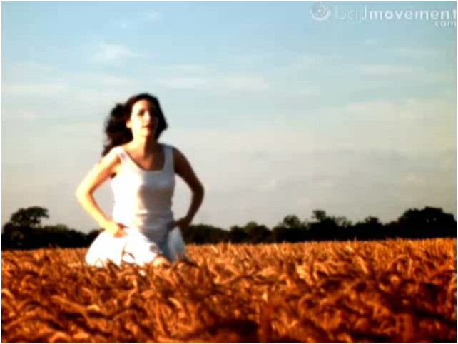
Optical Flow and Its Applications
Image
Rows
Time
Sub-image 1
Sub-image 2
1. Motion Interpolation
2.Skew Compensation

Slide 26
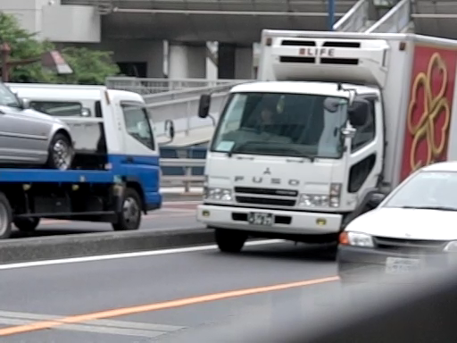
Optical Flow and Its Applications
Image
Rows
Time
Sub-image 1
Sub-image 2
1. Motion Interpolation
2.Skew Compensation
Conventional Rolling Shutter (512x384)
(Casio EX-F1. 300fps)

Slide 27
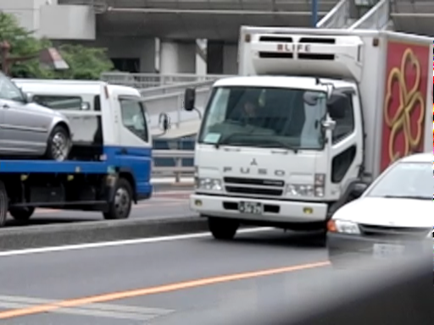
Optical Flow and Its Applications
Image
Rows
Time
Sub-image 1
Sub-image 2
1. Motion Interpolation
2.Skew Compensation
Output: Skew-free Image (512x384)

Slide 28
Optical Flow and Its Applications
Image
Rows
Time
Sub-image 1
Sub-image 2
1. Motion Interpolation
2.Skew Compensation
3. Motion Deblurring

Slide 29
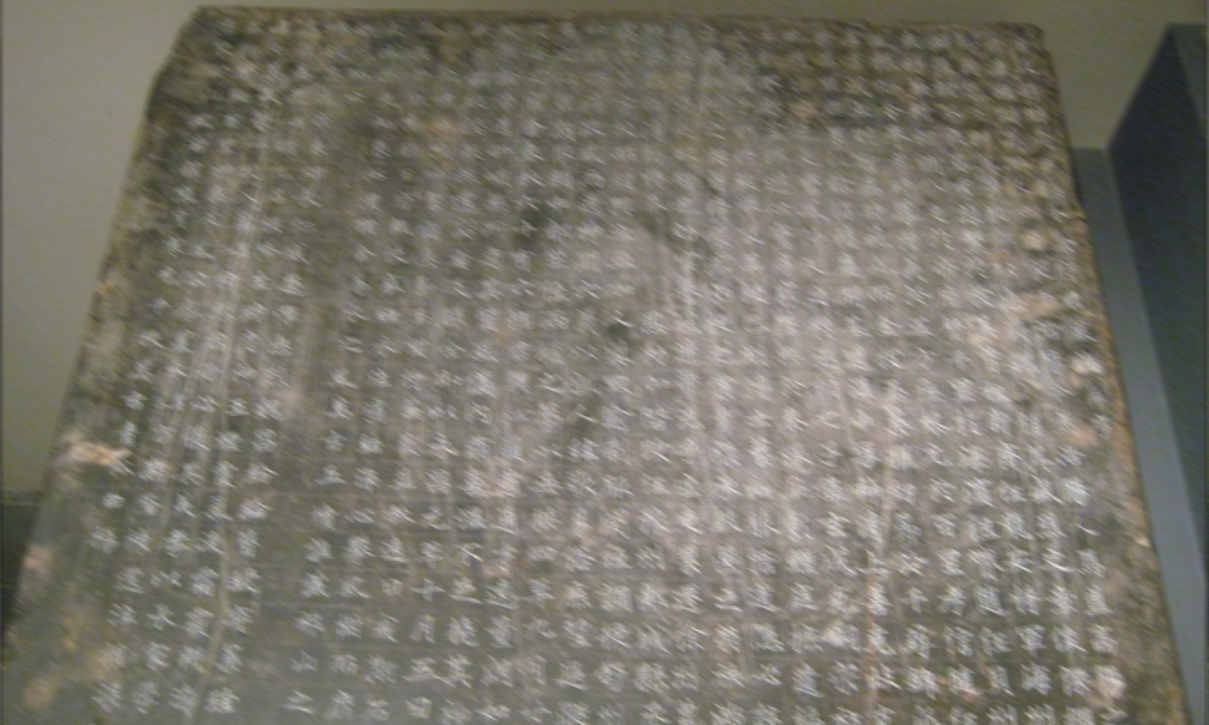
Optical Flow and Its Applications
Image
Rows
Time
Sub-image 1
Sub-image 2
1. Motion Interpolation
2.Skew Compensation
Removal Camera Shake
Input: Coded Image (1024x600)

Slide 30

Optical Flow and Its Applications
Image
Rows
rows
Time
Sub-image 1
Sub-image 2
time
Sub-image 1
Sub-image 2
Removal of motion blur
due to camera shake
1. Motion Interpolation
2.Skew Compensation
Output: Deblurred Image (1024x600)

Slide 31
Coded Rolling Shutter Photography
Coded Readout Timing
High Speed Photography
Optical Flow & Its Applications
Coded Exposure Length
Row-wise Adaptive Exposure

Slide 32
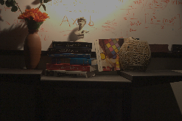
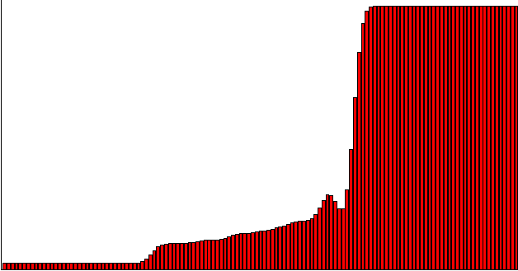
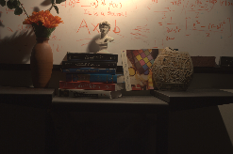
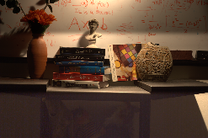
Row-wise Adaptive Exposure
Exposure
Image Rows
Row-wise
Exposure
1st shot (Conventional AE)
Output Image
2nd shot (Coded Image)

Slide 33
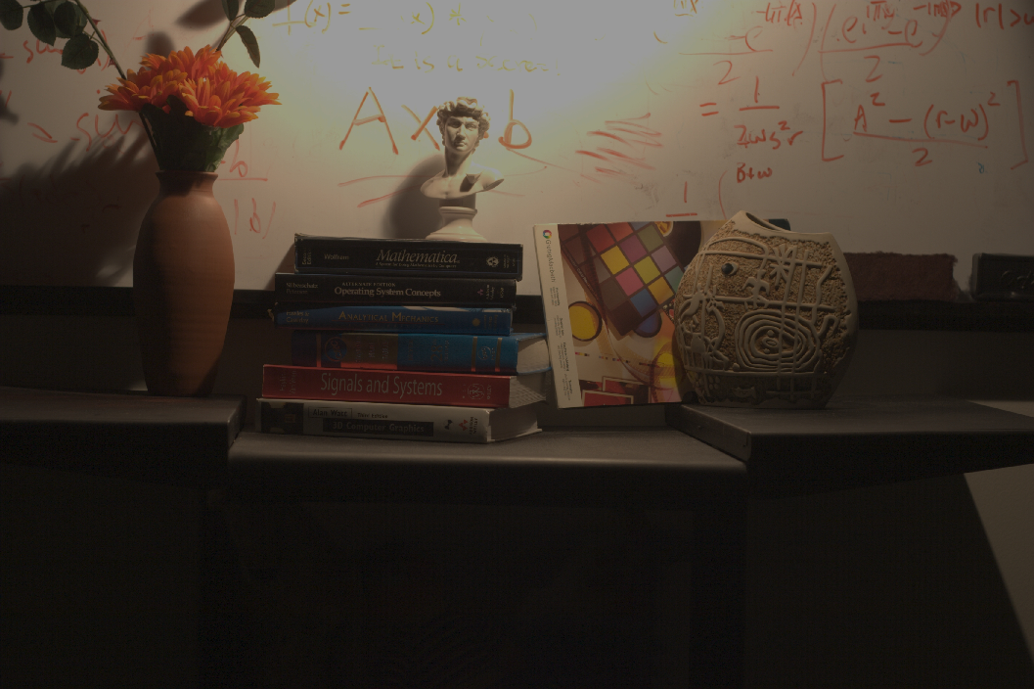
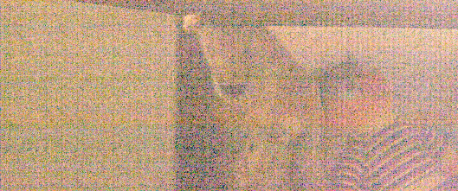
Row-wise Adaptive Exposure: Results
Saturation
300% Gain
Noise
Conventional Auto-Exposure
(Canon EOS 20D. ISO 100. 1.6 seconds. f/9)

Slide 34

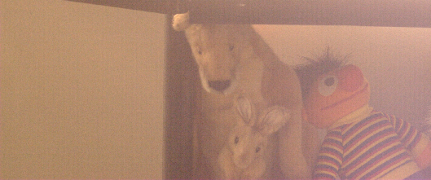
Row-wise Adaptive Exposure: Results
300% Gain
Output: Row-wise Adaptive Exposure

Slide 35
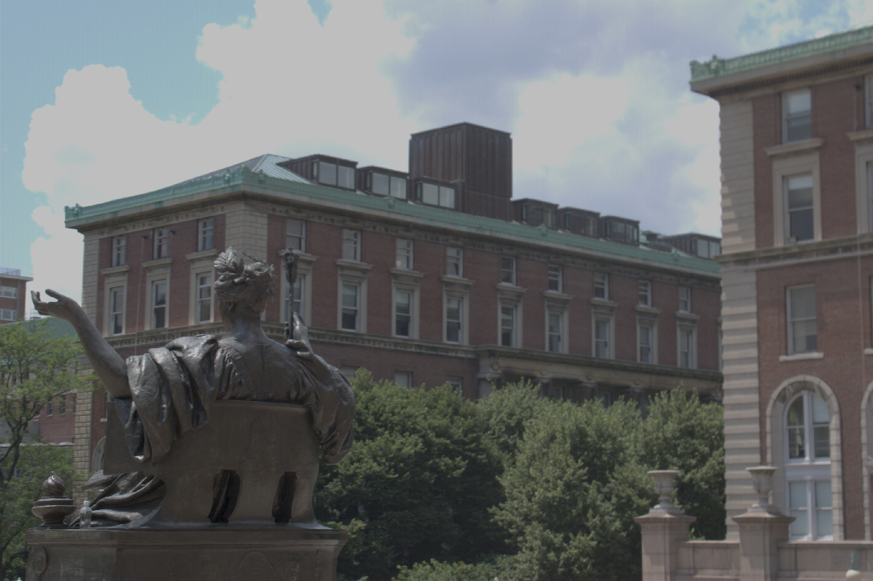
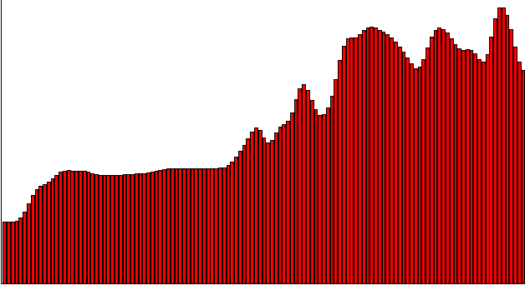

Row-wise Adaptive Exposure: Results
Exposure
Saturation
Noise
200%
Gain
Conventional Auto-Exposure
(Canon EOS 20D. ISO 100. 1/100 second. f/9)

Slide 36
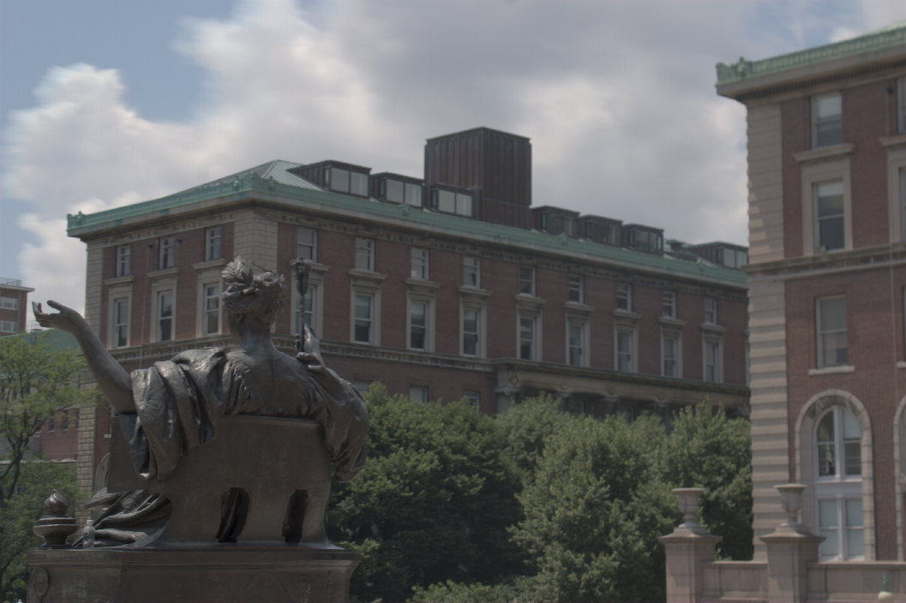

Row-wise Adaptive Exposure: Results
200%
Gain
Output: Row-wise Adaptive Exposure

Slide 37
Coded Rolling Shutter Photography
Coded Readout Timing
High Speed Photography
Optical Flow & Its Applications
Coded Exposure Length
Row-wise Adaptive Exposure
Coded Readout Timing & Exposure Length
High Dynamic Range Imaging with Hand-held Cameras

Slide 38
HDR Imaging with Hand-held Cameras
Embed multiple exposures & timings in a single shot
Assume camera shake is a translational motion
Conventional Rolling Shutter
Image
Rows
Time

Slide 39
HDR Imaging with Hand-held Cameras
Embed multiple exposures & timings in a single shot
Exposure ratios: extend dynamic range vs. motion
Coded Rolling Shutter
8T
2T
1T
Image
Rows
Time

Slide 40
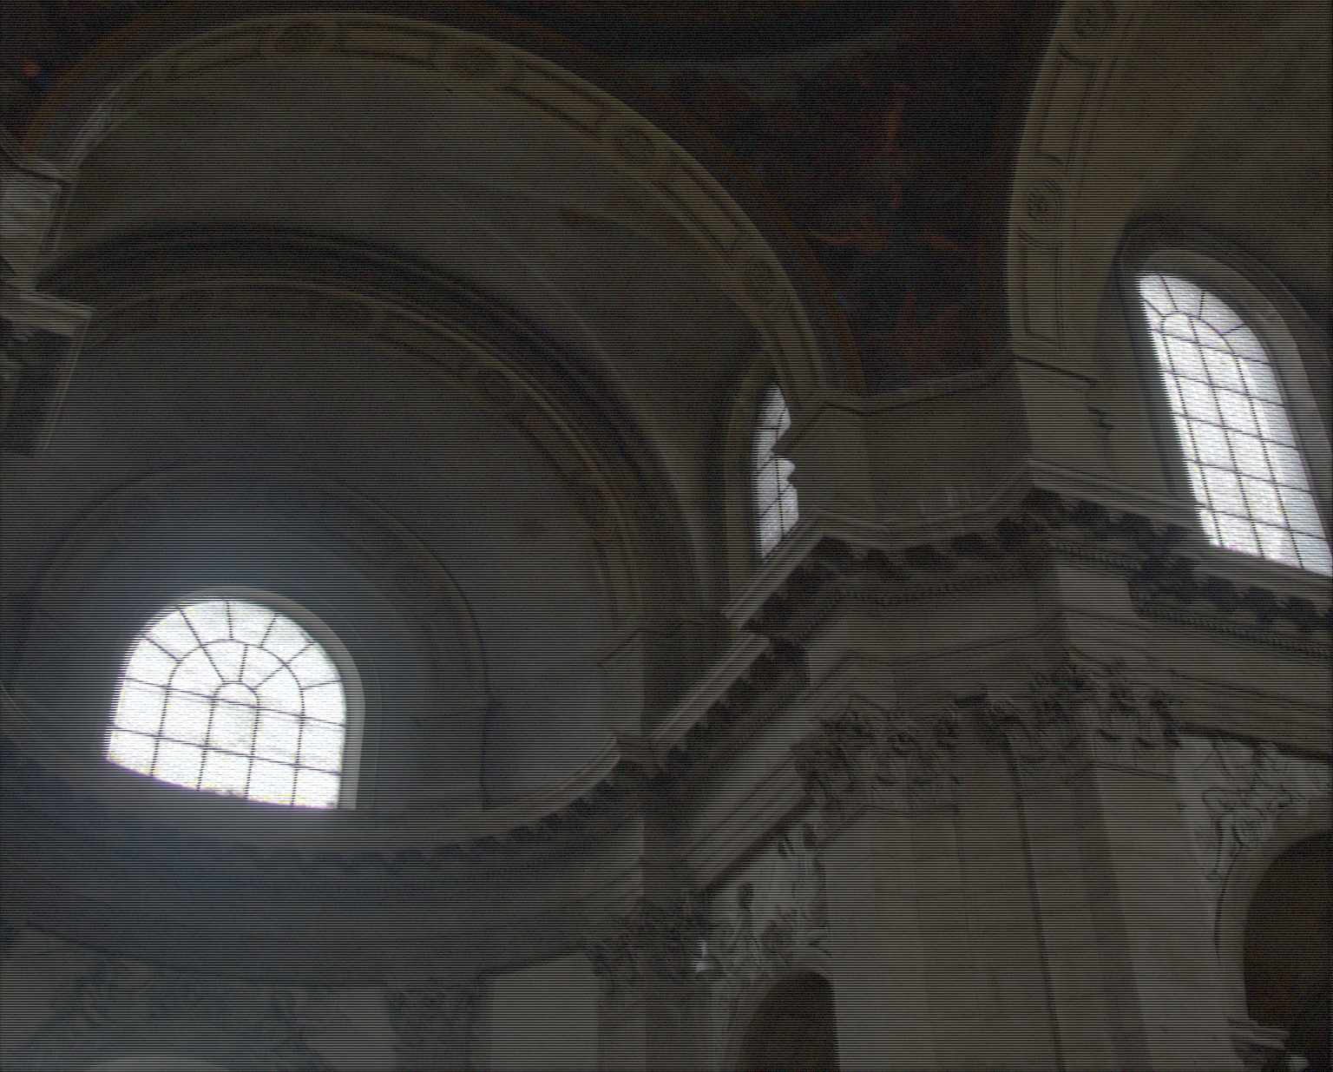
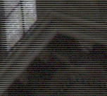
An Example
Input: Coded Image
Source HDR photo courtesy Rafal Mantiuk. http://pfstools.sf.net

Slide 41
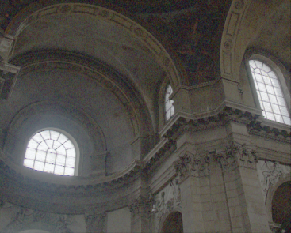
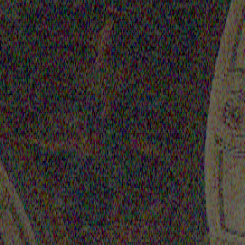
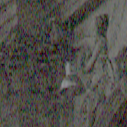
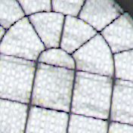
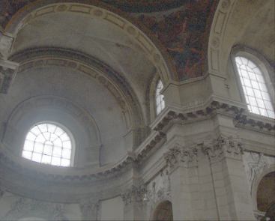
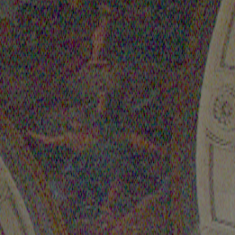
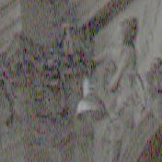
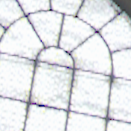
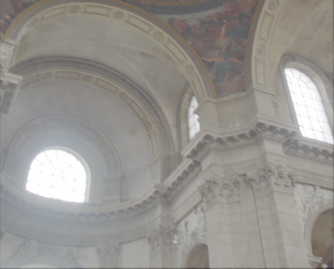
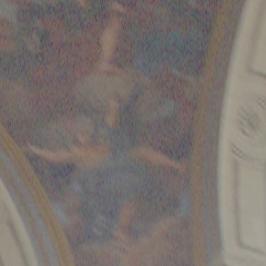
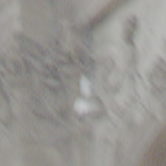
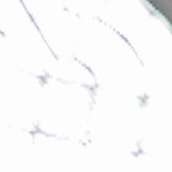
Interpolated Images with Three Exposures
Noisy
1T
Noise &
Motion Blur
2T
Saturation &
Motion Blur
8T

Slide 42


The Algorithm
Motion
Estimation
1T
Image
Deblurring
2T
Combine
Output:
8T
Exposure
Blur
Kernel
Noise

Slide 43


Combined Images are Better for Deblurring
Blur kernels are better conditioned.
1.0
1.0
Power
Spectrum
Of
Kernels
0
0
0
0
Frequency

Slide 44


Combined Images are Better for Deblurring
Blur kernels are better conditioned.
Aliasing due to interpolation can be suppressed.
1.0
1.0
Power
Spectrum
Of
Aliasing
0
0
0
0
Frequency
Assume

Slide 45



Interpolated Sub-images from the Input
1T
2T
8T
Three Interpolated Sub-images

Slide 46

Output: Recovered HDR Image
Output: HDR Image

Slide 47






Comparison Results
1T
2T
8T
Output HDR

Slide 48



Interpolated Sub-images from the Input
1T
2T
8T
Three Interpolated Sub-images
Source HDR photo courtesy Rafal Mantiuk. http://pfstools.sf.net

Slide 49

Output: Recovered HDR Image
Output: HDR Image

Slide 50












Comparison Results
1T
2T
8T
Output HDR

Slide 51









Coded Rolling Shutter Photography
Controls of rolling shutter provide flexibility for space-time sampling
Coded Readout: Better Sampling of Temporal Info
Coded Exposure: Better Sampling of Brightness Range
Low cost to implement

Slide 52
Future Work
Random Coding & Sparse Reconstruction
Image Rows
Time
Exposure Control: Row-wise (2D) → Pixel-wise (3D)

Slide 53
Coded Rolling Shutter Photography:
Flexible Space-Time Sampling
Jinwei Gu
Yasunobo Hitomi
Tomoo Mitsunaga
Shree Nayar
Columbia University
Sony Corporation
Sony Corporation
Columbia University
ICCP 2010
March 30, 2010

Slide 55
Performance: Noise
Averaged Normalized Root Mean Square Error between the recovered HDR and the original scene
Methods | Gaussian Additive Noise (σ)
 | 0.0005 | 0.001 | 0.002 | 0.005 | 0.01 | 0.02 | 0.05
I₁ / Δt_{e1} | 0.0184 | 0.0201 | 0.0250 | 0.0417 | 0.0641 | 0.0962 | 0.1579
I₂ / Δt_{e2} | 0.0224 | 0.0226 | 0.0235 | 0.0280 | 0.0375 | 0.0550 | 0.0940
I₃ / Δt_{e3} | 0.0644 | 0.0644 | 0.0644 | 0.0645 | 0.0650 | 0.0666 | 0.0739
I_{r} | 0.0176 | 0.0178 | 0.0183 | 0.0205 | 0.0255 | 0.0373 | 0.0736

Slide 56

Row-wise Adaptive Exposure
Exposure
Image Rows
Input: Row-wise Adaptive Exposure

Slide 57
Aliasing Due to Vertical Interpolation
Optical Blur
De-interlacing using Multiple frames
Transfer details from the horizontal dimension

Slide 58


Single-Shot Skew-free Video
Time
Image Rows
Coding Pattern
Input: Coded Image (512x384)
M=512, K=5

Slide 59


Single Shot Skew-free Video
Conventional Rolling Shutter
(512x384)
Output: Skew-free Video
(512 x 384 x 40 frames)

