Slide 1
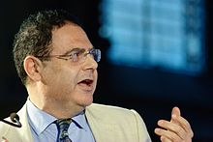
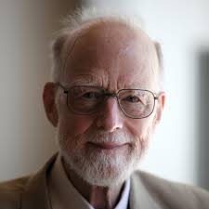
E6998: Formal Methods on Android Instructor: Professor Aho Student: Suzanna Schmeelk October 2014
Bertrand Meyers
C. A. R. Hoare
Suzanna Schmeelk
October 27, 2014
Android 4.4 KitKat

Slide 2
Outline
Formal Methods Objectives
Verification and Validation
Formal Method Techniques
Approaches
Hoare
Bertrand Meyers
Google’s Android Applications
History
Language – Java
App Lifecycle
Formal Methods in Java
Where are we with Android and Formal Methods?

Slide 3
Formal Methods Objectives
Definition:
Techniques used to model complex systems as mathematics entities
By building a mathematically rigorous model of a complex system, it is possible to verify the system’s properties in a more thorough fashion than empirical testing.
Usage:
High-fidelity systems
NASA, Boeing, Air Traffic Control, Finance, Hospitals, Defense
Notes:
1. Formal Methods. Carnegie Mellon University. Michael Collins. http://users.ece.cmu.edu/~koopman/des_s99/formal_methods/

Slide 4
Validation and Verification
Validation:
Testing (Software Test Plan, Test Coverage Map,…)¹
Formal Methods³
Fault Injection³
{Risk, Hazard, Dependability} Analysis ³
Dynamic Testing Tools¹
Verification:
Formal Methods: Prove or disprove the correctness of a system with respect to the formal specification or property²
Two well-known techniques – Model Checking and Theorem Proving
Testing (Software Test Plan, Test Coverage Map,…) ³
Dynamic Testing Tools³
Notes:
1. Schulmeyer & Mackenzie. Verification and Validation of modern software-intensive systems.
2. Cac Phuong Phap Hinh Thuc & Cho Phat Trien Phan Mem: Introduction to Formal Methods
3. Formal Methods. Carnegie Mellon University. Michael Collins. http://users.ece.cmu.edu/~koopman/des_s99/formal_methods/

Slide 5
Program correctness: Need to know what to prove
Different “tests” reveal different answers.
Correctness problem is Undecidable problem
In computability theory and computational complexity theory, an undecidable problem is a decision problem (yes-or-no answer on infinite inputs) for which it is known to be impossible to construct a single algorithm that always leads to a correct yes-or-no answer¹
Need forms of approximation ….
Approximation forms are typically broken-down into 3 main sub-groups: Abstract Interpretation, Theorem Proving and Model Checking
Notes:
1. http://en.wikipedia.org/wiki/Undecidable_problem

Slide 6
Ways to examine program correctness via Intermediate Representations:
Abstract Interpretation (Coverity, Julia, Klocwork):
Symbolic execution
Decision Tables
Border-line Informal Methods
Theorem Proving (Simplify, KeY, ACL2):
Finding a logical proof from the axioms of the system
System and properties expressed in some mathematical logic
Infinite space, reduction,
Syntactic domain²
Model Checking (Spin, BLAST, 50 on Wikipedia):
Build finite model of system and perform an exhaustive search
Finite State Machines, Temporal Logic
State-Space Explosion Problem
Example (book). Bowing International Space Station Software Static properties—disjointness and coverage. Dynamic properties—safety, liveness, timing, fault-states using SPIN.
Semantic domain²
Notes:
Schulmeyer & Mackenzie. Verification and Validation of modern software-intensive systems.
Manuel Carro. Technical University of Madrid. A Short Introduction to Formal Methods.
http://en.wikipedia.org/wiki/List_of_model_checking_tools
http://en.wikipedia.org/wiki/Automated_theorem_proving

Slide 7
Theorem Proving Proofs
Simple Inference Rule for an If Statement ¹
Cornell example: Proof of the proposition (A ⇒ B ⇒ C) ⇒ (A ∧ B ⇒ C).²
Notes:
1. http://webdocs.cs.ualberta.ca/~piotr/Courses/662/Reading/ESL-TIK-00214.pdf
2. http://www.cs.cornell.edu/courses/cs3110/2011sp/lectures/lec13-logic/logic.htm

Slide 8
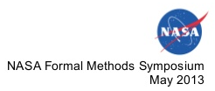

Slide 9
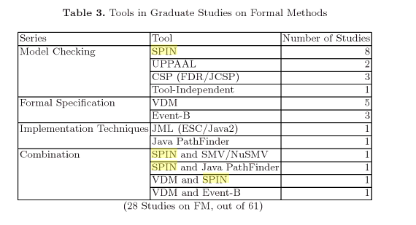
Teaching Formal Methods Conference 2009 “Teaching Formal Methods for the Unconquered Territory”
Notes:
http://poporo.uma.pt/docs/catano-tfm.pdf
http://books.google.com/books?id=kPp-KO3vMdEC&pg=PA68&lpg=PA68&dq=ESC/Java,+vs+Spin&source=bl&ots=hGshuQ-Mrr&sig=Lg9XNRHnyiJvXQlZR6GLMEj1mm8&hl=en&sa=X&ei=dNxLVKmEAfGHsQSI54GgDg&ved=0CGIQ6AEwCA#v=onepage&q=ESC%2FJava%2C%20vs%20Spin&f=false

Slide 10
Hoare Triple – pre/post conditions
C.A.R. Hoare (1969) describes a calculus to reason about program correctness in terms of pre and post conditions¹.
Approach to correctness introduced Hoare Tripple:¹
if property φ PRE holds before program P starts, φ POST holds after the execution of P¹
IR: Phi-Terms and SSA
E. G. Dijkstra (1975) extended Hoare’s ideas in the concept of “predicate transformers” which, instead of starting with a pre condition and post condition, starts with a post condition and uses the program code to determine the pre condition that needs to hold to establish the post condition.¹
Notes:
1. http://webdocs.cs.ualberta.ca/~piotr/Courses/662/Reading/ESL-TIK-00214.pdf

Slide 11
Meyers - Design by contract (1986)
Verification of Object Oriented Programming
Eiffel Programming Language
Contracts between Client and Server
Between Class and users of a class
Class Invariants
A class invariant is a property that applies to all instances of the class, transcending particular routines.
Example. A class invariant of a class describing nodes of a binary tree could be of the form stating that the parent of both the left and right children of the node, if these children exist, is the node itself.
Notes:
1. http://cecs.wright.edu/~pmateti/Courses/7140/Lectures/OOD/meyer-design-by-contract-1992.pdf

Slide 12
Google’s Android

Slide 13
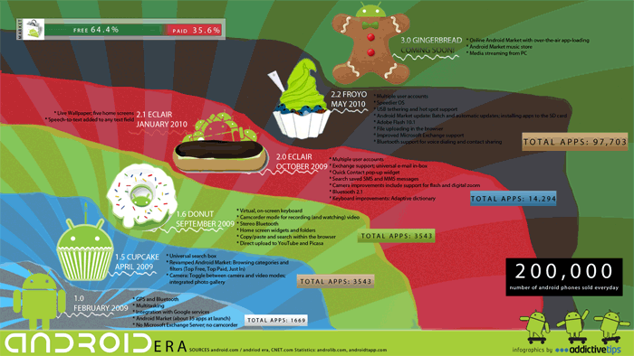
Notes:
http://www.cnet.com/news/a-brief-history-of-android-phones/
http://mochaguru.com/wp-content/uploads/2011/01/andriod-era-new1-11.gif

Slide 14
Android apps in java

Slide 15
Android Java into Delvik Code
Android Project Files:
Classes folder
Java classes
Classes.dex file
Delvik byte code
Res folder
Binary resources are copied over (e.g. images, movies, audio)
Resources.ap file
Archive of all XML resources
Application_Name.Apk
Final shippable product
Represents application in entirety
AndroidManifest.xml with permissions
Notes:
https://source.android.com/devices/tech/dalvik/dalvik-bytecode.html
http://stackoverflow.com/questions/7541281/what-is-dalvik-and-dalvik-cache

Slide 16
Android app lifecycle

Slide 17
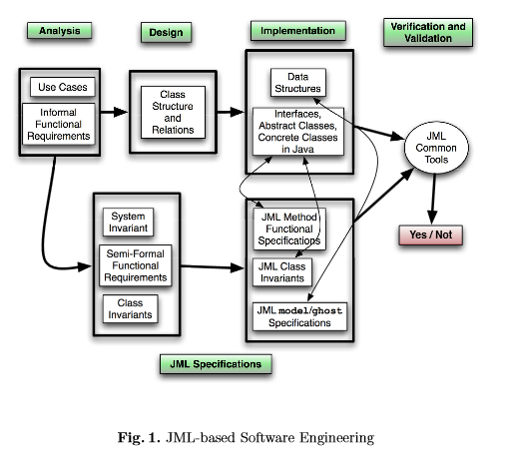
Formal methods in java
Java Modeling Language
Notes:
http://poporo.uma.pt/docs/catano-tfm.pdf

Slide 18
Java modeling language (JML)
Notes:
http://en.wikipedia.org/wiki/Java_Modeling_Language
ESC/JAVA User Manual

Slide 19
Java modeling language (JML)
Notes:
atomic operation [ə′täm·ik ‚äp·ə′rā·shən] (computer science) An operation that cannot be broken up into smaller parts that could be performed by different processors.
McGraw-Hill Dictionary of Scientific & Technical Terms, 6E, Copyright © 2003 by The McGraw-Hill Companies, Inc.

Slide 20
Theorem provers
Simplify
ESC/Java2
http://www.ict.kth.se/courses/2G1516/Docs05/EscJava/Tutorial/Example.htm
escjava -loop 3 List.java
Command-line Variables
--suggest
--counter-example
Key

Slide 21
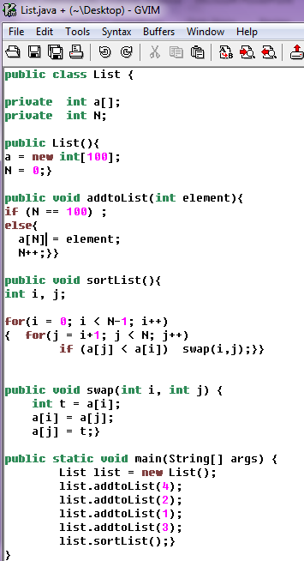
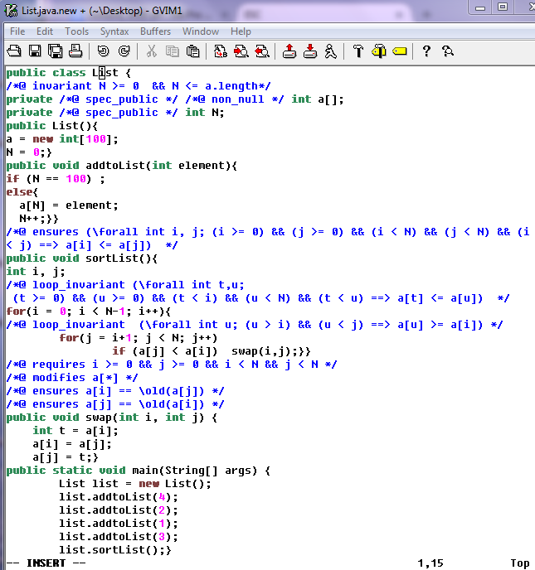
Notes:
KindSoftware
ESC/Java2 Reference Manual

Slide 22
ESC/Java2 Warnings produced (Sec 4)
ArrayStore
Assert
Cast
Deadlock
Exception
IndexNegative
IndexTooBig
Invariant
LoopInv
NegSize
NonNull
NonNullInit
Null
OwnerNull
Post
Pre
Race
Reachable
Unreadable
Uninit
ZeroDiv
Notes:
ESC/Java2 Reference Manual

Slide 23
Under the HOOD of ESC/Java

Slide 24
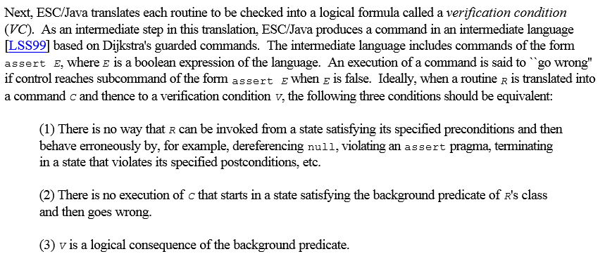
Under the HOOD of ESC/Java
Notes:
ESC/JAVA User Manual

Slide 25
ESC/Java Unsoundness
Trusting Pragmas, Loops, Object Invariants, Modification targets, multiple inheritance, ignored exceptional conditions, Shared Variables, etc.
Notes:
ESC/JAVA User Manual

Slide 26
Android Current Research by Country: Sweden – Chalmers (Thesis pgs. 130)
Formal Specification of Selected Android Core Applications and Library Functions by Masoumeh Al. Haghighi Mobarhan.
Phone Application – Emergency Dialer
Screen Manager Application – Lock/Unlock Functions
Contact Application
Key Theorem Prover
Examined Enter-Password Application for Proof Obligations:
Strong Contract, Preservers Invariant, Ensures Post, etc.

Slide 27
Vienna, Austria
Formal Description of Userinterfaces –Demonstrated in a Comparison of iPhone and Android Smartphones. Andrew Frank.
iPhone and Android
Describing conceptual aspects of a user interface in a formal language
Goal to simulate behavior of real device
Three Perspectives of User Interface:
Tasks
Actions
Operations
Mappings between perspectives change state of device
Translates task into sequence of actions
Users actions change state of operations

Slide 28
France & Italy
Static Analysis of Android Programs. Etienne Payet and Fausto Spoto. CADE 2011.
Julia Abstract Interpretation
Nullness checks
Equality checks
Classcast checks from AndroidManifest.XML class inflation
Deadcode checks
Termination checks
Etc.

Slide 29
United States
NASA Summer Project partially sponsored by Google
Java Pathfinder
Verify properties of Android Applications
“One of the main deliverables will be a set of model classes for the Android system: these will allow running through the model checker the implementation of activities and services. Moreover, the project will aim at verifying specific properties for parts of the system that are of special interest, like the correct usage of some of the basic components, for example, the PowerManager.“ [Ref in Notes]
Notes:
http://babelfish.arc.nasa.gov/trac/jpf/wiki/summer-projects/2010-android

Slide 30
Current Ideas
Asynchronous vs synchronous
Talked with Verification expert at Google, Dr. Ivancic, about current shortfall
Android has Asynchronous versus Synchronous capabilities that current state-of-the art verification does not yet do well
Android has various program states which add complexity to verification
Complex Process In General

