Slide 1
Programming Languages and Translators COMS W4115
Alfred V. Aho
aho@cs.columbia.edu
Lecture 1
January 21, 2015

Slide 2
Welcome to PLT Spring 2015!
Prof. Al Aho
aho@cs.columbia.edu
Office hours:
1:00-2:00pm, Mondays & Wednesdays
Room 513 Computer Science Building
http://www.cs.columbia.edu/~aho/cs4115
https://courseworks.columbia.edu
http://piazza.com/columbia/spring2015/comsw4115
Lectures: Mondays & Wednesdays, 2:40-3:55pm, 833 Mudd

Slide 3
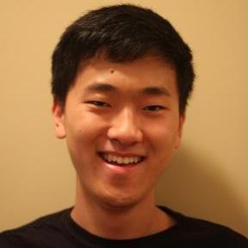
The TAs
Livi Byer
okb2102@barnard.edu
Chae Jubb
ecj2122@columbia.edu
Aquila Khanam
ak3654@columbia.edu
Daniel Park
sjp2172@columbia.edu
Kevin Walters
kmw2168@columbia.edu

Slide 4
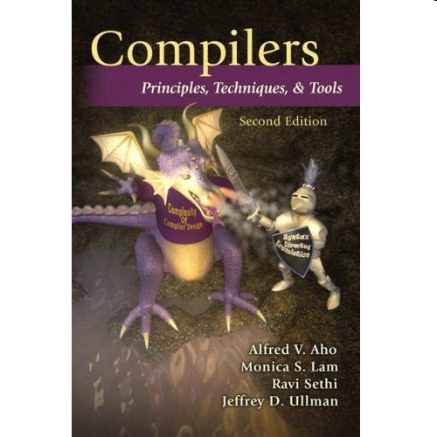
PLT in a Nutshell: What you will Learn
Theory
principles of programming languages
fundamentals of compilers
models of computation in PLs
Practice
a semester-long programming project in which you will work in a team of five to create and implement an innovative little language of your own design. You will learn computational thinking as well as project management, teamwork, and communication skills that are useful in all aspects of any career.
Notes:
PLT is a design studio where students to work in teams of five to create and implement an innovative new little language of their own design. This is an excellent way for students to learn and appreciate the importance of computational thinking.

Slide 5
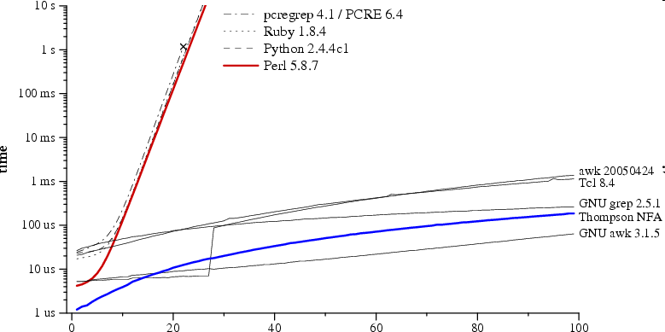
Theory in Practice: Regular Expression Pattern Matching in Perl, Python, Ruby vs. AWK
Time to check whether a?^{n}a^{n} matches a^{n}
regular expression and text size n
Russ Cox, Regular expression matching can be simple and fast (but is slow in Java, Perl, PHP, Python, Ruby, ...) [http://swtch.com/~rsc/regexp/regexp1.html, 2007]
Notes:
Another feature of AWK is that it used theory to do the pattern matching. At that time I was interested in efficient string matching algorithms and I incorporated one of my regular expression pattern matching algorithms into AWK. I was strongly influenced by Donald Knuth’s dictum that “the best theory is inspired by practice and the best practice is inspired by theory.”

Slide 6
Software in Our World Today
How much software does the world use today?
Guesstimate: more than one trillion lines of source code
What is the sunk cost of the legacy software base?
$100 per line of finished, tested source code
How many bugs are there in the legacy base?
10 to 10,000 defects per million lines of source code
A. V. Aho
Software and the Future of Programming Languages
Science, February 27, 2004, pp. 1131-1133
Notes:
Very few people are aware of the importance of software in the world today, how much money has been invested in software, and how fragile our software legacy base is.

Slide 7
What is a Programming Language?
A programming language is a notation that a person can understand and a computer can execute for specifying computational tasks. There is an implication that a programming language should be Turing-complete.
Every programming language has a syntax and semantics.
The syntax specifies how a concept is expressed.
Much of the syntax can be described by a grammar:
statement → while ( expression ) statement
Need to worry about ambiguity: “Time flies like an arrow.”
The semantics specifies what the concept means or does.
Semantics is usually specified in English.

Slide 8
Course Schedule
Lectures: Mondays & Wednesdays, 2:40−3:55pm,
833 Mudd
Midterm: Wednesday, March 11, 2015
Spring recess: March 16-20, 2015
Final: Monday, May 4, 2015
Final project report: Due on Courseworks, May 10/15
Project demos: Mon - Wed, May 11-13, 2015

Slide 9
Course Syllabus
Computational thinking
Structure and kinds of programming languages
Principles of compilers
Lexical analysis
Syntax analysis
Compiler tools
Syntax-directed translation
Types and type-checking algorithms
Semantic analysis
Run-time organization
Intermediate code generation
Code generation
Code optimization
The lambda calculus

Slide 10
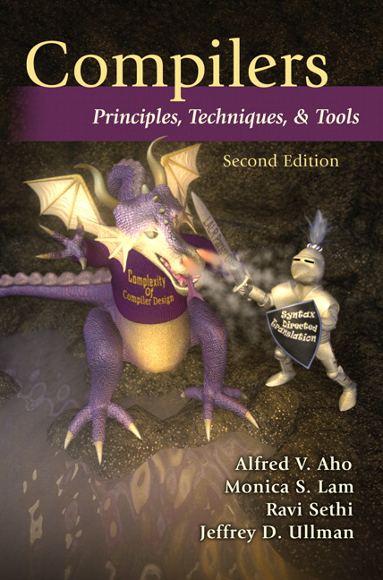
Textbook
A. V. Aho, M. S. Lam, R. Sethi, J. D. Ullman
Compilers: Principles, Techniques and Tools
Addison-Wesley, 2007. Second Edition.

Slide 11
Course Requirements
Homework: 10% of final grade
Midterm: 20% of final grade
Final: 30% of final grade
Course project: 40% of final grade

Slide 12
Course Prerequisites
Fluency in C, C++, Java, Python or equivalent language
COMS W3157: Advanced Programming
makefiles
version control
testing
COMS W3261: Computer Science Theory
regular expressions
finite automata
context-free grammars
COMS W3827: Fundamentals of Computer Systems

Slide 13
What does this C program do?
#include <stdio.h>
int main ( ) {
int i, j;
i = 1;
j = i++ + ++i;
printf("%d\n", j);
}

Slide 14
From the ISO-C Standard ISO/IEC 9899:TC3
Implementation-defined behavior
Unspecified behavior where each implementation documents how the choice is made
An example of implementation-defined behavior is the propagation of the high-order bit when a signed integer is shifted right.
Undefined behavior
Behavior, upon use of a nonportable or erroneous program construct or of erroneous data, for which this International Standard imposes no requirements
An example of undefined behavior is the behavior on integer overflow.
Unspecified behavior
Use of an unspecified value, or other behavior where this International Standard provides two or more possibilities and imposes no further requirements on which is chosen in any instance
An example of unspecified behavior is the order in which the arguments to a function are evaluated.

Slide 15
From the ISO-C Standard
ISO/IEC 9899:201x Committee Draft — April 12, 2011 N1570
6.5 Expressions
If a side effect on a scalar object is unsequenced relative to either a different side effect on the same scalar object or a value computation using the value of the same scalar object, the behavior is undefined. If there are multiple allowable orderings of the subexpressions of an expression, the behavior is undefined if such an unsequenced side effect occurs in any of the orderings.
This paragraph renders undefined statement expressions such as
i = ++i + 1;
a[i++] = i;
while allowing
i = i + 1;
a[i] = i;

Slide 16
The Course Project
Form a team of five by Feb 4, 2015
Contact Livi Byer (okb2102@barnard.edu) after 1/30/2015 for help forming or finding a team.
Design a new innovative little language
Examples of previous PLT languages can be found at
http://www.cs.columbia.edu/~aho/cs4115
Build a translator for it
Deposit final project report on Courseworks by May 10, 2015
Present a 30-minute demo of your translator May 11-13, 2015

Slide 17
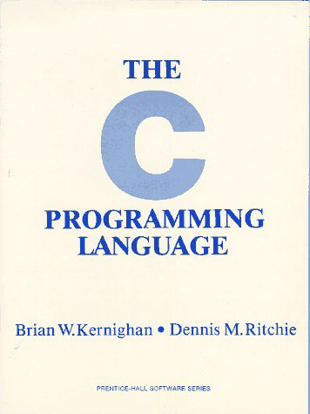
Project Timeline 2015
Date Deliverable
2/4 Form a team of five and start designing your new language
2/25 Hand in a whitepaper on your proposed language modeled
after the Java whitepaper
3/25 Hand in a tutorial patterned after Chapter 1 and
a language reference manual patterned after
Appendix A of Kernighan and Ritchie’s book,
The C Programming Language
5/10 Deposit a final project report on Courseworks
5/11-13 Give a 30-minute working demo of your translator to the
teaching staff
Notes:
A lightweight software engineering process accompanies the development of the language and translator. With it, no team fails to deliver a working compiler at the end of the semester.

Slide 18
Final Project Report Sections
Language whitepaper (written by the entire team)
Language tutorial (by team)
Language reference manual (by team)
Project plan (by project manager)
Language evolution (by language guru)
Translator architecture (by system architect)
Development environment and runtime (by systems integrator)
Test plan and scripts (by tester)
Conclusions (by team)
Code listing (by team)
To see a sample final project report click here.

Slide 19
Project Roles and Responsibilities
Project Manager
timely completion of project deliverables
Language Guru
language integrity and tools
System Architect
compiler architecture
System Integrator
development and execution environment
Verification and Validation
test plan and test suites

Slide 20
Some Previous PLT Languages
arthur: a fun language for manipulating and integrating media
MineTime: a language for creating Minecraft maps
Q-HSK: a language for teaching quantum computing
Swift Fox: a language for configuring sensor networks
Trowel: a webscraping language for journalists
Upbeat: a language for auralizing data
W2W: a language for making recommendations what to wear

Slide 21
W2W: PLT Spring 2012

Slide 22
What to Wear - 1

Slide 23
What to Wear - 2

Slide 24
What to Wear - 3

Slide 25
What to Wear - 4

Slide 26
Programming Languages Today
Today there are thousands of programming languages.
The website http://www.99-bottles-of-beer.net
has programs in over 1,500 different
programming languages and variations to generate
the lyrics to the song “99 Bottles of Beer.”
Notes:
There are as many programming languages in the world today as there are natural languages. There is a website at Murdoch University in Australia that apparently lists over 8000 programming languages. However, what’s more fun is the website “99 bottles of beer.”

Slide 27
“99 Bottles of Beer”
99 bottles of beer on the wall, 99 bottles of beer.
Take one down and pass it around, 98 bottles of beer on the wall.
98 bottles of beer on the wall, 98 bottles of beer.
Take one down and pass it around, 97 bottles of beer on the wall.
.
.
.
2 bottles of beer on the wall, 2 bottles of beer.
Take one down and pass it around, 1 bottle of beer on the wall.
1 bottle of beer on the wall, 1 bottle of beer.
Take one down and pass it around, no more bottles of beer on the wall.
No more bottles of beer on the wall, no more bottles of beer.
Go to the store and buy some more, 99 bottles of beer on the wall.
[Traditional]
Notes:
In case you are not familiar with song “99 bottles of beer” here are its lyrics. As you can see, it is a drinking song.

Slide 28
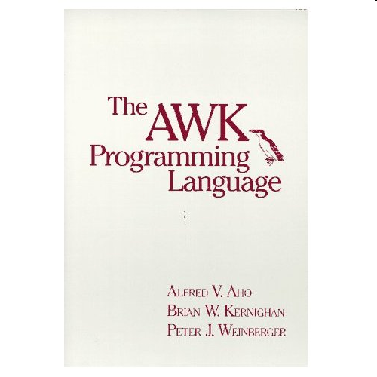
“99 Bottles of Beer” in AWK
BEGIN {
for(i = 99; i >= 0; i--) {
print ubottle(i), "on the wall,", lbottle(i) "."
print action(i), lbottle(inext(i)), "on the wall."
print
}
}
function ubottle(n) {
return sprintf("%s bottle%s of beer", n ? n : "No more", n - 1 ? "s" : "")
}
function lbottle(n) {
return sprintf("%s bottle%s of beer", n ? n : "no more", n - 1 ? "s" : "")
}
function action(n) {
return sprintf("%s", n ? "Take one down and pass it around," : \
"Go to the store and buy some more,")
}
function inext(n) {
return n ? n - 1 : 99
}
[Osamu Aoki, http://www.99-bottles-of-beer.net/language-awk-1623.html]
Notes:
On this website there is a program to print the lyrics of 99 bottles of beer in one of my favorite languages – AWK.

Slide 29
“99 Bottles of Beer” in AWK (bottled version)
BEGIN{
split( \
"no mo"\
"rexxN"\
"o mor"\
"exsxx"\
"Take "\
"one dow"\
"n and pas"\
"s it around"\
", xGo to the "\
"store and buy s"\
"ome more, x bot"\
"tlex of beerx o"\
"n the wall" , s,\
"x"); for( i=99 ;\
i>=0; i--){ s[0]=\
s[2] = i ; print \
s[2 + !(i) ] s[8]\
s[4+ !(i-1)] s[9]\
s[10]", " s[!(i)]\
s[8] s[4+ !(i-1)]\
s[9]".";i?s[0]--:\
s[0] = 99; print \
s[6+!i]s[!(s[0])]\
s[8] s[4 +!(i-2)]\
s[9]s[10] ".\n";}}
[Wilhem Weske, http://www.99-bottles-of-beer.net/language-awk-1910.html
Notes:
On this website there is a program to print the lyrics of 99 bottles of beer in one of my favorite languages – AWK.

Slide 30
“99 Bottles of Beer” in Python 2.7
for quant in range(99, 0, -1):
if quant > 1:
print quant, "bottles of beer on the wall,", quant, "bottles of beer."
if quant > 2:
suffix = str(quant - 1) + " bottles of beer on the wall."
else:
suffix = "1 bottle of beer on the wall."
elif quant == 1:
print "1 bottle of beer on the wall, 1 bottle of beer."
suffix = "no more beer on the wall!"
print "Take one down, pass it around,", suffix
print "--"
[Gerold Penz, http://www.99-bottles-of-beer.net/language-python-808.html]
Notes:
On this website there is a program to print the lyrics of 99 bottles of beer in one of my favorite languages – AWK.

Slide 31
“99 Bottles of Beer” in the Whitespace language
[Andrew Kemp, http://compsoc.dur.ac.uk/whitespace/]
Notes:
And here is a program in the Whitespace language to print out the lyrics. The Whitespace language only uses blanks, tabs and linefeeds as input characters.

Slide 32
Evolution of Programming Languages
1970
Fortran
Lisp
Cobol
Algol 60
APL
Snobol 4
Simula 67
Basic
PL/1
Pascal
2015
C
Java
Objective-C
C++
C#
PHP
JavaScript
Python
Perl
PL/SQL
TIOBE Index
January 2015
2015
Java
PHP
Python
C#
C++
C
JavaScript
Objective-C
Ruby
Swift
PYPL Index
January 2015
2014
Java
C
C++
C#
Python
JavaScript
PHP
Ruby
SQL
MATLAB
IEEE Top 10 PLs
Spectrum 2014
Notes:
Since all software systems are written in a programming language, let’s look at how programming languages have changed over the last forty-five years. Here are the Tiobe.com and Popularity of Programming Language indexes for Jan 2013. Although the popular languages have changed, there is still a lot of software being developed and maintained today with the old languages like Fortran and Cobol.

Slide 33
Why Are There So Many Languages?
One language cannot serve all application areas well
e.g., scientific computing needs floating point arithmetic
e.g., systems need fine-grained, real-time control
new application areas arise frequently (Internet, mobiles)
Programmers often have strongly held opinions about
what makes a good language
how programming should be done
There is no universally accepted metric for a good language!

Slide 34
Evolutionary Forces on Languages
Increasing diversity of applications
Stress on increasing programmer productivity and shortening time to market
Need to improve software security, reliability and maintainability
Emphasis on mobility and distribution
Support for parallelism and concurrency
New mechanisms for modularity
Trend toward multi-paradigm programming
Notes:
New languages are being created regularly. Even the existing languages like C and Java undergo substantial revisions with each new version. There are several powerful forces driving these changes.

Slide 35
Some New Languages to Watch
Elm
a functional language for creating web GUIs
Rust
an efficient multi-paradigm systems language
Swift
Apple’s new language to replace Objective-C

Slide 36
Example New Language: Elm
Elm is a functional programming language for declaratively creating web browser based graphical user interfaces.
It uses functional reactive programming and purely functional graphical layout to build user interfaces without any destructive updates.
Elm was designed in 2012 by Evan Czaplicki.
The key features in Elm are signals, immutability, static types, and interoperability with HTML, CSS, and JavaScript.
elm-lang.org

Slide 37
Example New Language: Rust
Rust is a general-purpose, multi-paradigm, compiled programming language.
It is designed to be a safe, concurrent, practical language.
First pre-alpha release of the Rust compiler was in 2012.
It supports pure-functional, concurrent-actor, imperative-procedural, and object-oriented programming styles.
Rust was originally designed by Graydon Hoare and is supported by Mozilla Research.
It advertises itself as “a systems programming language that runs blazingly fast, prevents almost all crashes, and eliminates data races.”
www.rust-lang.org

Slide 38
Example New Language: Swift
Swift is Apple’s new programming language for iOS and OS X whose code is designed to work with Objective-C
It was designed with code safety and performance in mind.
Some of the features of Swift include
named parameters
inferred types
modules
automatic memory management
closures with unified function pointers
functional programming patterns like map and filter
https://developer.apple.com/library/ios/documentation/Swift/Conceptual/Swift_Programming_Language/

Slide 39
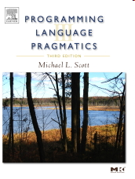
Models of Computation in Languages
Underlying most programming languages is a model of computation:
Procedural: Fortran (1957)
Functional: Lisp (1958)
Object oriented: Simula (1967)
Logic: Prolog (1972)
Relational algebra: SQL (1974)
Notes:
Programming languages are usually designed around some model of computation. Here are some of the most important ones.

Slide 40
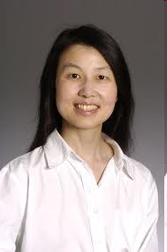
Computational Thinking
Computational thinking is a fundamental skill for everyone, not just for computer scientists. To reading, writing, and arithmetic, we should add computational thinking to every child’s analytical ability. Just as the printing press facilitated the spread of the three Rs, what is appropriately incestuous about this vision is that computing and computers facilitate the spread of computational thinking.
Jeannette M. Wing
Computational Thinking
CACM, vol. 49, no. 3, pp. 33-35, 2006
Notes:
People in different disciplines think very differently about computation if they think about it at all. Jeannette Wing, who was the former director of the CISE directorate at the NSF, and who is now the international vice president for research at Microsoft, has been advocating that computational thinking is as important a skill as the 3 R’s for everyone in the 21st century.

Slide 41
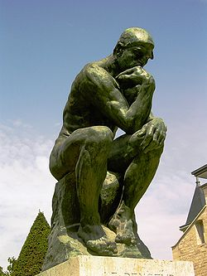
What is Computational Thinking?
The thought processes involved in formulating problems so their solutions can be represented as computation steps and algorithms.
Alfred V. Aho
Computation and Computational Thinking
The Computer Journal, vol. 55, no. 7, pp. 832- 835, 2012
Notes:
Recently I spent two years serving on a NRC Workshop on the nature and scope of computational thinking. The first thing I noticed is that there is no universally agreed upon on definition for the term CT. Here is the definition I have been using for a long time. Notice there are two steps to computational thinking: first finding the appropriate abstractions for a problem domain and then formulating algorithms for solving problems using these abstractions. Finding the appropriate abstractions is key and can be very challenging. This talk is about finding these appropriate abstractions. We can think of these abstractions as models of computation.

Slide 42
Computational Model of AWK
AWK is a scripting language designed to perform routine data-processing tasks on strings and numbers
Use case: given a list of name-value pairs, print the total value associated with each name.
An AWK program
is a sequence of
pattern-action statements
alice 10
eve 20
bob 15
alice 30
{ total[$1] += $2 }
END { for (x in total) print x, total[x] }
eve 20
bob 15
alice 40
Notes:
Brian Kernighan and Peter Weinberger and I developed a little language for processing data that got to be known as AWK. AWK uses a pattern-action model of computation. An AWK program is of a sequence of pattern-action statements. The program reads the input a line at a time. A line is scanned for each pattern in the program, and for each pattern that matches, the associated action is executed.
Here is a two-line AWK program that reads a sequence of name-value pairs and for each name accummates the total value.
AWK became a utility on the UNIX operating system that was developed in the research center at Bell Labs where we worked. It soon became one of the ten most popular programs on UNIX because people could easily learn the language and one of the most common initial uses of it was to transform the output of one Unix program into a form so that it could be piped into another program.
AWK was inspired by the Unix program grep, and it provided inspiration for Larry Wall to develop the Perl programming language.

Slide 43
A Good Way to Learn Computational Thinking
Design and implement your own
programming language!
Notes:
A good way to teach computational thinking!

Slide 44
Programming Languages: Domains of Application
Scientific
Fortran
Business
COBOL
Artificial intelligence
LISP
Systems
C
Web
Java
General purpose
C++

Slide 45
Kinds of Languages - 1
Imperative
Specifies how a computation is to be done.
Examples: C, C++, C#, Fortran, Java
Declarative
Specifies what computation is to be done.
Examples: Haskell, ML, Prolog
von Neumann
One whose computational model is based on the von Neumann architecture.
Basic means of computation is through the modification of variables (computing via side effects).
Statements influence subsequent computations by changing the value of memory.
Examples: C, C++, C#, Fortran, Java

Slide 46
Kinds of Languages - 2
Object-oriented
Program consists of interacting objects.
Each object has its own internal state and executable functions (methods) to manage that state.
Object-oriented programming is based on encapsulation, modularity, polymorphism, and inheritance.
Examples: C++, C#, Java, OCaml, Simula 67, Smalltalk
Scripting
A dynamic interpreted language with high-level operators for "gluing together" computations.
Examples: AWK, Perl, PHP, Python, Ruby
Functional
One whose computational model is based on the recursive definition of functions (the lambda calculus).
Examples: Haskell, Lisp, ML

Slide 47
Kinds of Languages - 3
Parallel
One that allows a computation to run concurrently on multiple processors.
Examples
Libraries: POSIX threads, MPI
Languages: Ada, Cilk, OpenCL, Chapel, X10
Architecture: CUDA (parallel programming architecture for GPUs)
Domain specific
Many areas have special-purpose languages to facilitate the creation of applications.
Examples
YACC for creating parsers
LEX for creating lexical analyzers
MATLAB for numerical computations
SQL for database applications
Markup
Not programming languages in the sense of being Turing complete, but widely used for document preparation.
Examples: HTML, XHTML, XML

Slide 48
Language Design Issues to Think About
Application domain
exploit domain restrictions for expressiveness, performance
Computational model
simplicity, ease of expression
incorporate a few primitives that can be elegantly combined to solve large classes of problems
Abstraction mechanisms
reuse, suggestivity
Type system
reliability, security
Usability
learnability, readability, writability, maintainability, efficiency

Slide 49
Example Language Whitepaper: The Buzzwords of Java
Java: A
simple,
object-oriented,
familiar,
robust,
secure,
architecture neutral,
portable,
high-performance,
interpreted
threaded,
dynamic
language.
http://www.oracle.com/technetwork/java/index-136113.html

Slide 50
To Do
1. Start thinking of what kind of language you want to design and for what class of applications.
Use Piazza to publicize your background and interests to find compatible teammates.
2. Form or join a five-person project team immediately.
Contact Livi Byer (okb2102@barnard.edu) after Jan 30 if you need help forming or joining a team.
3. Once you have formed your project team, let Livi know the name of your team and the names of its members.

