Slide 1


From Algorithms to Software
Al Aho
aho@cs.columbia.edu
NEC Foundation
November 30, 2017

Slide 2


Slide 3
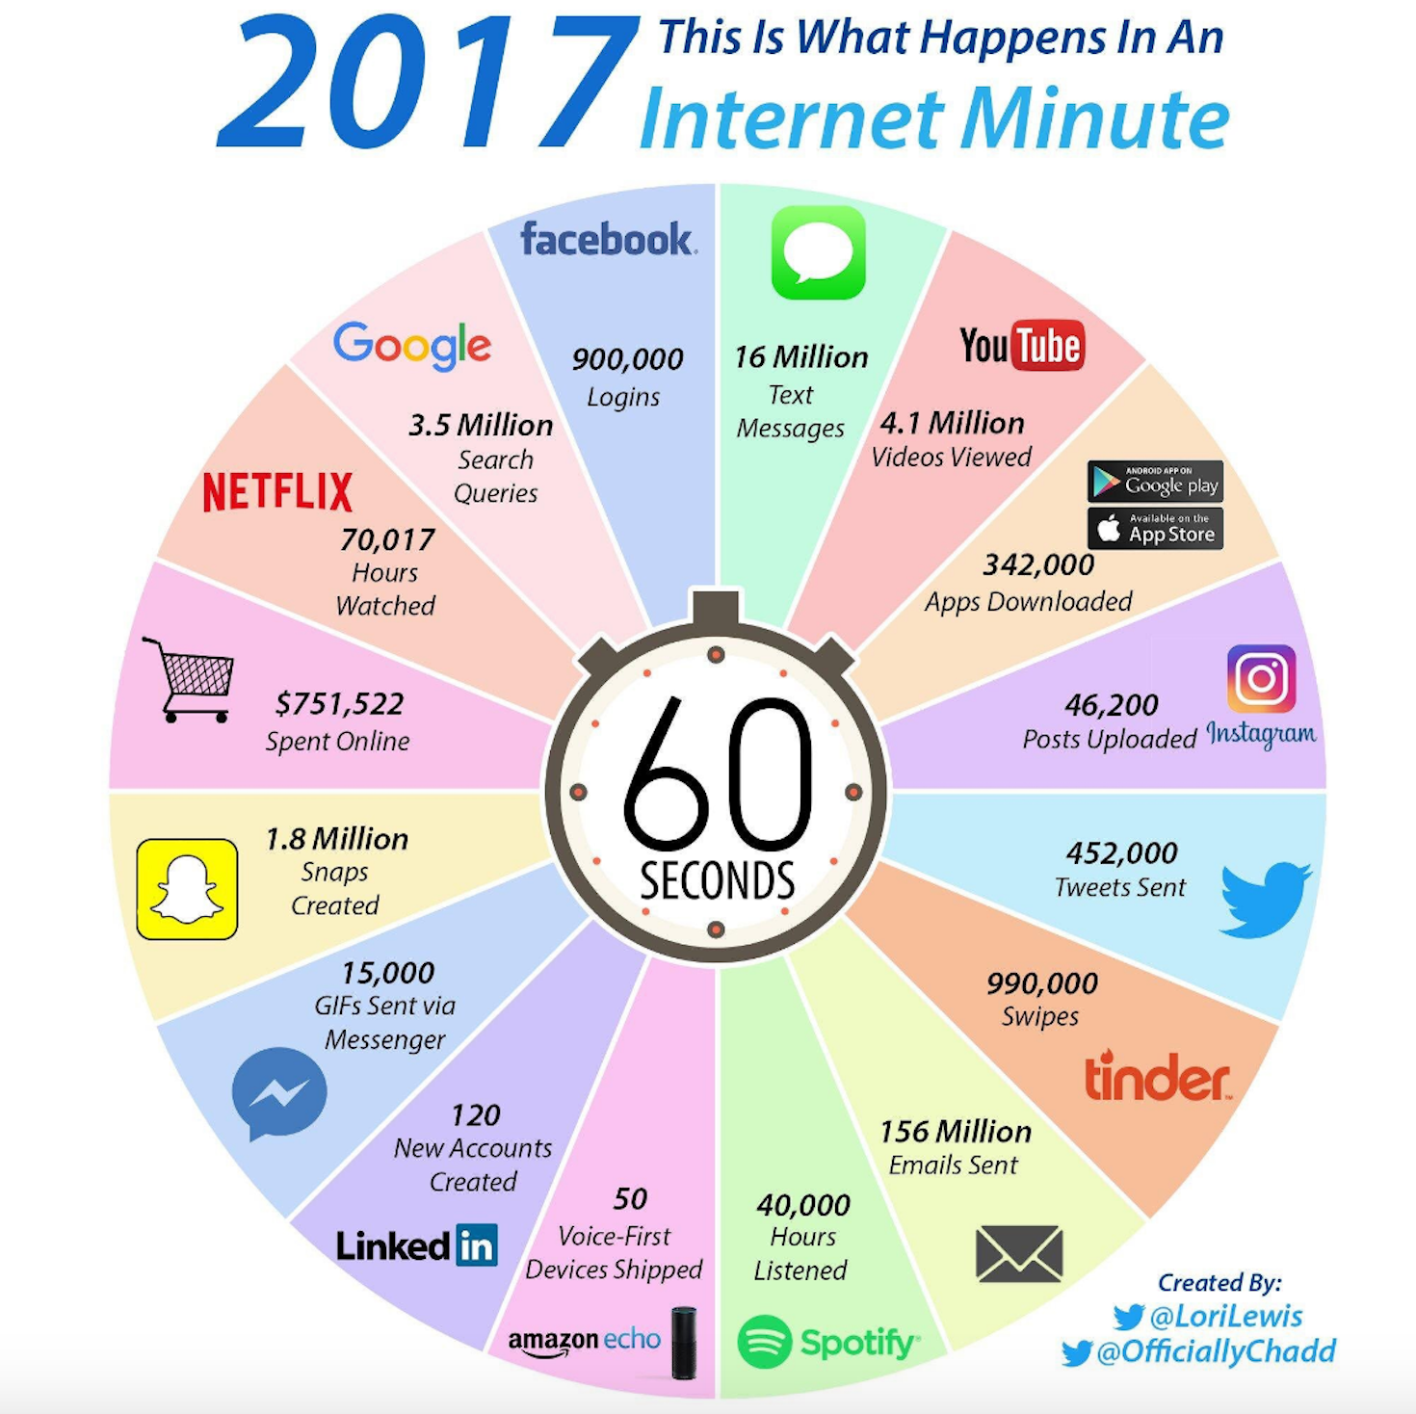

Slide 4
Software in Our World Today
How much software does the world use today?

Slide 5
Sizes of Some Software Codebases
Software System
Millions of lines of code
Microsoft Visual Studio 2012 | 50
Facebook | 62
Mac OSX 10.4 | 86
Typical new car | 100
Google | 2,000
  http://www.informationisbeautiful.net/visualizations/million-lines-of-code/

Slide 6
The Importance of Computational Thinking
Problem
Domain
Problem
Abstraction
Algorithms +
Software +
Systems
Solve Problems
A, V. Aho
Computation and
Computational Thinking
The Computer Journal, 2012

Slide 7
The Importance of Algorithms
Every software system implements
a collection of algorithms.

Slide 8
Programming Languages
Make Algorithms Come Alive
Algorithms + Programming Languages =
Software

Slide 9
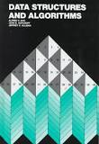
What is an Algorithm?
A finite sequence of instructions, each of which has a clear meaning and can be performed with a finite amount of effort in a finite length of time.
Alfred V. Aho, John E. Hopcroft, and Jeffrey D. Ullman
Data Structures and Algorithms
Addison Wesley, 1983

Slide 10
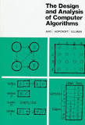
Algorithms are the Essence of Computation
The study of algorithms is at the very heart of computer science.
Alfred V. Aho, John E. Hopcroft, and Jeffrey D. Ullman
The Design and Analysis of Computer Algorithms
Addison Wesley, 1974

Slide 11
Widely Used Models of Computation
    Person with pencil and paper
    Random access machines
    The lambda calculus
    Circuits with Boolean gates

Slide 12
Algorithm Design Techniques
Recursion
  e.g., Euclid’s algorithm
Divide-and-conquer
  e.g., Fast Fourier transform
Dynamic programming
  e.g., Longest common subsequence
Alfred V. Aho, John E. Hopcroft, and Jeffrey D. Ullman
The Design and Analysis of Computer Algorithms
Addison Wesley, 1974

Slide 13
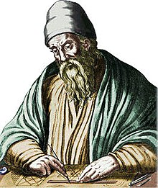
Euclid’s Algorithm:
Finding the greatest common divisor of two integers
euclid(m,n)
if n == 0 then
return m
else
return euclid(n, m mod n)
m mod n is the remainder when m is divided by n
E.g.: euclid(16,12) = euclid(12, 4) = euclid(4, 0) = 4

Slide 14
Computational Complexity
T(n) = maximum amount of time required to solve any
problem of size n
Examples
  Sort n numbers: T(n) is O(n log n)
  Multiply two n x n matrices: T(n) is O(n³)
  Satisfiability of a Boolean expression of size n: T(n) is O(2^{n})

Slide 15
Algorithms for Finding Patterns in Strings
The grep programs on Unix/Linux:
  grep ‘pattern’ file
    Ken Thompson algorithm
    time complexity: O(p x n)
  fgrep ‘set of keywords’ file
    Aho-Corasick algorithm
    time complexity: O(p + n)
  egrep ‘POSIX regular expression’ file
    dynamically cached deterministic finite automaton
    observed time complexity O(p + n)
A. V. Aho
Algorithms for Finding Patterns in Strings
Handbook of Theoretical Computer Science, Vol. A, 1990

Slide 16
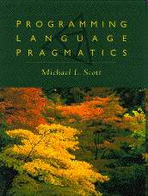
Programming Languages
Programming languages are notations for describing algorithms to people and to machines.
A language may support one or more programming paradigms:
Procedural: C, C++, C#, Java
Declarative: SQL
Functional: Haskell, OCaml
Object oriented: Simula 67, C++
Scripting: AWK, Perl, Python, Ruby
Notes:
.

Slide 17
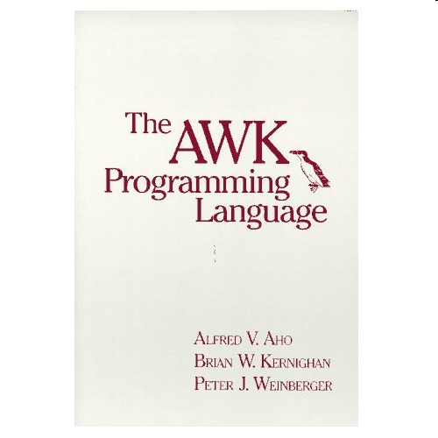
The AWK Programming Language
AWK is a scripting language for routine data-processing tasks designed by Al Aho, Brian Kernighan, Peter Weinberger at Bell Labs
Each co-designer had a slightly different motivation:
  Aho wanted a generalized grep
  Kernighan wanted a programmable editor
  Weinberger wanted a database query tool
Each co-designer wanted a simple,
  easy-to-use language

Slide 18
Structure of an AWK Program
An AWK program is a sequence of pattern-action statements
    pattern { action }
    pattern { action }
    . . .
Each pattern is a Boolean combination of regular, numeric, and string expressions
An action is a C-like program
  If there is no { action }, the default is to print the line
Invocation
    awk ‘program’ [file1 file2 . . . ]
    awk –f progfile [file1 file2 . . . ]

Slide 19
AWK’s Model of Computation:
Pattern-Action Programming
for each file
for each line of the current file
for each pattern in the AWK program
if the pattern matches the input line then
execute the associated action

Slide 20
Some Useful AWK “One-liners”
Print the total number of input lines
        END { print NR }
Print the last field of every input line
            { print $NF }
Print each input line preceded by its line number
        { print NR, $0 }
Print all non-empty input lines
        NF > 0
Print all unique input lines
        !x[$0]++

Slide 21
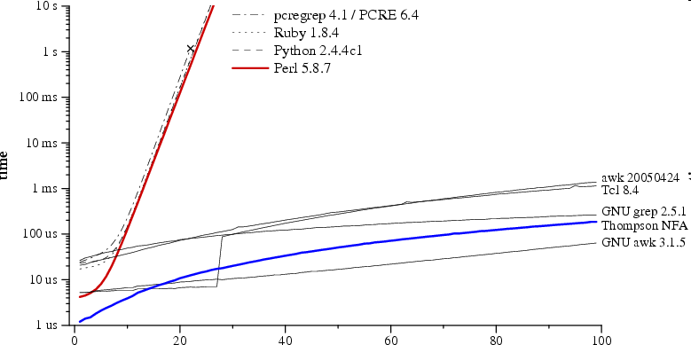
Comparison: Regular Expression Pattern Matching in Perl, Python vs. AWK, grep
Time to check whether a?^{n}a^{n} matches a^{n}
regular expression and text size n
Russ Cox, Regular expression matching can be simple and fast (but is slow in Java, Perl, PHP, Python, ...) [http://swtch.com/~rsc/regexp/regexp1.html, 2007]

Slide 22

Translation of Programming Languages
input
Compiler
source
program
target
program
output
Notes:
.

Slide 23
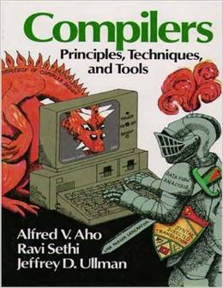
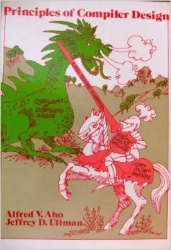
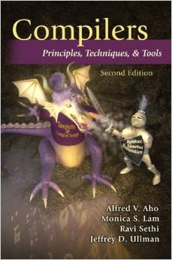
The Dragon Books Captured the Enormous
Synergy Between Theory and Compiler Design
1986
type checking
run-time organization
automatic code
generation
1977
finite automata
grammars
lex & yacc
syntax-directed translation
2007
garbage collection
optimization
parallelism
interprocedural analysis

Slide 24
Phases of a Compiler
source
program
target
program
Lexical
Analyzer
Syntax
Analyzer
Semantic
Analyzer
Interm.
Code
Gen.
Code
Optimizer
Code
Gen.
token
stream
syntax
tree
annotated
syntax
tree
interm.
rep.
interm.
rep.
Symbol Table
Alfred V. Aho, Monica S. Lam, Ravi Sethi and Jeffrey D. Ullman
Compilers: Principles, Techniques, & Tools
Addison Wesley, 2007

Slide 25
Front End Compiler Component Generators
lex
specification
yacc
specification
Lexical
Analyzer
Generator
LEX
Syntax
Analyzer
Generator
YACC
Lexical
Analyzer
Syntax
Analyzer
source
program
token
stream
syntax
tree
Michael E. Lesk and Eric Schmidt
Lex – A Lexical Analyzer Generator
CSTR 39, Bell Labs 1975
Stephen C. Johnson
Yacc-Yet Another Compiler Compiler
CSTR 32, Bell Labs, 1975

Slide 26
Quantum Computing
Study of computational systems that use quantum mechanical phenomena such as superposition and entanglement to perform operations on data
Promising application areas include integer factorization, simulation of quantum many-body systems, quantum chemistry, machine learning
Field is still in its infancy

Slide 27
Towards a Model of Computation for
Quantum Computing
The four postulates of quantum mechanics
M. A. Nielsen and I. L. Chuang
Quantum Computation and Quantum Information
Cambridge University Press, 2000

Slide 28
Postulate 1: State Space
Associated to any isolated physical system is a complex vector space with an inner product (that is, a Hilbert space) known as the state space of the system.
The system is completely described by its state vector, which is a unit vector in the system’s state space.

Slide 29
Qubit: quantum bit
The state of a quantum bit can be described by a unit vector in a 2-dimensional complex Hilbert space (in Dirac notation)
where α and β are complex coefficients called the amplitudes of the basis states and , and
In linear algebra

Slide 30
Postulate 2: Time Evolution
The evolution of a closed quantum system is described by a unitary transformation. That is, the state
of the system at time t₁ is related to the state of the system at time t₂ by a unitary operator U which depends only on the times t₁ and t₂: = U .
U
state of
the system
at time t₁
state of
the system
at time t₂

Slide 31
Useful Quantum Operators: Hadamard
The Hadamard operator has the matrix representation
H maps the computational basis states as follows
Note that HH = I.

Slide 32
Postulate 3: Composite Systems
The state space of a composite physical system is
the tensor product space of the state spaces of its component subsystems.
For example, if one system is in the state and another is in the state , then the joint state of the total system is .
is often written as or as .

Slide 33
Useful Quantum Operators: CNOT
The two-qubit CNOT (controlled-NOT) operator has the matrix representation:
CNOT flips the target bit t iff the control bit c has the value 1:
.
c
c
t
The CNOT gate maps

Slide 34
Postulate 4: Quantum Measurement
Quantum measurements are described by a
collection of operators acting on the state space
of the system being measured. If the state of the
system is before the measurement, then the probability that the result m occurs is given by
and the state of the system after measurement is

Slide 35
Properties of Measurement Operators
The measurement operators satisfy the completeness equation:
The completeness equation says the probabilities sum to one:

Slide 36
Computational Model: quantum circuits
Quantum circuit to create Bell (Einstein-Podulsky-Rosen) states:
Circuit maps
Output is an entangled state, one that cannot be written in a product form. (Einstein: “Spooky action at a distance.”)
x
H
y

Slide 37

Shor’s Integer Factorization Algorithm
Problem: Given a composite n-bit integer, find a prime factor.
Best-known deterministic algorithm on a classical computer has time complexity
exp(O( n^{1/3} log^{2/3} n )).
A quantum computer can solve this
problem in O( n³ ) operations.
Peter Shor
Algorithms for Quantum Computation: Discrete Logarithms and Factoring
Proc. 35th Annual Symposium on Foundations of Computer Science, 1994, pp. 124-134

Slide 38
Integer Factorization: Estimated Times
Classical: number field sieve
  Time complexity: exp(O(n^{1/3} log^{2/3} n))
  Time for 512-bit number: 8400 MIPS years
  Time for 1024-bit number: 1.6 billion times longer
Quantum: Shor’s algorithm
  Time complexity: O(n³)
  Time for 512-bit number: 3.5 hours
  Time for 1024-bit number: 31 hours
    (assuming a 1 GHz quantum device)
M. Oskin, F. Chong, I. Chuang
A Practical Architecture for Reliable Quantum Computers
IEEE Computer, 2002, pp. 79-87

Slide 39
Shor’s Quantum Factoring Algorithm
Input: A composite number N
Output: A nontrivial factor of N
if N is even then return 2;
if N = a^{b} for integers a >= 1, b >= 2 then
return a;
x := rand(1,N-1);
if gcd(x,N) > 1 then return gcd(x,N);
r := order(x mod N); // only quantum step
if r is even and x^{r/2} != (-1) mod N then
{f1 := gcd(x^{r/2}-1,N); f2 := gcd(x^{r/2}+1,N)};
if f1 is a nontrivial factor then return f1;
else if f2 is a nontrivial factor then return f2;
else return fail;
Nielsen and Chuang, 2000

Slide 40
The Order-Finding Problem
Given positive integers x and N, x < N, such that
gcd(x, N) = 1, the order of x (mod N) is the smallest integer r such that x ^{r} ≡ 1 (mod N).
E.g., the order of 5 (mod 21) is 6.
The order-finding problem is, given two relatively prime integers x and N, to find the order of x (mod N).
All known classical algorithms for order finding are
superpolynomial in the number of bits in N.

Slide 41
Quantum Order Finding
Order finding for an integer N can be done with a quantum circuit containing
O((log N)² log log (N) log log log (N))
elementary quantum gates.
Best known classical algorithm requires
exp(O((log N)^{1/3} (log log N)^{2/3} ))
time on a classical computer.

Slide 42
Other Models of Quantum Computation
Adiabatic quantum computing
evolving in the ground state an easy-to-prepare Hamiltonian to a Hamiltonian encoding the problem solution
pros: easier to engineer and scale
cons: current devices can perform only a limited class of computations

Slide 43
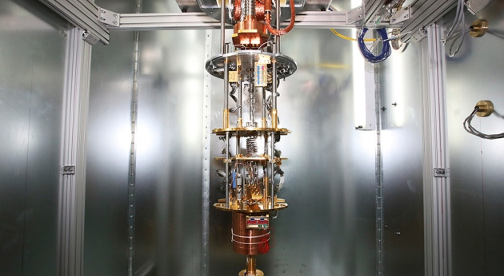
D-Wave Systems Quantum Annealer
D-Wave Upgrade, Nature | News, 24 Jan 2017

Slide 44
Other Models of Quantum Computation
Topological quantum computing
employs two-dimensional quasiparticles called anyons whose world lines pass around one another to form braids in three-dimensional spacetime
these braids form the logic gates
pros: appears to be much more robust to noise than other models
cons: engineering challenges still at a very early state

Slide 45
Artist’s Conception of Topological Quantum Device
Theorem (Simon, Bonesteel, Freedman… PRL05): In any topological quantum computer, all computations can be performed by moving only a single quasiparticle!

Slide 46
Quantum Computer Compilers
QIR: quantum intermediate representation
QASM: quantum assembly language
QPOL: quantum physical operations language
quantum
source
program
QIR
QASM
QPOL
Front
End
Technology
Independent
CG+Optimizer
Technology
Dependent
CG+Optimizer
Technology
Simulator
Quantum Computer Compiler
ABSTRACTIONS
quantum
mechanics
quantum
circuit
quantum
circuit
quantum
device

Slide 47
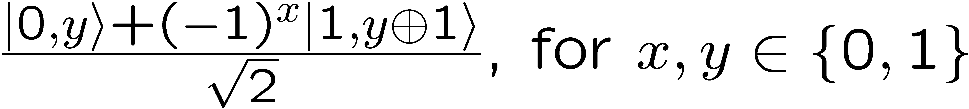
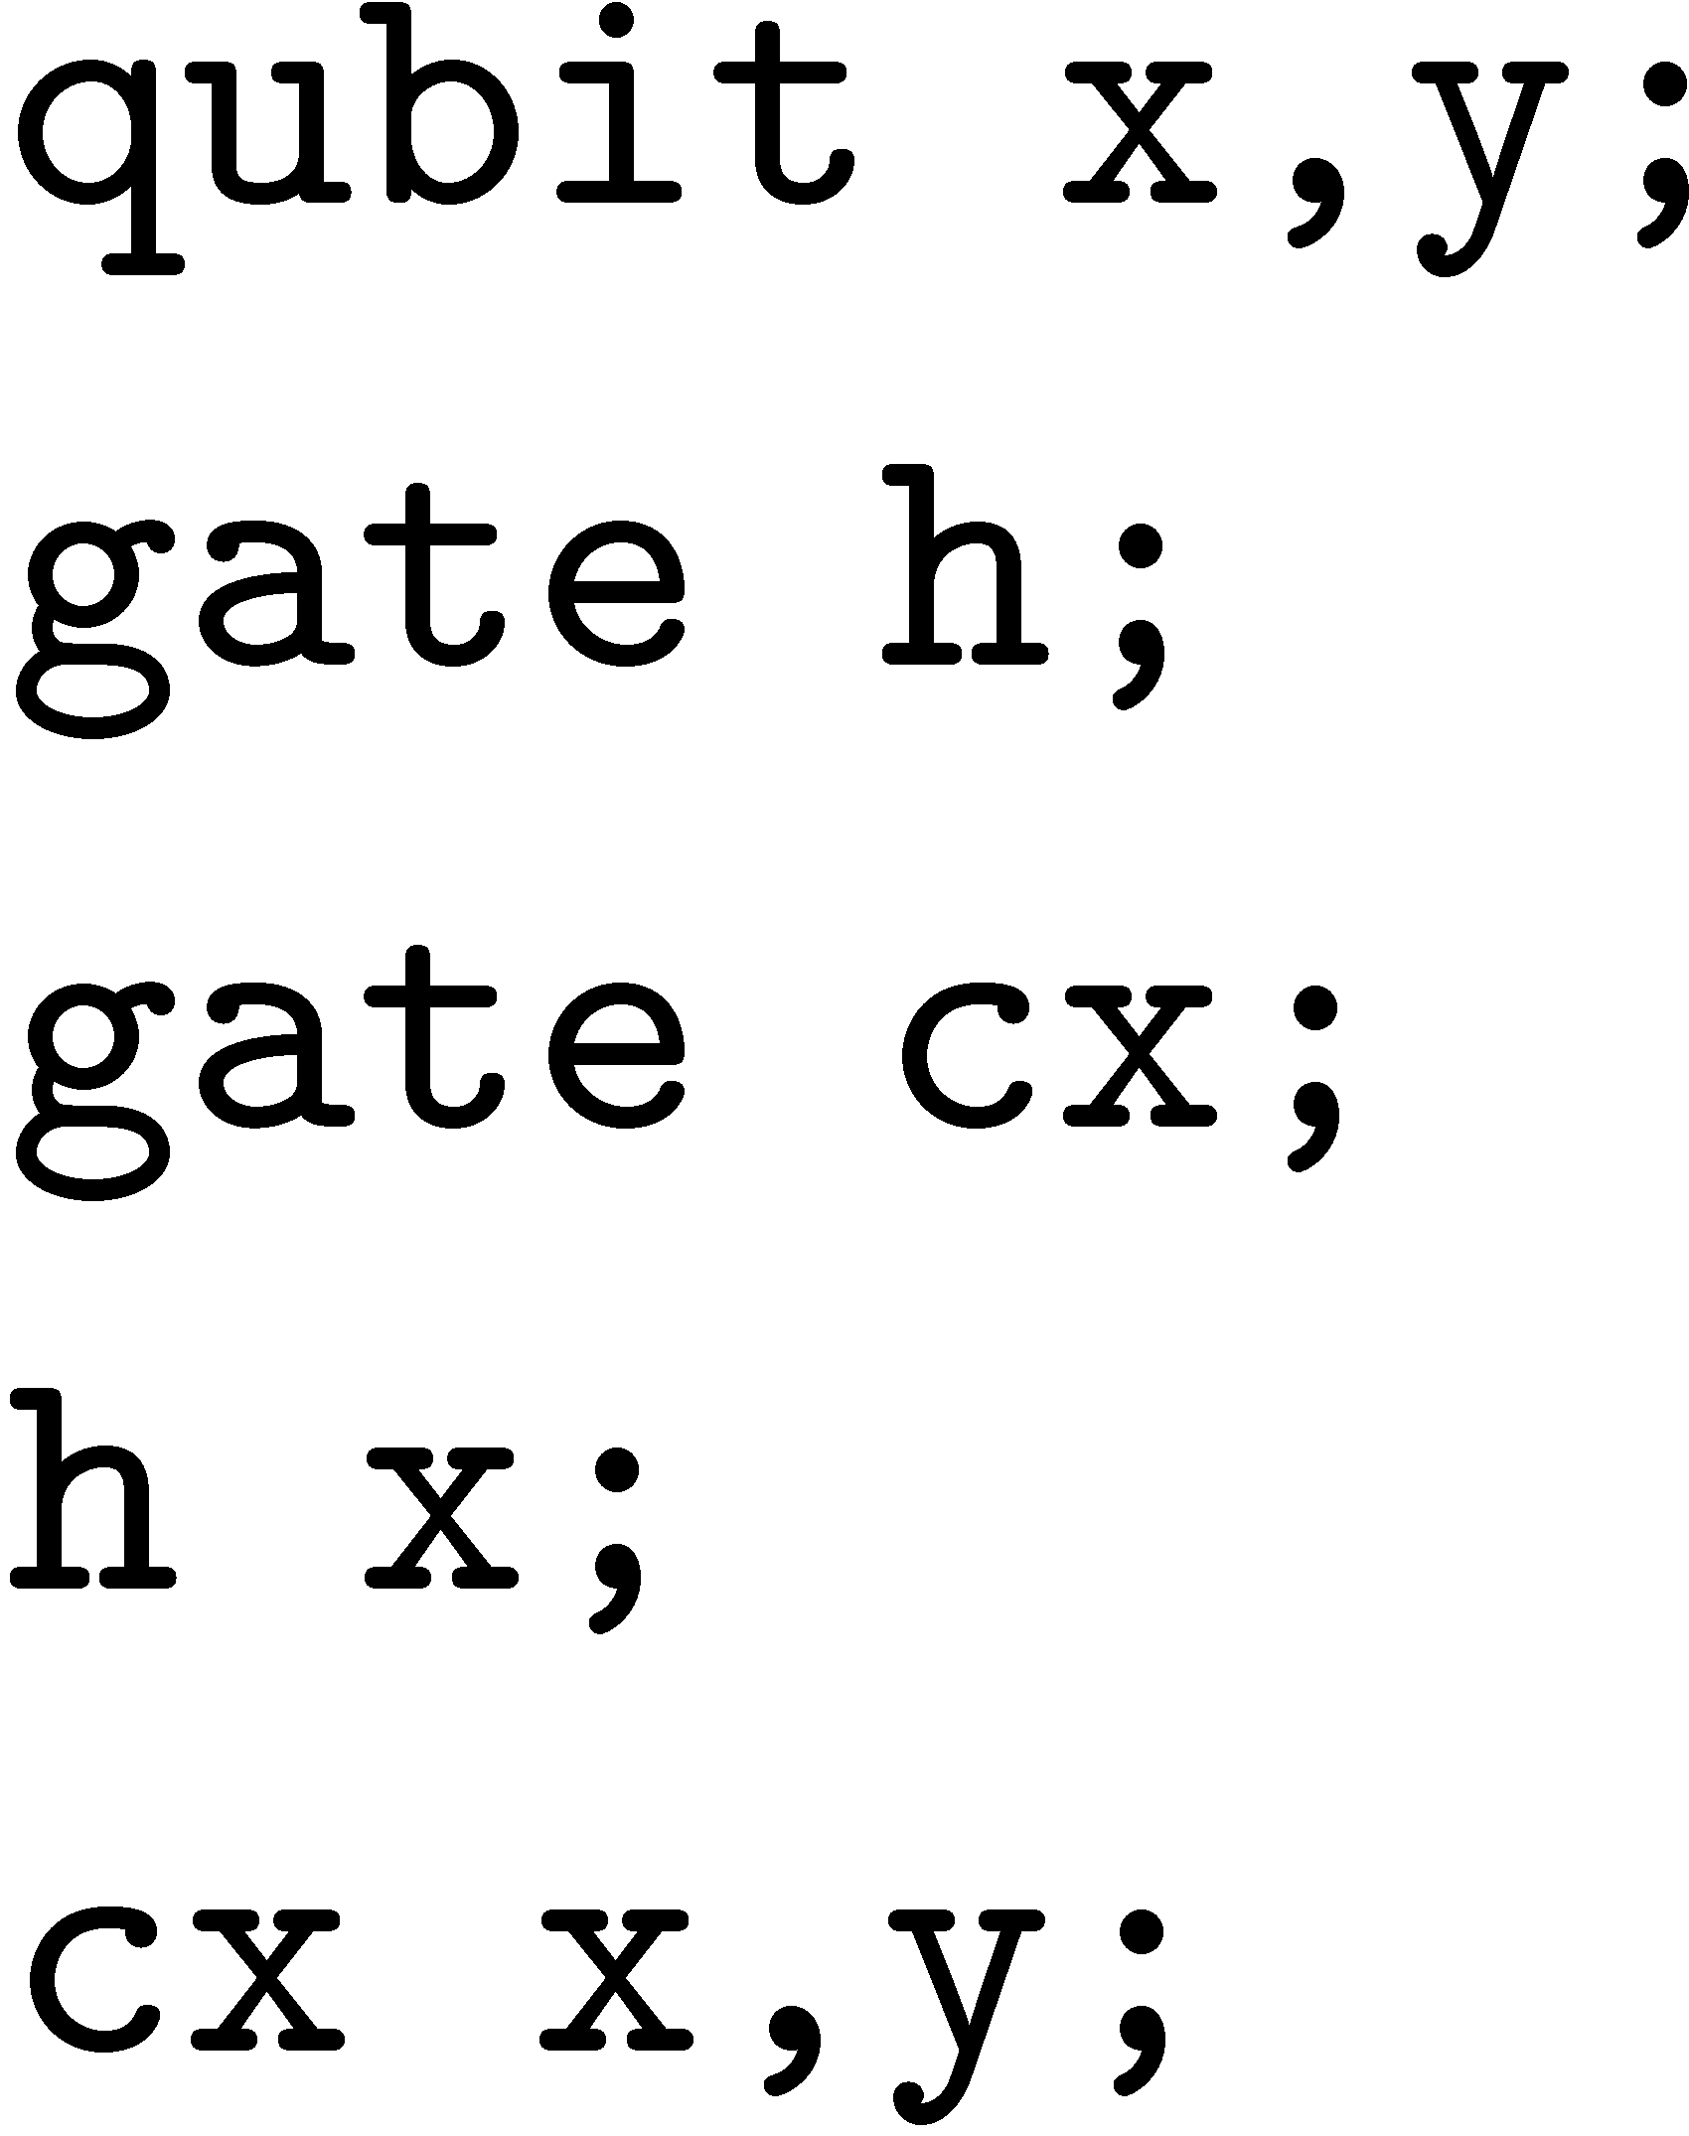
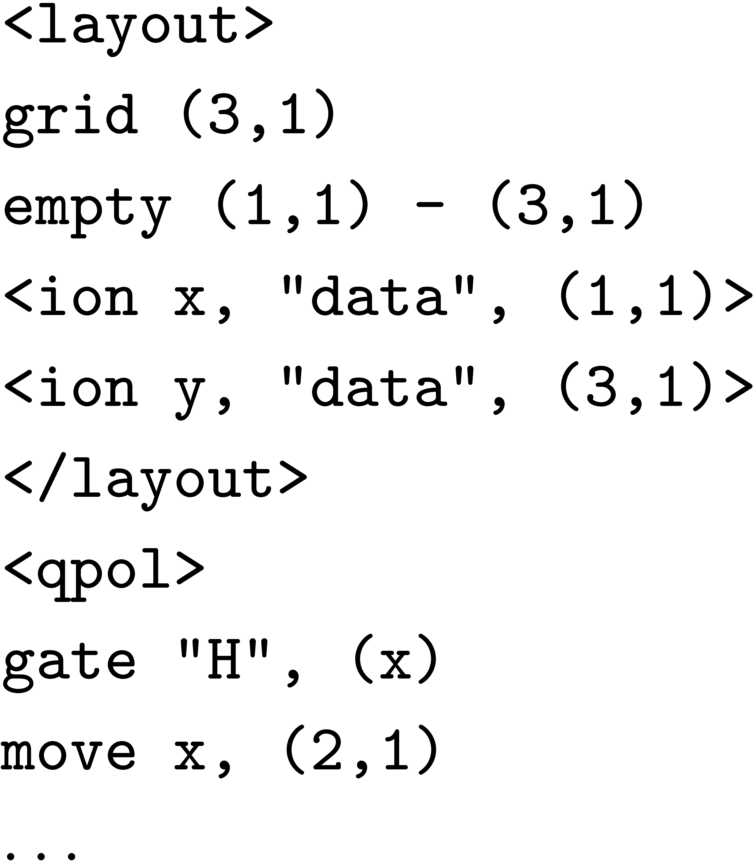

Quantum Computing Design Flow with Fault Tolerance and Error Correction
Mathematical Model:
Quantum mechanics,
unitary operators,
tensor products
Computational
Formulation:
Quantum bits,
gates, and circuits
QCC:
QIR,
QASM
Software:
QPOL
Physical System:
Laser pulses
applied
to ions in traps
EPR Pair Creation
Quantum Circuit Model
QIR
QASM
QPOL
Machine Instructions
Physical Device
A
1
2
3
B
A
1
2
3
B
Fault Tolerance and Error Correction (QEC)
QEC
Moves
Moves
QEC
K. Svore
PhD Thesis
Columbia, 2006

Slide 48
Quantum Computing Design Tools
Vision: Layered hierarchy with well-defined interfaces
Programming Languages
Compilers
Optimizers
Layout Tools
Simulators
K. Svore, A. Aho, A. Cross, I. Chuang, I. Markov
A Layered Software Architecture for Quantum Computing Design Tools
IEEE Computer, 2006, vol. 39, no. 1, pp.74-83

Slide 49
LIQUi|>: Language-integrated Quantum Operations
LIQUi|> is a software architecture and toolsuite for quantum computing
Includes a programming language, optimization and scheduling algorithms, and quantum simulations
Translates quantum algorithms written in a high-level programming language into the low-level instructions for a quantum device
Developed by Dave Wecker and Krysta Svore of the Quantum Architectures and Computation group at Microsoft Research
Dave Wecker and Krysta Svore
LIQUi|>: A Software Design Architecture and
Domain-Specific Language for Quantum Computing
arXiv:1402.4467v1 [quant-ph] 18 Feb 2014

Slide 50
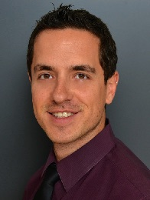
Ongoing Research: QAOA
Quantum Approximate Optimization Algorithms (QAOA)
A QAOA circuit consists of alternating applications of phase separator operators and mixing operators.
Research Problem: Can QAOA circuits produce efficient quantum programs for optimizing hard combinatorial problems?
Stuart Andrew Hadfield
Quantum Algorithms for Scientific Computing and Approximate Optimization
PhD Thesis, Columbia University, 2017

Slide 51

The Future of Algorithms?
“Organisms are algorithms.”

