Slide 1
Software, Computation and Models of Computation
Al Aho
aho@cs.columbia.edu
Workshop on Computational Brain Research
IIT Madras, January 8, 2016

Slide 2
Algorithms and Data Structures for Natural Language Processing

Slide 3
What is an Algorithm?
A finite sequence of instructions, each of which has a clear meaning and can be performed with a finite amount of effort in a finite length of time.
Alfred V. Aho, John E. Hopcroft, and Jeffrey D. Ullman
Data Structures and Algorithms
Addison Wesley, 1983

Slide 4
Universal Models of Computation
Turing machines
Random access machines
The lambda calculus

Slide 5
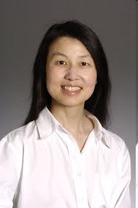
The Importance of Computational Thinking
Computational thinking is a fundamental skill for everyone, not just for computer scientists. To reading, writing, and arithmetic, we should add computational thinking to every child’s analytical ability. Just as the printing press facilitated the spread of the three Rs, what is appropriately incestuous about this vision is that computing and computers facilitate the spread of computational thinking.
Jeannette M. Wing
Computational Thinking
CACM, vol. 49, no. 3, pp. 33-35, 2006

Slide 6
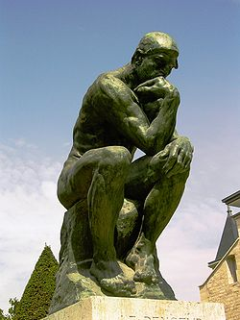
What is Computational Thinking?
The thought processes involved in formulating problems so their solutions can be represented as computation steps and algorithms.
Alfred V. Aho
Computation and Computational Thinking
The Computer Journal, vol. 55, no. 7, pp. 832- 835, 2012

Slide 7
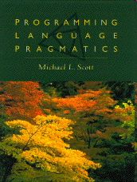
Programming Languages
Programming languages are notations for describing computations to people and to machines.
Underlying every programming language is a model of computation:
Procedural: C, C++, C#, Java
Declarative: SQL
Logic: Prolog
Functional: Haskell
Scripting: AWK, Perl, Python, Ruby

Slide 8
Software
Software =
Algorithms + Programming Languages

Slide 9
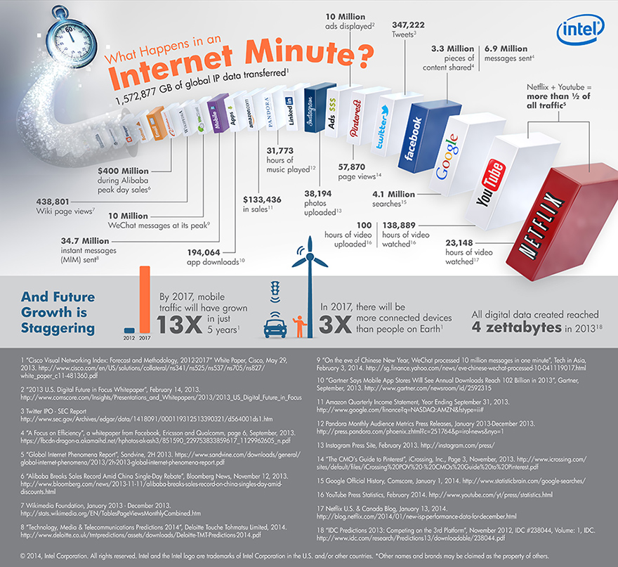

Slide 10
Software in Our World Today
How much software does the world use today?
Guesstimate: over one trillion lines of source code
What is the sunk cost of the legacy base?
$10 to $100 per line of finished, tested source code
How many bugs are there in the legacy base?
10 to 10,000 defects per million lines of source code
Adapted from A. V. Aho
Software and the Future of Programming Languages
Science, February 27, 2004, pp. 1131-1133

Slide 11
Programming Languages
Today there are thousands of programming languages.
Tiobe.com’s ten most popular languages for December 2015:
1. Java 6. PHP
2. C 7. Visual Basic .NET
3. C++ 8. JavaScript
4. Python 9. Perl
5. C# 10. Ruby
[http://www.tiobe.com]

Slide 12
Why Are There So Many Languages?
One language cannot serve all application areas well
e.g., programming web pages (JavaScript)
e.g., electronic design automation (VHDL)
e.g., parser generation (YACC)
Programmers often have strongly held opinions about
what makes a good language
how programming should be done
There is no universally accepted metric for a good language!

Slide 13
Evolutionary Forces on Languages
Increasing diversity of applications
Increasing programmer productivity and shortening time to market
Need to improve software security, reliability and maintainability
Emphasis on mobility and distribution
Support for parallelism and concurrency
New mechanisms for modularity
Trend toward multi-paradigm programming

Slide 14
Computational Thinking for
Programming Language Design
Problem
Domain
Mathematical
Abstraction
Mechanizable
Model of
Computation
Programming
Language
14

Slide 15
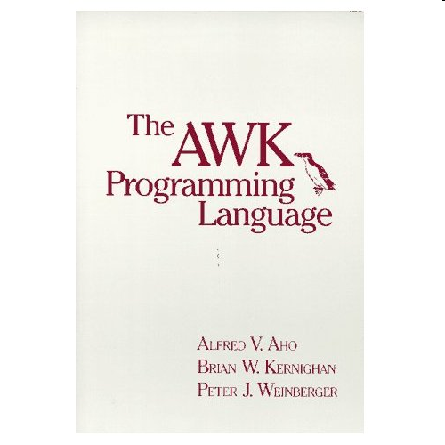
The Birth of AWK
AWK is a scripting language for routine data-processing tasks designed by Al Aho, Brian Kernighan, Peter Weinberger at Bell Labs
Each co-designers had a slightly different motivation
Aho wanted a generalized grep
Kernighan wanted a programmable editor
Weinberger wanted a database query tool
Each co-designer wanted a simple,
easy to use language

Slide 16
AWK’s Model of Computation: Pattern-Action Programming
for each file
for each line of the current file
for each pattern in the AWK program
if the pattern matches the input line then
execute the associated action

Slide 17
Structure of an AWK Program
An AWK program is a sequence of pattern-action statements
pattern { action }
pattern { action }
. . .
Each pattern is a boolean combination of regular, numeric, and string expressions
An action is a C-like program
If there is no { action }, the default is to print the line
Invocation
awk ’program’ [file1 file2 . . . ]
awk –f progfile [file1 file2 . . . ]

Slide 18
Some Useful AWK “One-liners”
Print the total number of input lines
END { print NR }
Print the last field of every input line
{ print $NF }
Print each input line preceded by its line number
{ print NR, $0 }
Print all non-empty input lines
NF > 0
Print all unique input lines
!x[$0]++

Slide 19
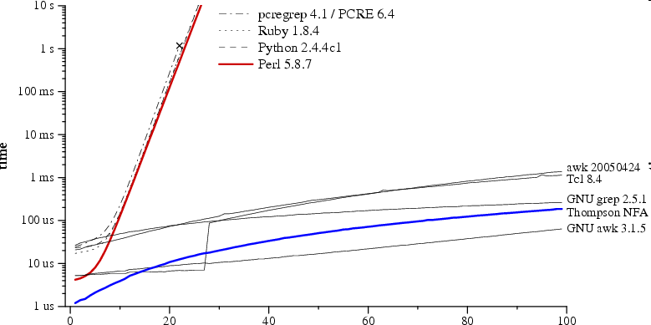
Comparison: Regular Expression Pattern Matching in Perl, Python, Ruby vs. AWK
Time to check whether a?^{n}a^{n} matches a^{n}
regular expression and text size n
Russ Cox, Regular expression matching can be simple and fast (but is slow in Java, Perl, PHP, Python, Ruby, ...) [http://swtch.com/~rsc/regexp/regexp1.html, 2007]

Slide 20
Language Translation
Given a source language S, a target language T, and a sentence s in S, map s into a sentence t in T that has the same meaning as s.

Slide 21
Translation of Programming Languages
input
Compiler
source
program
target
program
output

Slide 22
Methods for Specifying the Semantics of Programming Languages
Operational semantics
translation of program constructs to an understood language
Axiomatic semantics
assertions called preconditions and postconditions specify the properties of statements
Denotational semantics
semantic functions map syntactic objects to semantic values

Slide 23
Phases of a Compiler
source
program
target
program
Lexical
Analyzer
Syntax
Analyzer
Semantic
Analyzer
Interm.
Code
Gen.
Code
Optimizer
Code
Gen.
token
stream
syntax
tree
annotated
syntax
tree
interm.
rep.
interm.
rep.
Symbol Table
Alfred V. Aho, Monica S. Lam, Ravi Sethi and Jeffrey D. Ullman
Compilers: Principles, Techniques, & Tools
Addison Wesley, 2007

Slide 24
Natural Languages
A natural language is any language that develops naturally in humans through use and repetition without any conscious planning or premeditation.
[Wikipedia]
Popular spoken natural languages:
Chinese 1,197m Portuguese 203m
Spanish 399m Bengali 189m
English 335m Russian 166m
Hindi 260m Japanese 128m
Arabic 242m Punjabi 100m
Ethnologue catalogs over 7,100 spoken languages.

Slide 25
Natural Languages are Messy
I made her duck.
[5 meanings: D. Jurafsky and J. Martin, 2000]
One morning I shot an elephant in my pajamas. How he got into my pajamas I don’t know.
[Groucho Marx, Animal Crackers, 1930]
List the sales of the products produced in 1973 with the products produced in 1972.
[455 parses: W. Martin, K. Church, R. Patil, 1987]

Slide 26
Towards More Reliable Software
How can we get reliable software from unreliable programmers?

Slide 27
IEEE Spectrum Software Hall of Shame
Year
Company
Costs in US $
2004 | UK Inland Revenue | Software errors contribute to $3.45 billion tax-credit overpayment
2004 | J Sainsbury PLC [UK] | Supply chain management system abandoned after deployment costing $527M
2002 | CIGNA Corp | Problems with CRM system contribute to $445M loss
1997 | U. S. Internal Revenue Service | Tax modernization effort cancelled after $4 billion is spent
1994 | U. S. Federal Aviation Administration | Advanced Automation System canceled after $2.6 billion is spent
R. N. Charette, Why Software Fails, IEEE Spectrum, September 2005

Slide 28
Software Errors in Scientific Papers
Five papers published in Science, the Journal of Molecular Biology and the Proceedings of the National Academy of Sciences retracted because of software errors.
Zeeya Merali
Computational science: … Error ... why scientific programming does not compute
Nature 467, 775-777, 13 October 2010

Slide 29
Software Errors in Scientific Papers
The opportunities for both subtle and profound errors in software and data management are boundless, yet they remain surprisingly underappreciated. Here I estimate that any reported scientific result could very well be wrong if data have passed through a computer, and that these errors may remain largely undetected. It is therefore necessary to greatly expand our efforts to validate scientific software and computed results.
DAW Soergel
Rampant software errors may undermine scientific results
F1000Research 2015, 3:303

Slide 30
NASA’s Mars Science Laboratory
Mars Science Laboratory (MSL) is a robotic space probe mission launched by NASA on November 26, 2011
It successfully landed Curiosity, a robotic Mars rover, in the Gale Crater on August 5, 2012
MSL depends on millions of lines of software working correctly

Slide 31
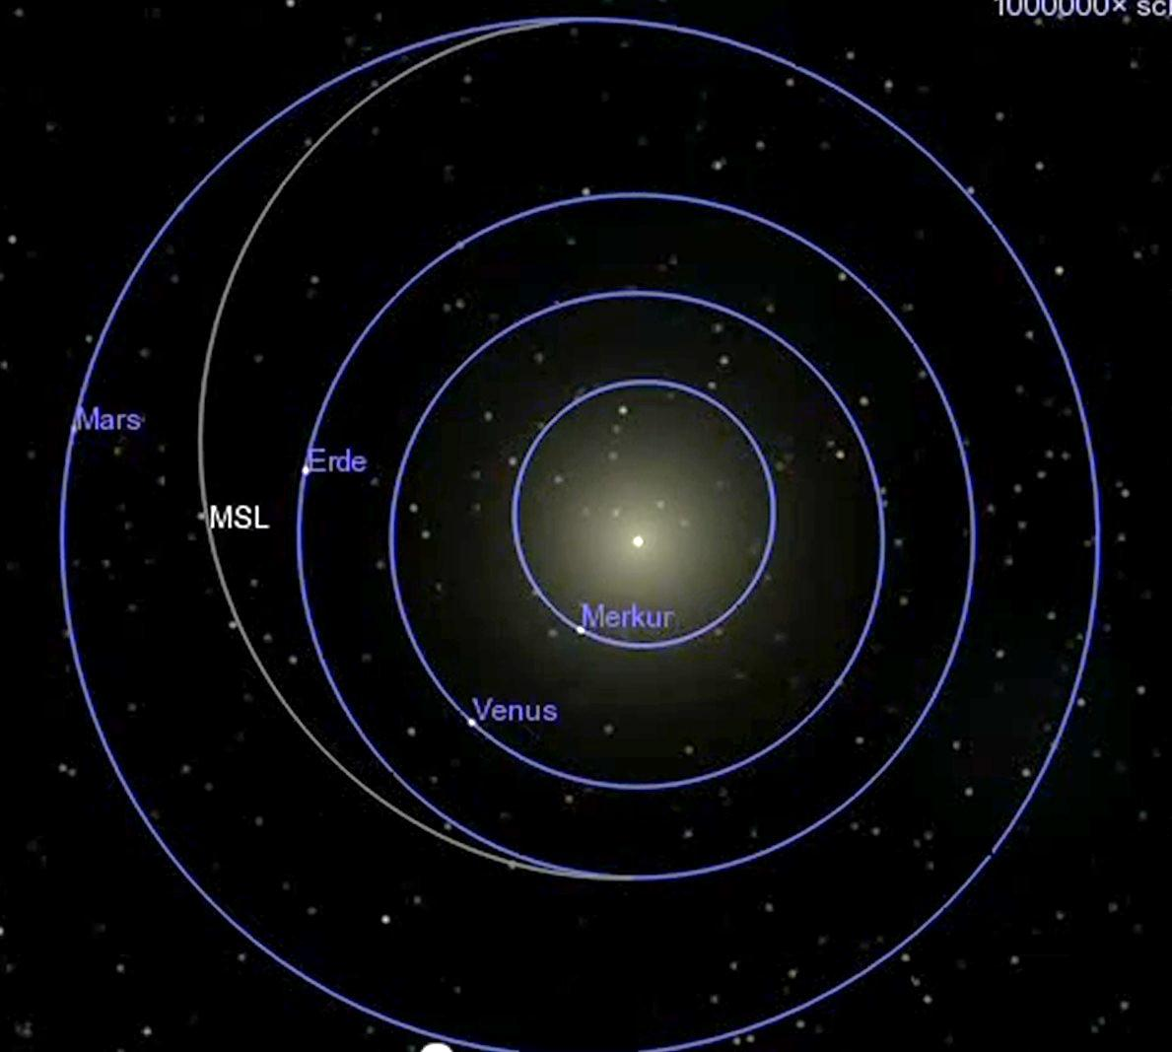
Mission to
Mars…
5 August 2012
Mars
Earth
Sun
Mercury
Venus
26 November 2011
a trip of
350 million miles

Slide 32
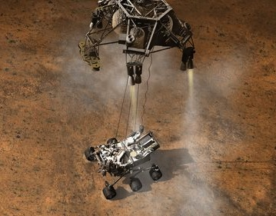
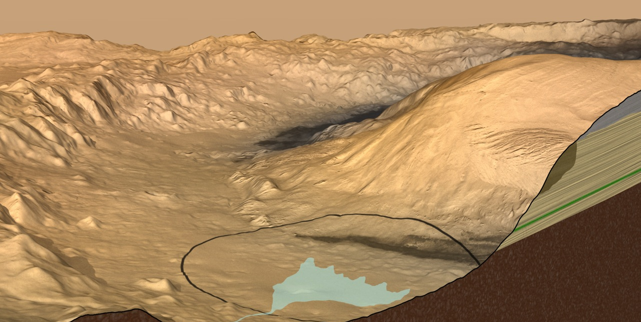
Destination: Gale Crater
an old streambed
12 x 4.3 mile landing ellipse

Slide 33
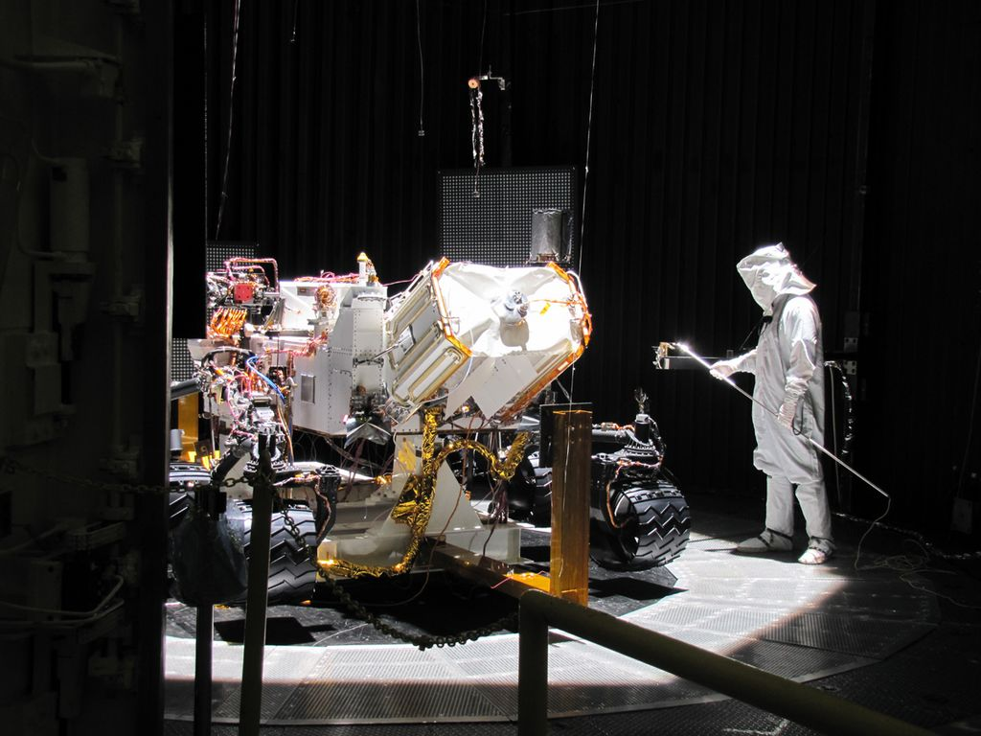
How Do You Make Sure That It Works?

Slide 34
And What About the Software?
3 million lines of C code
120 parallel threads
VxWorks tasks
2 CPUs (1 spare)
5 years development time, with
a team of 40 software engineers
< 10 lines of code per hour
1 customer, 1 use:
it has to work the first time
How do you get it right?
Gerard Holzmann

Slide 35
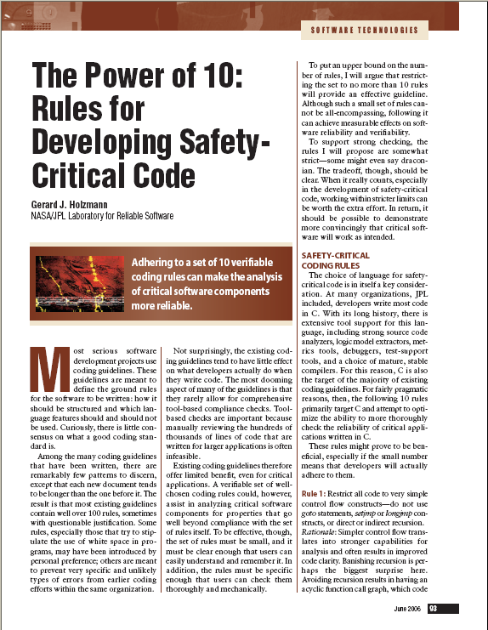
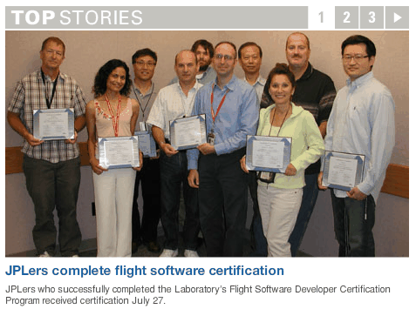
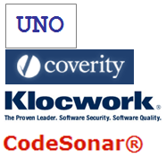
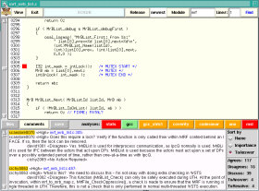
Getting It Right some of the things done differently from previous missions
Defined a new risk-based Coding Standard with tool-based compliance checks
Introduced a Certification program for flight software developers
Introduced routine use of strong Static Source Code Analysis tools
Defined a new Code Review process and Tool (scrub), integrated with static analysis
Made use of formal analysis for key subsystems with Logic Model Checking

Slide 36
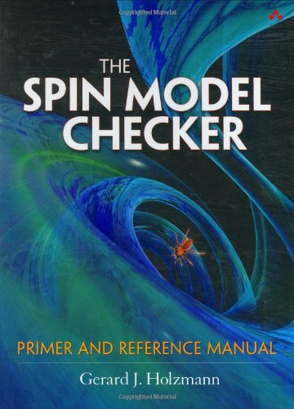
The Spin Model Checker
Developed by Gerard Holzmann at Bell Labs starting in 1980
Spin has been used worldwide for the formal verification of multi-threaded software applications
Available as an open-source software verification tool
Spin was used to help verify the software in NASA’s Mars Science Laboratory

Slide 37
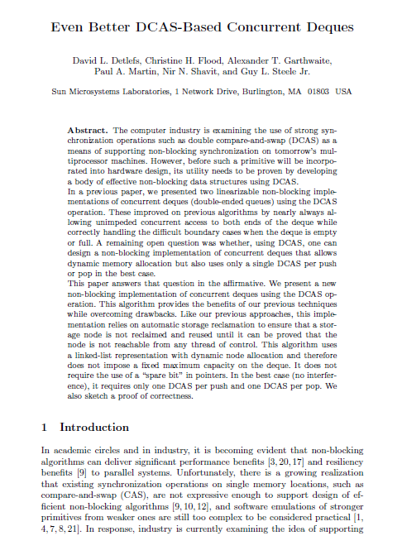
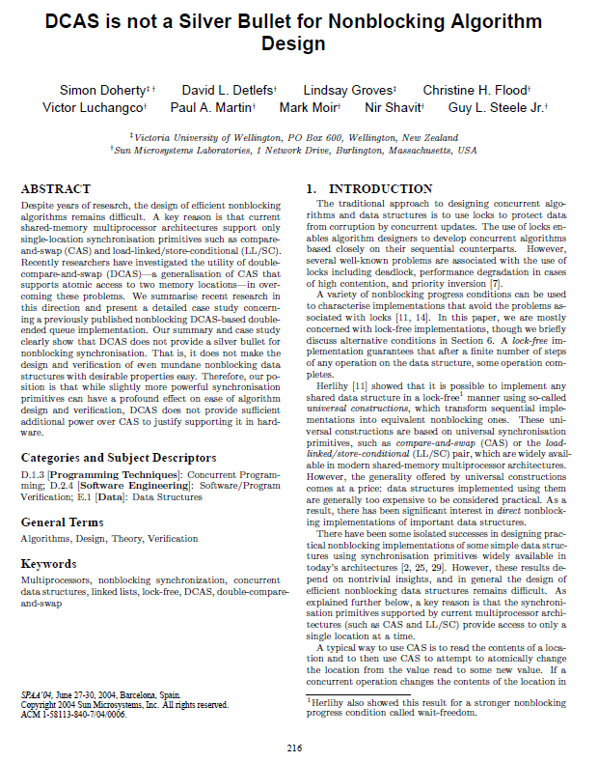
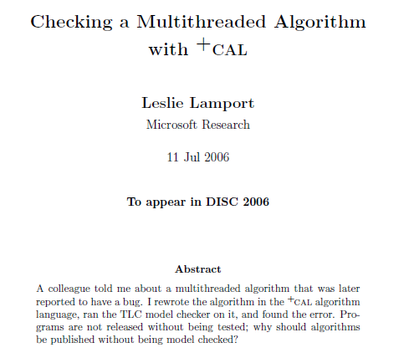
Verifying Concurrent Code What is the State-of-the-art?
2000
a small example
2004
2006
2000: manual proof (a few months)
proof sketch: 5 pages, 7 Lemmas, 5 Theorems
2004: new proof with PVS theorem prover (3 months)
2006: +CAL model & TLA+ proof (a few days)
Is it any easier today?

Slide 38
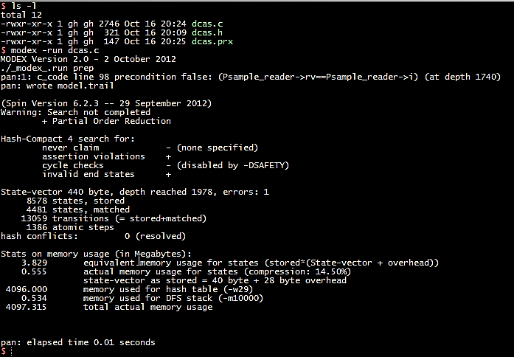
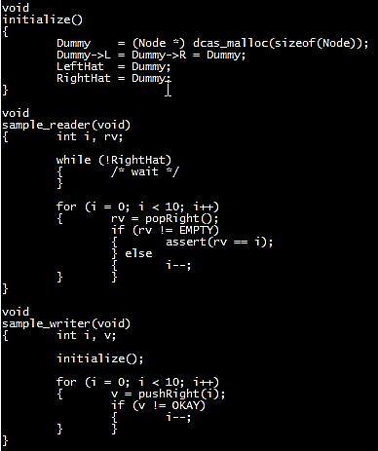
Today This Verification Takes Seconds
$ verify dcas.c
..report assertion violation
$
this takes C code as input
it uses the modex model-extractor to generate
a formal model mechanically, and then runs the
Spin model-checker to check if the assertion
can be violated
all steps together take about 10 seconds
the verification step itself takes a fraction of that
Gerard Holzmann

Slide 39
Cutting to the Chase
In the first (Earth) year on the surface of Mars the previous mission lost 26 days of operation to software bugs.
In the first year on Mars the MSL mission lost 1 day to a single bug.

Slide 40
Al Aho asks Don Knuth a Question
Al Aho, Columbia: We all know that the Turing Machine is a universal model for sequential computation.
But let's consider reactive distributed systems that maintain an ongoing interaction with their environment—systems like the Internet, cloud computing, or even the human brain. Is there a universal model of computation for these kinds of systems?
Twenty Questions for Donald Knuth
May 20, 2014
http://www.informit.com/articles/article.aspx?p=2213858

Slide 41
Knuth’s Answer - 1
I'm not strong on logic, so TAOCP [The Art of Computer Programming] treads lightly on this sort of thing. The TAOCP model of computation, discussed on pages 4–8 of Volume 1, considers "reactive processes," a.k.a. "computational methods," which correspond to single processors.

Slide 42
Knuth’s Answer - 2
I've long planned to discuss recursive coroutines and other cooperative processes in Chapter 8, after I finish Chapter 7. The beautiful model of context-free parsing via semiautonomous agents, in Floyd's great survey paper of 1964, has strongly influenced my thinking in this regard.

Slide 43
Knuth’s Answer - 3
I'd like to see extensions of the set-theoretic model of computation at the beginning of Volume 1 to the things you mention. They might well shed light on the subject.

Slide 44
Knuth’s Answer - 4
But fully distributed processes are well beyond the scope of my books and my own ability to comprehend them. For a long time I've thought that an understanding of the way ant colonies are able to perform incredibly organized tasks might well be the key to an understanding of human cognition. Yet the ants that invade my house continually baffle me.

Slide 45
Summary
Is there a universal model of computation for reactive distributed systems that maintain an ongoing interaction with their environment?

