Slide 1


Programming Languages and Compilers for Quantum Computers
Al Aho
aho@cs.columbia.edu
June 16, 2014

Slide 2
A Compiler Writer Looks at Quantum Computation
Why is there so much excitement about quantum computation?
Computational thinking for quantum programming
Candidate quantum device technologies
Why do we need quantum programming languages and compilers?
Important remaining challenges

Slide 3
Why the Excitement?
“Quantum information is a
radical departure in information
technology, more fundamentally
different from current technology
than the digital computer is from
the abacus.”
William D. Phillips,
1997 Nobel Prize Winner in Physics

Slide 4

Shor’s Integer Factorization Algorithm
Problem: Given a composite n-bit integer, find a nontrivial factor.
Best-known deterministic algorithm on a classical computer has time complexity
exp(O( n^{1/3} log^{2/3} n )).
A quantum computer can solve this
problem in O( n³ ) operations.
Peter Shor
Algorithms for Quantum Computation: Discrete Logarithms and Factoring
Proc. 35th Annual Symposium on Foundations of Computer Science, 1994, pp. 124-134

Slide 5
Integer Factorization: Estimated Times
Classical: number field sieve
  Time complexity: exp(O(n^{1/3} log^{2/3} n))
  Time for 512-bit number: 8400 MIPS years
  Time for 1024-bit number: 1.6 billion times longer
Quantum: Shor’s algorithm
  Time complexity: O(n³)
  Time for 512-bit number: 3.5 hours
  Time for 1024-bit number: 31 hours
    (assuming a 1 GHz quantum device)
M. Oskin, F. Chong, I. Chuang
A Practical Architecture for Reliable Quantum Computers
IEEE Computer, 2002, pp. 79-87

Slide 6
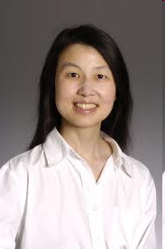
The Importance of Computational Thinking
Computational thinking is a fundamental skill for everyone, not just for computer scientists. To reading, writing, and arithmetic, we should add computational thinking to every child’s analytical ability. Just as the printing press facilitated the spread of the three Rs, what is appropriately incestuous about this vision is that computing and computers facilitate the spread of computational thinking.
Jeannette M. Wing
Computational Thinking
CACM, vol. 49, no. 3, pp. 33-35, 2006

Slide 7
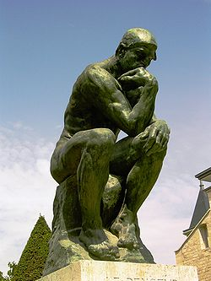
What is Computational Thinking?
The thought processes involved in formulating problems so their solutions can be represented as computation steps and algorithms.
Alfred V. Aho
Computation and Computational Thinking
The Computer Journal, vol. 55, no. 7, pp. 832- 835, 2012

Slide 8
Computational Thinking for
Quantum Computing
Quantum
Phenomena
Mathematical
Abstraction
Mechanizable
Model of
Computation
Algorithms for
Computation

Slide 9
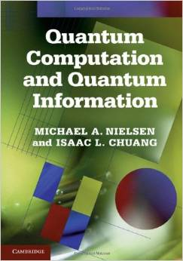
Quantum Mechanics:
The Mathematical Abstraction for
Quantum Computing
The Four Postulates of Quantum Mechanics
M. A. Nielsen and I. L. Chuang
Quantum Computation and Quantum Information
Cambridge University Press, 2000

Slide 10
State Space Postulate
Postulate 1
The state of an isolated quantum system can be described
by a unit vector in a complex Hilbert space.

Slide 11
Qubit: Quantum Bit
The state of a quantum bit in a 2-dimensional complex Hilbert space can be described by a unit vector (in Dirac notation)
where α and β are complex coefficients called the amplitudes of the basis states |0⟩ and |1⟩ and
In conventional linear algebra

Slide 12
Time-Evolution Postulate
Postulate 2
The evolution of a closed quantum system
can be described by a unitary operator U.
(An operator U is unitary if U † = U ⁻¹.)
U
state of
the system
at time t₁
state of
the system
at time t₂

Slide 13
Useful Quantum Operators: Pauli Operators
Pauli operators
X
In conventional linear algebra
is equivalent to

Slide 14
Useful Quantum Operators: Hadamard Operator
The Hadamard operator has the matrix representation
H maps the computational basis states as follows
Note that HH = I.

Slide 15
Composition-of-Systems Postulate
Postulate 3
The state space of a combined physical system is
the tensor product space of the state spaces of the
component subsystems.
If one system is in the state and another is in
the state , then the combined system is in the
state .
is often written as or as .

Slide 16
Useful Quantum Operators: the CNOT Operator
The two-qubit CNOT (controlled-NOT) operator:
CNOT flips the target bit t iff the control bit c has the value 1:
.
c
c
t
The CNOT gate maps

Slide 17
Measurement Postulate
Postulate 4
Quantum measurements can be described by a collection {M_{m} } of operators acting on the state space of the system being measured. If the state of the system is |ψ⟩ before
measurement, then the probability that the result m occurs is
and the state of the system after measurement is

Slide 18
Measurement Postulate (cont’d)
The measurement operators satisfy the
completeness equation:
The completeness equation says the probabilities sum
to one:

Slide 19
Measurement Example
Suppose the state being measured is that of a single qubit
and we have two measurement operators: M₀ which projects the state onto the |0⟩ basis and M₁ which projects the state onto the |1⟩ basis.
The probability that the result 0 occurs is
and the state of the system after measurement is

Slide 20
Three Models of Computation for
Quantum Computing
Quantum circuits
Topological quantum computing
Adiabatic quantum computing

Slide 21
Quantum Circuit Model for Quantum Computation
Quantum circuit to create Bell (Einstein-Podulsky-Rosen) states:
Circuit maps
Each output is an entangled state, one that cannot be written in a product form. (Einstein: “Spooky action at
a distance.”)
x
H
y

Slide 22
Alice and Bob’s Qubit-State Delivery Problem
Alice knows that she will need to send to Bob the state of an important secret qubit sometime in the future.
Her friend Bob is moving far away and will have a very low bandwidth Internet connection.
Therefore Alice will need to send her qubit state to Bob cheaply.
How can Alice and Bob solve their problem?

Slide 23
Alice and Bob’s Solution: Quantum Teleportation!
Alice and Bob generate an EPR pair |β₀₀⟩ .
Alice takes one half of the pair; Bob the other half. Bob moves far away.
Alice gets and interacts her secret qubit |ψ⟩ with her EPR-half and measures the two qubits.
Alice sends the two resulting classical measurement bits to Bob.
Bob decodes his half of the EPR pair using the two bits to discover |ψ⟩ .
H
M₁
M₂
X
Z

Slide 24
Quantum Computer Architecture
Quantum
Memory
Quantum
Logic Unit
Knill [1996]: Quantum RAM, a classical computer combined with a quantum device with operations for initializing registers of qubits and applying quantum operations and measurements
Classical Computer
E. Knill
Conventions for Quantum Pseudocode
Los Alamos National Laboratory, LAUR-96-2724, 1996

Slide 25
DiVincenzo Criteria for a Quantum Computer
Be a scalable system with well-defined qubits
Be initializable to a simple fiducial state
Have long decoherence times
Have a universal set of quantum gates
Permit efficient, qubit-specific measurements
David DiVincenzo
The Physical Implementation of Quantum Computation
arXiv:quant-ph/0002077v3

Slide 26
Candidate Quantum Device Technologies
Ion traps
Persistent currents in a superconducting circuit
Josephson junctions
Nuclear magnetic resonance
Optical photons
Optical cavity quantum electrodynamics
Quantum dots
Nonabelian fractional quantum Hall effect anyons

Slide 27
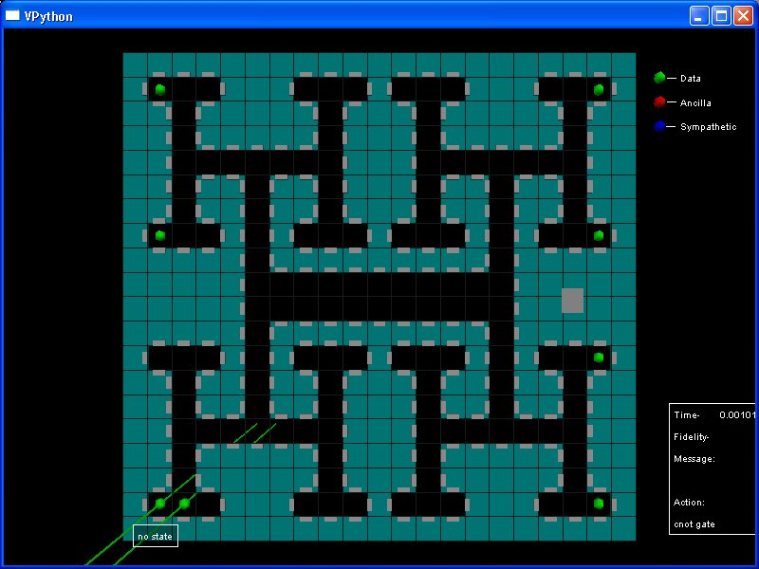
MIT Ion Trap Simulator

Slide 28
Ion Trap Quantum Computer: The Reality

Slide 29
Shor’s Quantum Factoring Algorithm
Input: A composite number N
Output: A nontrivial factor of N
if N is even then return 2;
if N = a^{b} for integers a >= 1, b >= 2 then
return a;
x := rand(1,N-1);
if gcd(x,N) > 1 then return gcd(x,N);
r := order(x mod N); // only quantum step
if r is even and x^{r/2} != (-1) mod N then
{f1 := gcd(x^{r/2}-1,N); f2 := gcd(x^{r/2}+1,N)};
if f1 is a nontrivial factor then return f1;
else if f2 is a nontrivial factor then return f2;
else return fail;
Nielsen and Chuang, 2000

Slide 30
The Order-Finding Problem
Given positive integers x and N, x < N, such that
gcd(x, N) = 1, the order of x (mod N) is the smallest positive integer r such that x^{r} ≡ 1 (mod N).
E.g., the order of 5 (mod 21) is 6.
The order-finding problem is, given two relatively prime integers x and N, to find the order of x (mod N).
All known classical algorithms for order finding are
superpolynomial in the number of bits in N.

Slide 31
Quantum Order Finding
Order finding can be done with a quantum circuit containing
O((log N)² log log (N) log log log (N))
elementary quantum gates.
Best known classical algorithm requires
exp(O((log N)^{1/2} (log log N)^{1/2} ))
time.

Slide 32
Some Proposed Quantum Programming Languages
Quantum pseudocode [Knill, 1996]
QCL [Ömer, 1998-2003]
  imperative C-like language with classical and quantum data
Quipper [Green et al., 2013]
  strongly typed functional programming language with Haskell as the host language
qScript [Google, 2014]
  scripting language, part of Google’s web-based IDE called the Quantum Computing Playground

Slide 33
LIQUi|>: A Software Design Architecture for
Quantum Computing
Contains an embedded, domain-specific language hosted in F# for programming quantum systems
Enables programming, compiling, and simulating quantum algorithms and circuits
Does extensive optimization
Generates output that can be exported to external hardware and software environments
Simulated Shor’s algorithm factoring a 14-bit number (8193 = 3 x 2731) with 31 qubits using 515,032 gates
Dave Wecker and Krysta M. Svore
LIQUi|>:
A Software Design Architecture and Domain-Specific Language for Quantum Computing
arXiv:quant-ph/1402.4467v1, 18 Feb 2014

Slide 34
Language Abstractions and Constraints
States are superpositions
Operators are unitary transforms
States of qubits can become entangled
Measurements are destructive
No-cloning theorem: you cannot copy an unknown quantum state!

Slide 35
Quantum Algorithm Design Techniques
Phase estimation
Quantum Fourier transform
Period finding
Eigenvalue estimation
Grover search
Amplitude amplification

Slide 36
Quantum Computer Design Tools: Desiderata
A design flow that will map high-level quantum programs into efficient fault-tolerant technology-specific implementations on different quantum computing devices
Languages, compilers, simulators, and design tools to support the design flow
Well-defined interfaces between components
Efficient methods for incorporating fault tolerance and quantum error correction
Efficient algorithms for optimizing and verifying quantum programs

Slide 37
Quantum Design Tools Hierarchy
Vision: Layered hierarchy with well-defined interfaces
Programming Languages
Compilers
Optimizers
Layout Tools
Simulators
K. Svore, A. Aho, A. Cross, I. Chuang, I. Markov
A Layered Software Architecture for Quantum Computing Design Tools
IEEE Computer, 2006, vol. 39, no. 1, pp. 74-83

Slide 38

Need for Quantum Programming Languages and Compilers
input
Compiler
source
program
target
program
output

Slide 39
Phases of a Compiler
source
program
target
program
Lexical
Analyzer
Syntax
Analyzer
Semantic
Analyzer
Interm.
Code
Gen.
Code
Optimizer
Target
Code
Gen.
token
stream
syntax
tree
annotated
syntax
tree
interm.
rep.
interm.
rep.
Symbol Table

Slide 40
Universal Sets of Quantum Gates
A set of gates is universal for quantum computation if any unitary operation can be approximated to arbitrary accuracy by a quantum circuit using gates from that set.
The phase gate S = ; the π/8 gate T =
Common universal sets of quantum gates:
    { H, S, CNOT, T }
    { H, I, X, Y, Z, S, T, CNOT }
CNOT and the single qubit gates are exactly universal for quantum computation.

Slide 41
Languages and Abstractions in the Design Flow
QIR: quantum intermediate representation
QASM: quantum assembly language
QPOL: quantum physical operations language
quantum
source
program
QIR
QASM
QPOL
Front
End
Technology
Independent
CG+Optimizer
Technology
Dependent
CG+Optimizer
Technology
Simulator
Quantum Computer Compiler
quantum
mechanics
quantum
circuit
quantum
circuit
quantum
device
ABSTRACTIONS

Slide 42
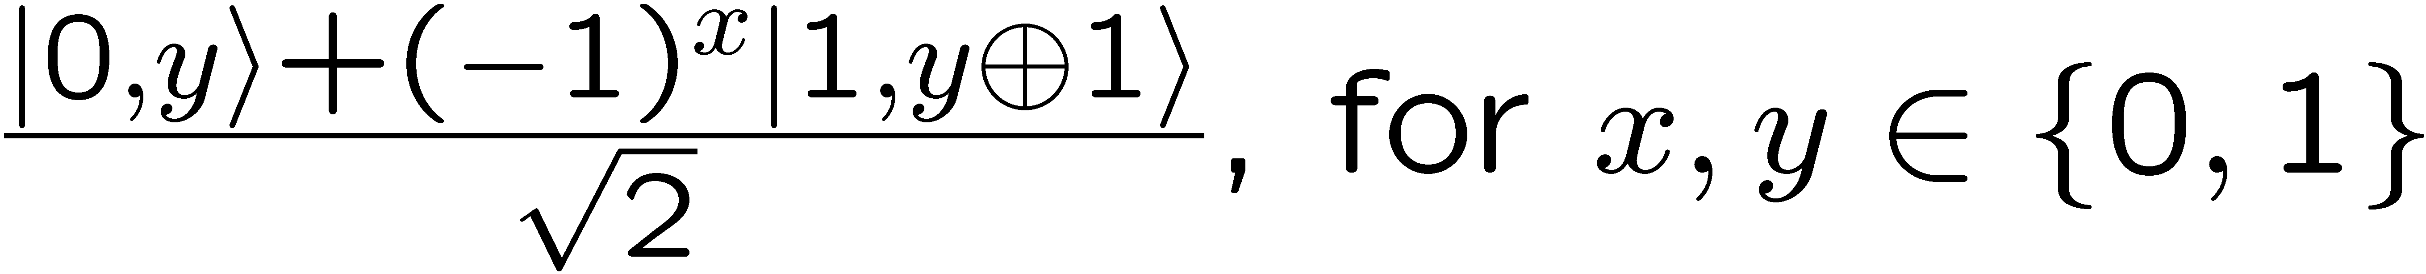
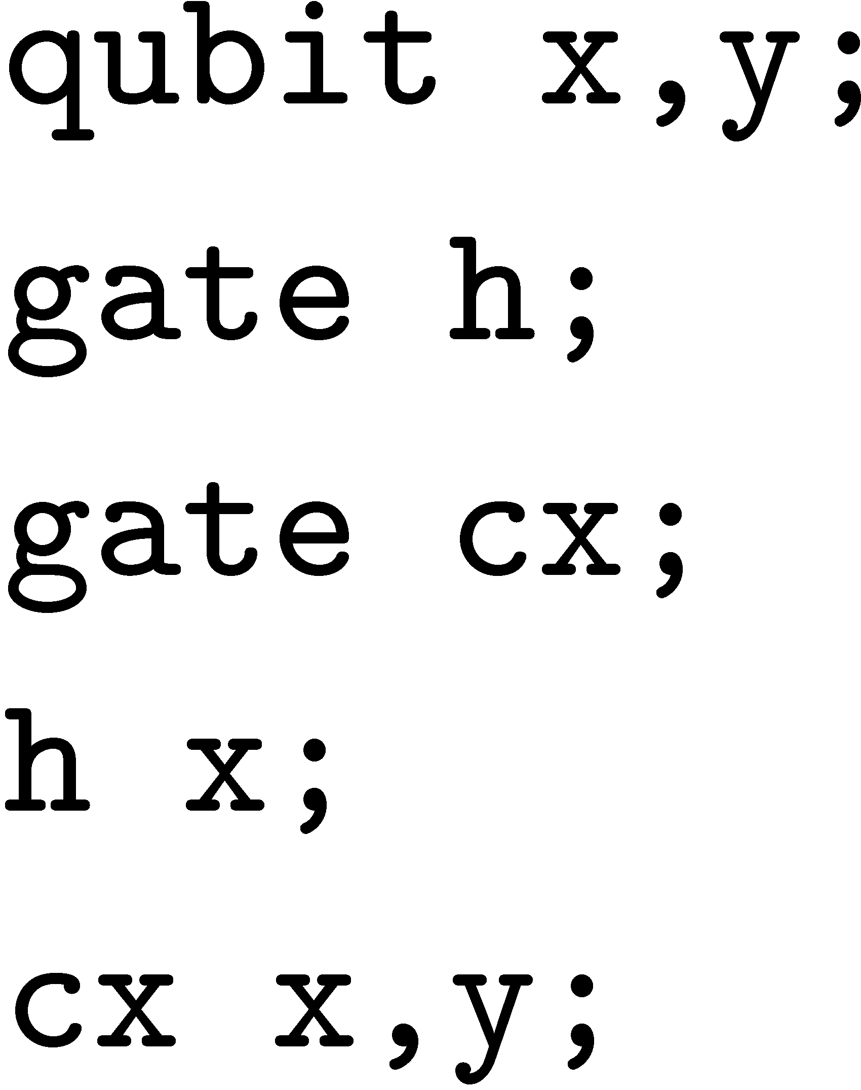
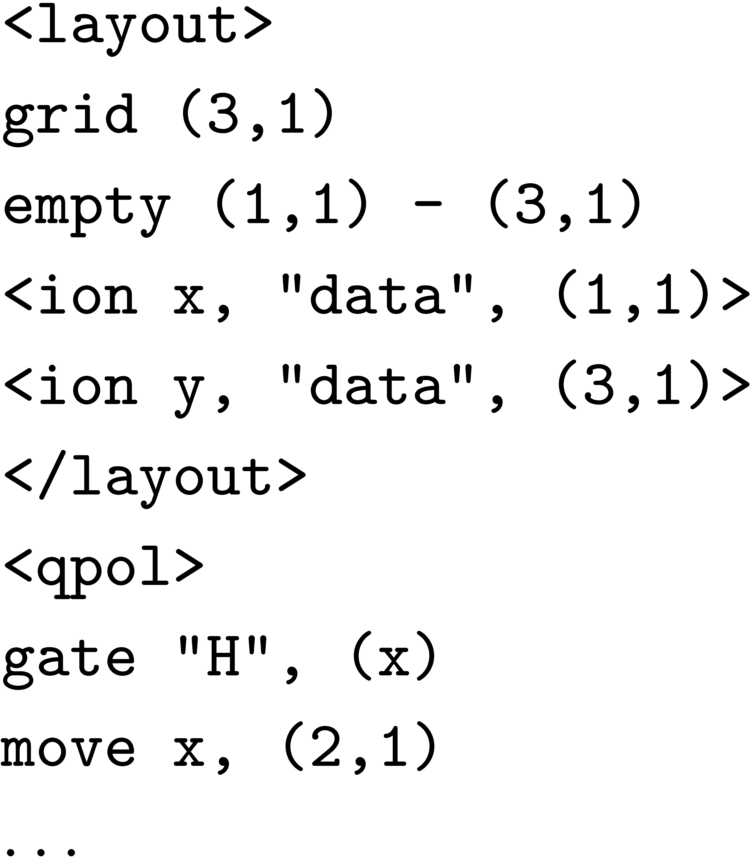
Design Flow for Ion Trap
Mathematical Model:
Quantum mechanics,
unitary operators,
tensor products
Computational
Formulation:
Quantum bits,
gates, and circuits
QCC:
QIR,
QASM
Target
QPOL
Physical System:
Laser pulses
applied
to ions in traps
EPR Pair Creation
Quantum Circuit Model
QIR
QASM
QPOL
Machine Instructions
Physical Device
A
1
2
3
B
A
1
2
3
B

Slide 43
Overcoming Decoherence: Fault Tolerance
In a fault-tolerant quantum circuit computer, more than 99% of the resources spent will probably go to quantum error correction [Chuang, 2006].
A circuit containing N (error-free) gates can be simulated with probability of error at most ε, using N log(N/ε) faulty gates, which fail with probability p, so long as p < p_{th} [von Neumann, 1956].

Slide 44
Quantum Error-Correcting Codes
Obstacles to applying classical error correction to quantum circuits:
  no cloning
  errors are continuous
  measurement destroys information
Shor [1995] and Steane [1996] showed that these obstacles can be overcome with concatenated quantum error-correcting codes.
P. W. Shor
Scheme for Reducing Decoherence in Quantum Computer Memory
Phys. Rev. B 61, 1995
A. Steane
Error Correcting Codes in Quantum Theory
Phys. Rev. Lett. 77, 1996

Slide 45

Design Flow with Fault Tolerance and
Error Correction
Mathematical Model:
Quantum mechanics,
unitary operators,
tensor products
Computational
Formulation:
Quantum bits,
gates, and circuits
QCC:
QIR,
QASM
Software:
QPOL
Physical System:
Laser pulses
applied
to ions in traps
EPR Pair Creation
Quantum Circuit Model
QIR
QASM
QPOL
Machine Instructions
Physical Device
A
1
2
3
B
A
1
2
3
B
Fault Tolerance and Error Correction (QEC)
QEC
Moves
Moves
QEC
K. Svore
PhD Thesis
Columbia, 2006

Slide 46
Synthesis and Simulation of Quantum Circuits
Synthesis of efficient quantum circuits
repeat-until-success circuits [Bocharov, Roetteler & Svore, 2014]
faster phase estimation [Svore, Hastings & Freedman, 2013]
depth-optimal single-qubit circuits [Bocharov & Svore, 2012]
fault-tolerant single-qubit rotations [Duclos-Cianci & Svore, 2012]
fast synthesis of depth-optimal quantum circuits
  [Amy, Maslov, Mosca & Roetteler, 2012]
exact synthesis of multi-qubit Clifford and T- circuits
  [Giles & Sellinger, 2012]
Efficient simulation of quantum circuits
QuIDDPro quantum circuit simulator [Viamontes, Markov & Hayes,
  University of Michigan, 2009]

Slide 47
A Second Model for Quantum Computing:
Topological Quantum Computing
In any topological quantum computer, all computations can be performed by moving only a single quasiparticle!
S. Simon, N. Bonesteel, M. Freedman, N. Petrovic, and L. Hormozi
Topological Quantum Computing with Only One Mobile Quasiparticle
Phys. Rev. Lett, 2006

Slide 48
Topological Robustness

Slide 49
Topological Robustness
=
=
time

Slide 50

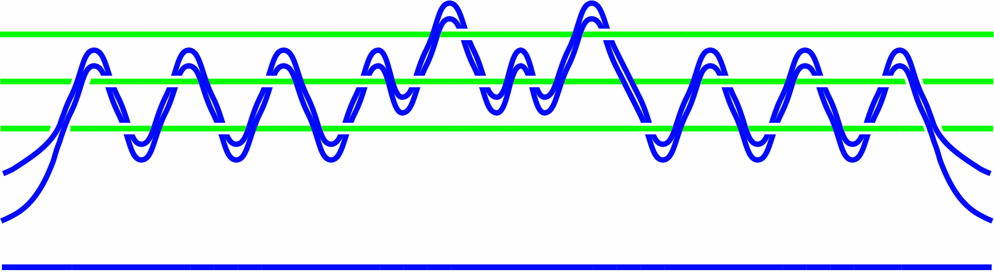
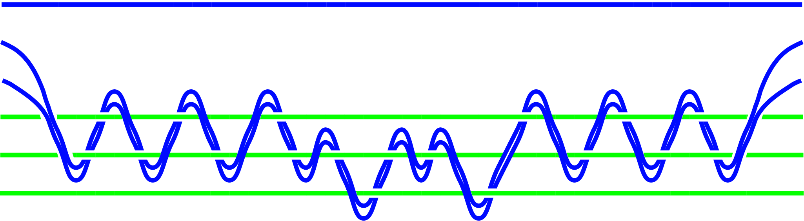



Bonesteel, Hormozi, Simon, … ; PRL 2005, 2006; PRB 2007
Braid
Quantum Circuit
U
=
U
time

Slide 51
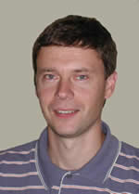
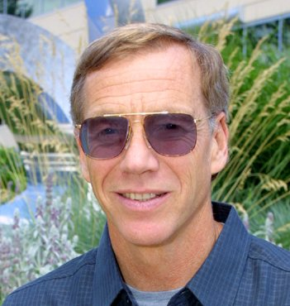
1. Degenerate ground states (in punctured system) act as the qubits.
2. Unitary operations (gates) are performed on ground state by braiding
punctures (quasiparticles) around each other.
Particular braids correspond to particular computations.
3. State can be initialized by “pulling” pairs from vacuum.
State can be measured by trying to return pairs to vacuum.
4. Variants of schemes 2,3 are possible.
Advantages:
Topological Quantum “memory” highly protected from noise
The operations (gates) are also topologically robust
Kitaev Freedman
C. Nayak, S. Simon, A. Stern, M. Freedman, S. DasSarma
Non-Abelian Anyons and Topological Quantum Computation
Rev. Mod. Phys., June 2008

Slide 52
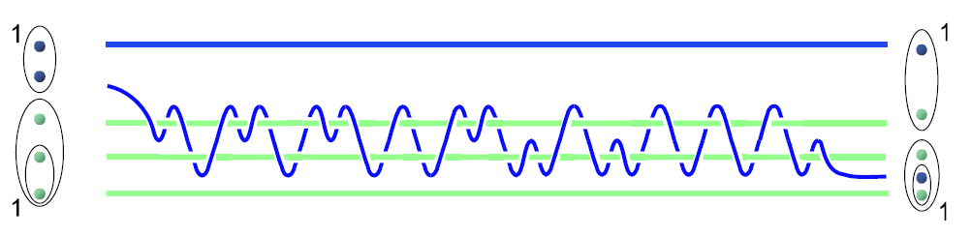

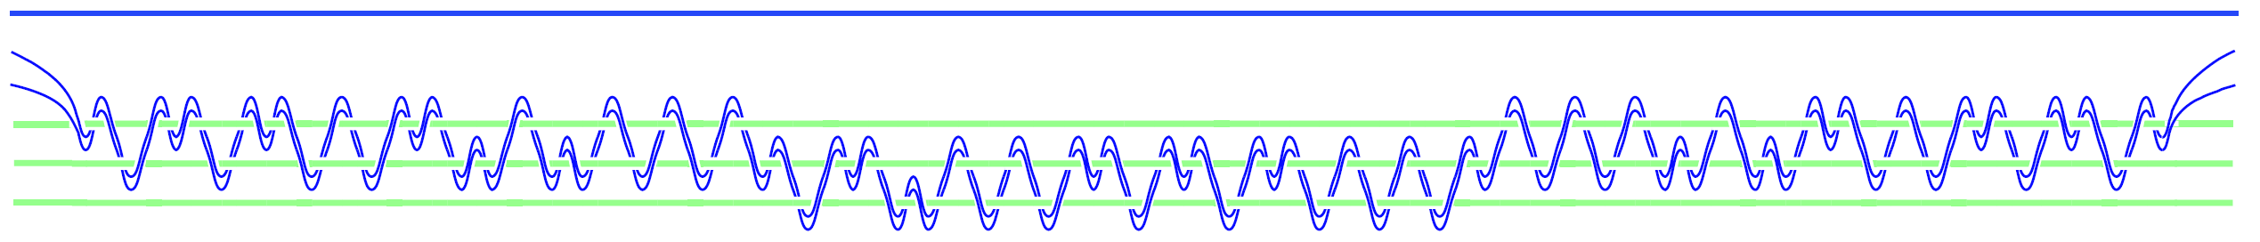
Universal Set of Topologically Robust Gates
Single qubit rotations:
Controlled NOT:
Bonesteel, Hormozi, Simon, 2005, 2006

Slide 53
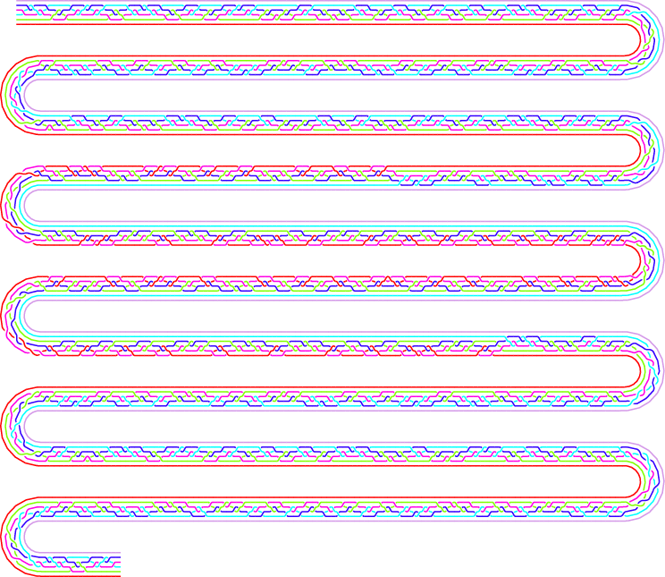
Target Code Braid for CNOT Gate
with Solovay-Kitaev optimization

Slide 54
Optimal Braids
Braids to implement single-qubit unitaries to precision ε using Fibonacci anyons can be generated in polynomial time
Braids have an asymptotically optimal depth of O(log(1/ε))
Vadym Kliuchnikov, Alex Bocharov, and Krysta M. Svore
Asymptotically Optimal Topological Quantum Compiling
Physical Review Letters, v. 112, n. 140504, 9 April 2014

Slide 55
A Third Model for Quantum Computing:
Adiabatic Quantum Computing
  A quantum system will stay near its
  instantaneous ground state if the
  Hamiltonian that governs its evolution varies
  slowly enough.
E. Fahri, J. Goldstone, S. Gutmann, M. Sipser
Quantum Computation by Adiabatic Evolution
arXiv:quant-ph/0001106

Slide 56
Adiabatic Quantum Computing
Quantum computations can be implemented by the adiabatic evolution of the Hamiltonian of a quantum system
To solve a given problem we initialize the system to the ground state of a simple Hamiltonian
We then evolve the Hamiltonian to one whose ground state encodes the solution to the problem
The evolution needs to be done slowly to always keep the energy of the evolving system in its ground state
The speed at which the Hamiltonian can be evolved adiabatically depends on the energy gap between the ground state and the next higher state (the two lowest eigenvalues)

Slide 57
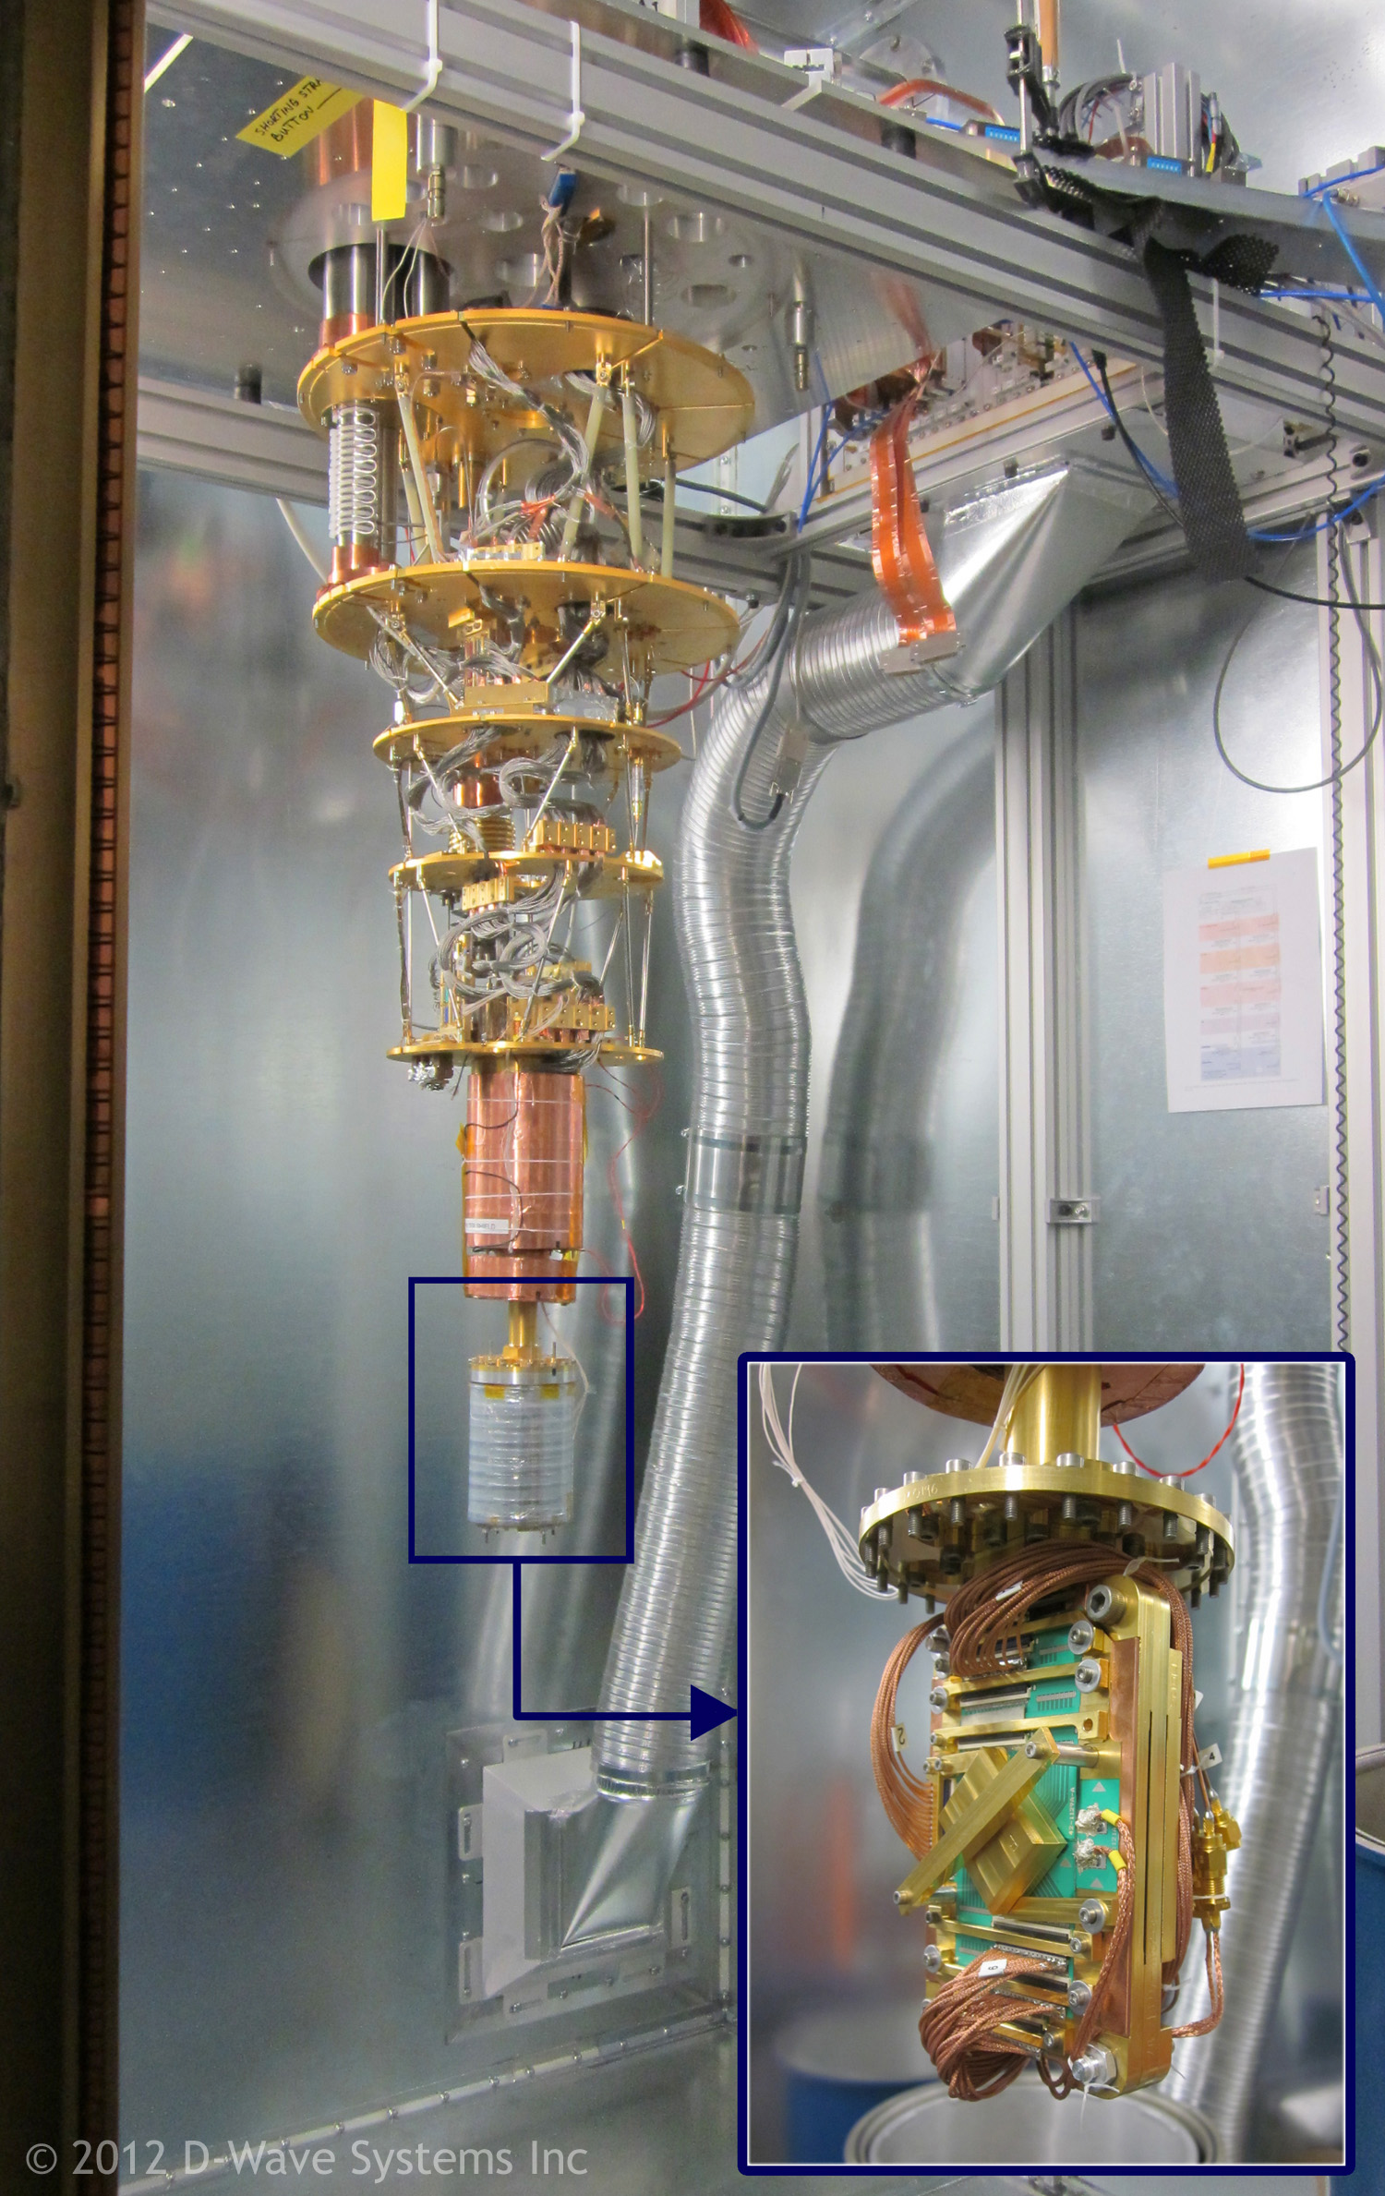
D-Wave Systems Quantum Computer
D-Wave Systems has built a 512-qubit quantum annealer
Uses chilled, superconducting niobium loops to store the qubits
Computation is controlled by a framework of switches formed from Josephson junctions
Processor is housed in a 10’x10’x10’ refrigerator kept below 20mK
The annealer is a co-processor attached to a conventional computer
http://www.dwavesys.com/d-wave-two-system

Slide 58
Programming the D-Wave System
The D-Wave System is designed to solve discrete optimization problems by finding many solutions to an instance of a corresponding Ising spin glass model problem
A number of programming interfaces to the annealer are provided including
  Quantum machine instructions
  A higher-level language (C, C++, Java, Fortran)
  A hybrid mathematical interpreter that maps algebraic expressions into quantum machine instructions

Slide 59
D-Wave System Programming Model
The input to the annealer is an optimization problem formulated as mimimizing an objective function of the form
where the q_{i}’s are qubits with weights a_{i} and the b_{ij}’s are the strengths of the coupling between qubit q_{i} and qubit q_{j}.
A sample is the collection of qubit values for the problem.
The answer is a distribution consisting of an equal weighting across all samples minimizing the objective function.

Slide 60
The Programming Task
Encode the possible solutions in the qubit values.
Translate the constraints into values for the weights and constraints so that when the objective function is minimized the qubits will satisfy the constraints.
Since the annealer is probabilistic, several solutions to the object function are returned.

Slide 61
Important Remaining Challenges
Substantial research challenges remain!
  More qubits
  Scalable, fault-tolerant architectures
  Software
  More algorithms

Slide 62
Takeaways
Quantum computing is exciting from many perspectives: research, engineering, business, potential impact on society
Realizing scalable quantum computing is going to require the collaboration of computer scientists, engineers, mathematicians, and physicists
Substantial research and technical breakthroughs are still needed
Don’t forget the importance of software!

Slide 63
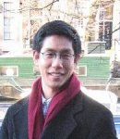
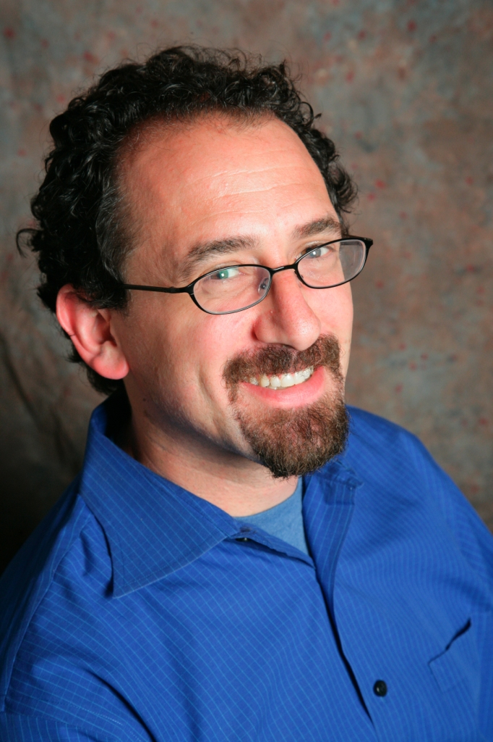


Collaborators
Isaac Chuang
MIT
Topological
Quantum
Computing
Steve Simon
Bell Labs, Oxford
Andrew Cross
MIT, IBM
Igor Markov
U. Michigan
Krysta Svore
Columbia, Microsoft Research

Slide 64
Programming Languages and Compilers for Quantum Computers
Al Aho
aho@cs.columbia.edu
Thanks for
Listening!
June 16, 2014

